Slide 2
Monday 24th January
L.O. – I can plan a fair test to investigate what impacts the speed of evaporation.
Success Criteria
I can explain the effect of temperature on the process of evaporation.
I can plan and carry out a comparative test using equipment accurately and display my results.

Slide 3
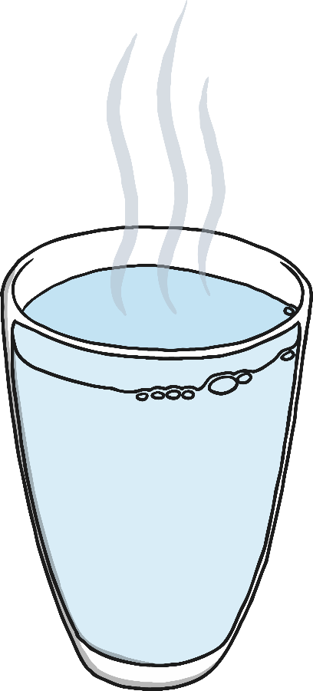
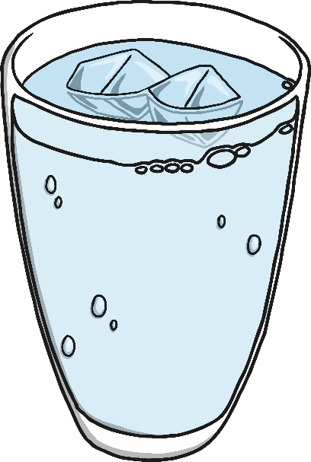
How Do Wet Clothes Dry?
Evaporation is the process of a liquid changing into a gas.
When clothes dry on the washing line, it is evaporation that causes the liquid on the wet clothes to turn into gas, leaving the clothes dry.
But how is the water evaporated from the wet clothes? I will show you some children's ideas about what makes this happen. Have a look at each statement, think about whether you agree or disagree with it, and write your ideas around it.

Slide 4
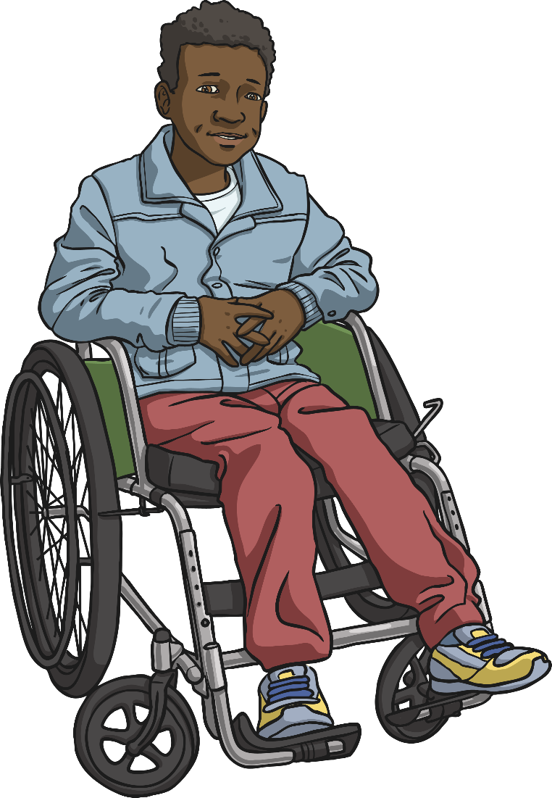
How Do Wet Clothes Dry?
This boy has the answer!
The particles in a liquid have energy and are moving around each other quite fast. Some of the particles move so quickly that they turn into a gas and move away from the liquid.
This happens quickly if the liquid is boiling, but when clothes are drying it is not that hot so I think it just happens slower. Eventually all the particles will have changed into a gas and the clothes will be dry!

Slide 5
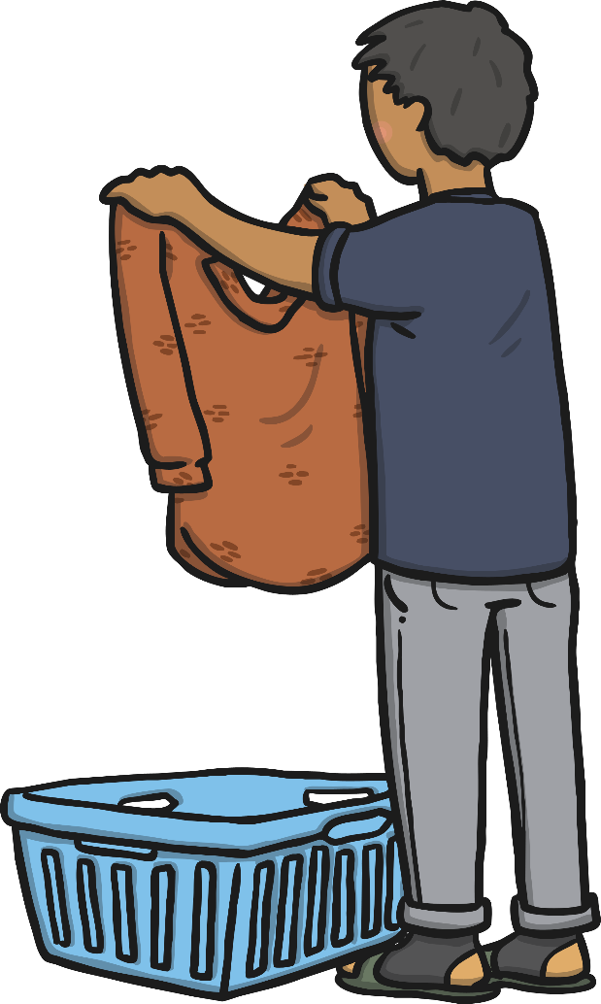
How Do Wet Clothes Dry?
When clothes are hung on a washing line to dry, they are exposed to heat. They are not boiling, but there is some heat.
The particles in the liquid water are moving around and over each other, and some particles move faster than others.
These particles move so fast that they change state, turning into water vapour. The particles of water vapour move away from the clothes, spreading out into the air. The particles don't turn into air!
Eventually, if the clothes are left on the washing line for long enough, all the particles of liquid water will change state into gaseous water vapour. The water will have evaporated and the clothes will be dry.

Slide 6
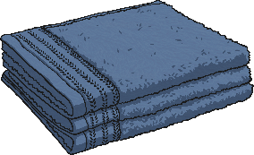
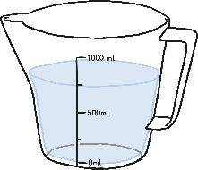
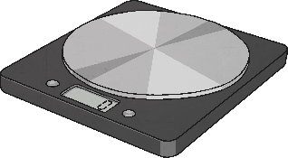
Does the Temperature Affect How Fast Towels Dry?
You are going to work in a group to plan and set up an investigation to find the answer to this question.
You will have access to the following equipment:
water
three tea towels
measuring jug
thermometer
a clock
scales

Slide 7
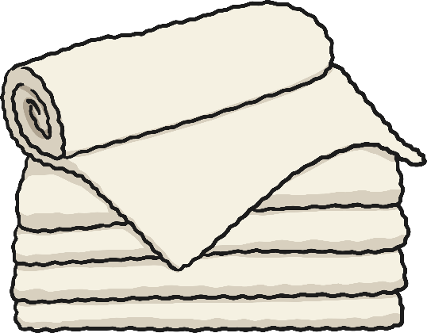
Does the Temperature Affect How Fast Towels Dry?
You will need to decide how to use the equipment to answer this question.
You will also make a prediction about what you think the answer will be.
You must think about how you will make sure each towel is equally wet at the start of the investigation. If one towel is completely wet through but another is just damp then you won't get reliable results!
You should also think carefully about how you will be able to tell how dry the tea towels are after they have been hung up on the washing lines for some time. Will you feel them, observe them, measure their temperature, find their weight, or something else?

Slide 8
Things we need to think about for our investigation.
How will we wet the towels and make sure they are all equally wet?
Where can we hang the towels where they will all be different temperatures?
When or how often shall we check the towels?
How will we know how dry they are? How can we measure this?
How can we make sure we get reliable results? What are we keeping the same and what is the one thing we are changing?
Once we have set up the experiment you need to write up what we have done. This is called the method. Then, write your prediction of what you think the results will be using as many scientific words as possible.]

Slide 9
Carry out your investigation and record your results in a table like the one below.

Slide 10
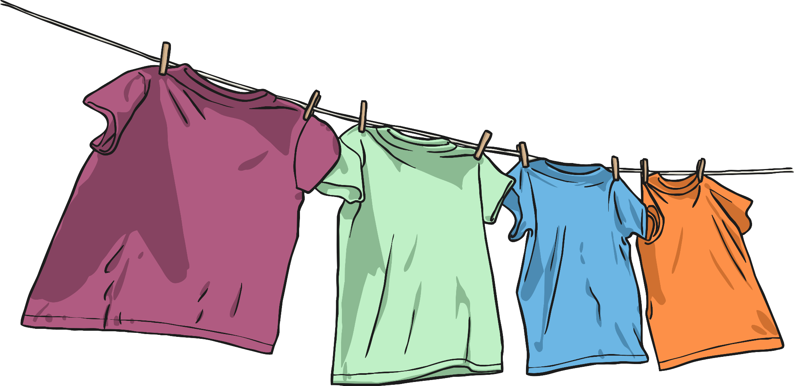
Sharing Ideas and Evaluating
Display your results using a table and write up the results underneath.
What have we found out?
Was is the same as what you predicted?

Slide 11
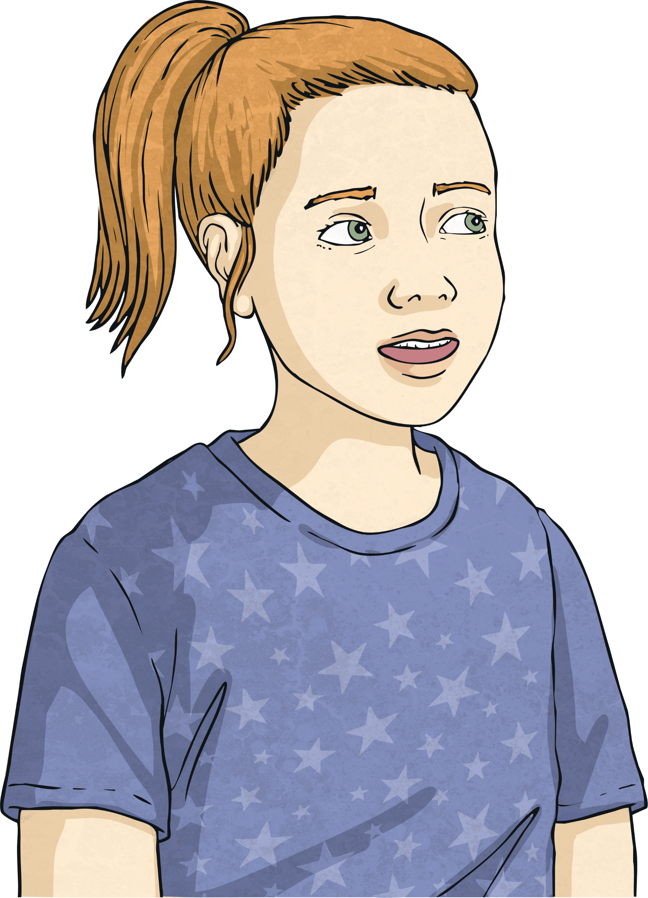
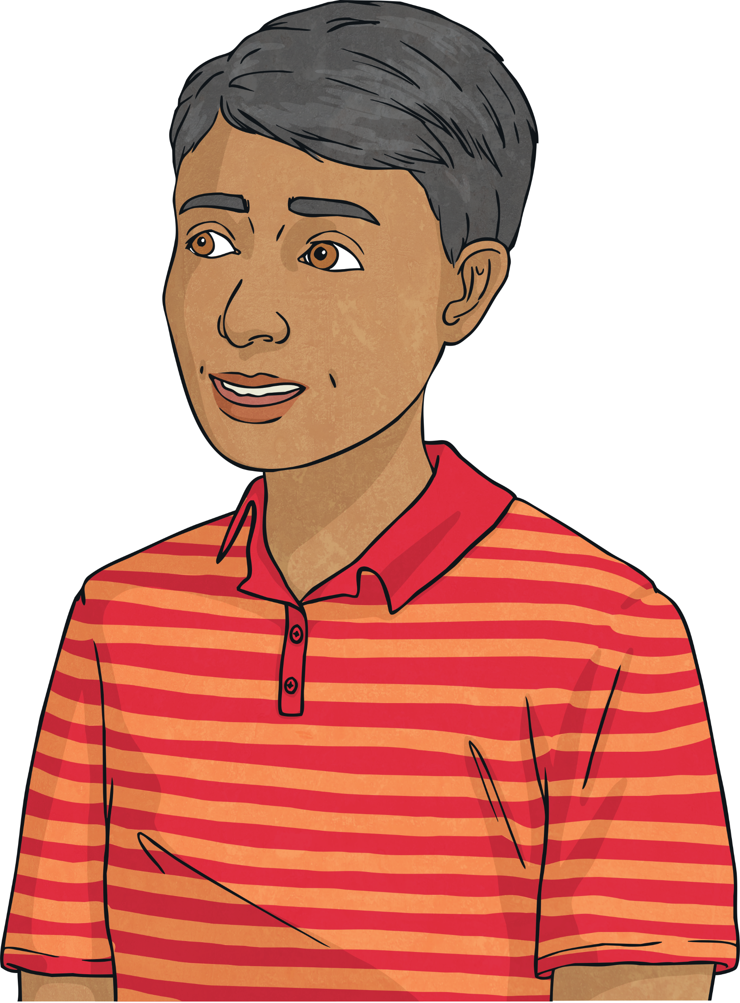
Sharing Ideas and Evaluating
How could we improve this investigation?
Are there any further questions you would like to investigate following on from this investigation?

