Slide 1
Tuesday 4th January 2022
LO: To write a finding tale (COLD WRITE)

Slide 2
What do you think a finding tale is?

Slide 3
Can you create some suspense in your finding tale?
What is suspense?

Slide 4
What might your characters find?
Let’s collect some ideas.

Slide 5
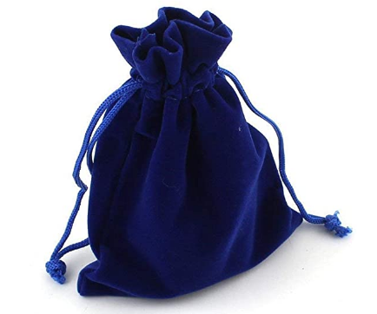
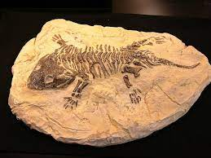
They might find…

