Slide 1
Monday 18th January
L.O. I can make equal groups.
Multiplication and division

Slide 4
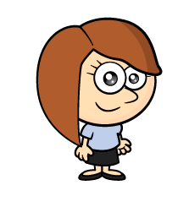
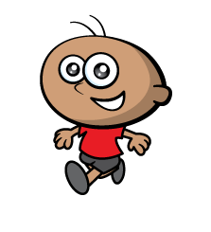
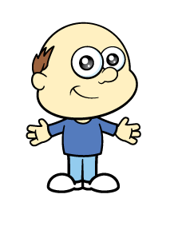
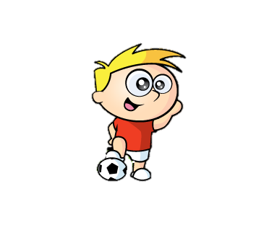
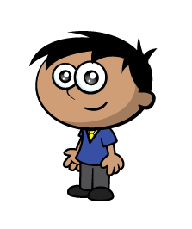
Blue Team Red Team
1)
2)
3)
4) 2 $+$ 2 $+$ 2 $+$ 2
5 $+$ 5

Slide 5
Blue Team Red Team
1)
2)
3)
4) 2 $+$ 2 $+$ 2 $+$ 2
5 $+$ 5
$$=$$

Slide 7
Have a think
There are equal groups of
3
5

Slide 8
Have a think
There are equal groups of
5
3

Slide 9
equal groups
3
3
3
3
unequal groups
Have a
think
4
4
5

Slide 10
Have a go at questions 1 and 2 on the worksheet

Slide 11
There are equal groups of
4
3
Have a
think
There are equal groups of
3
4

Slide 12
I have equal groups.

Slide 13
Have a think
There are equal groups of
2
4
There are equal groups of
4
2

Slide 14
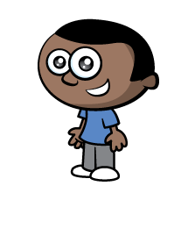
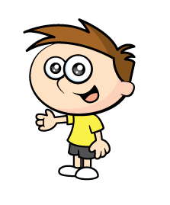
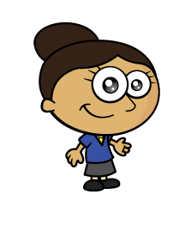
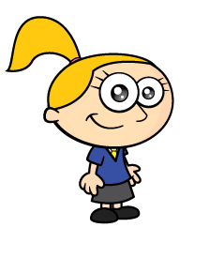
Can you describe how these children are grouped?
There are equal groups of
4
3
There are equal groups of
3
4
Have a think

Slide 15
Have a go at the rest of the questions on the worksheet

Slide 16
Challenge

