Slide 1
Thought for the Day – Background information for Adults.
Collective worship in schools aims to provide the opportunity for pupils to worship God, to consider spiritual and moral issues and to explore their own beliefs; to encourage participation and response, whether through active involvement in the presentation of worship or through listening to and joining in the worship offered; and to develop community spirit, promote a common ethos and shared values, and reinforce positive attitudes. Collective worship allows time for personal reflection and prayer.
Acts of collective worship may include exploring an idea or theme, hearing quotes from an individual or a story about someone’s life and their impact in the world, for example. It gives opportunities for pupils to reflect on a diverse range of world views, religious and otherwise. Collective acts of worship can contain some elements which relate specifically to the Christian religion, and, where appropriate, address the special status accorded to Jesus, but when such material is shared with non-Christian pupils it is shared in a spirit and in a manner which is educational in intent. In other words, pupils are informed that Christians believe that Jesus is the Son of God. Christians who attend the act of collective worship might be afforded an opportunity to worship him. However, whilst non-Christian pupils will not be required to worship Jesus, they shall be invited, to encourage the feeling of community, to reflect in silence on what they have heard.

Slide 2
Taken from a Save the Children Document

Slide 3
Monday
The Christian story of the First Christmas
Animation
https://www.bbc.co.uk/programmes/articles/1pYRg2f202rqWHrp3ywhTyX/religions-of-the-world

Slide 4
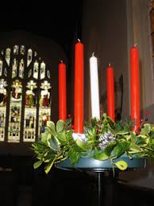
Tuesday
Advent
For Christians, advent is a time to wait and prepare for Christmas.
Candles are lit to remind Christians of :
Hope – (to trust and believe that something good will happen)
Love- (putting the needs of others first)
Joy- (a happiness that makes you feel secure and
strong as you focus on God)
Peace- (calmness, safety, no war or fighting)
Jesus – the light of the world
They read about the prophets who said that Jesus would be born.
They read the story of the first Christmas and imagine what it must have been like for the people who were there.
Over the next few days, we will learn about other objects that help us to think of something else.

Slide 5
Wednesday
Star
The star was a heavenly sign of promises long ago.
Christians believe that God promised a Saviour for the world,
and the star was the sign of the fulfilment of that promise.
The Wisemen followed the star to Bethlehem.
At that time some people believed that if something changed in
the night sky, it meant that something was going to happen, or had
happened on Earth.

Slide 6
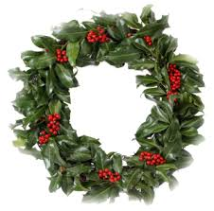
Thursday
Christmas Wreath
For Christians, the wreath symbolises the real nature
of love.
Real love never stops. It is like God’s love.
God’s love never ends. It has no beginning or end.
It doesn’t matter what you do, God will still love you.

Slide 7
Friday
Our School Prayer.
God bless our school.
Bless those who teach,
Bless those who learn,
Bless us with knowledge.
Amen.
What have you enjoyed at school?
What have you learned this week?
Have you helped someone else to learn?
Ask the children to listen to our school prayer.
Remind the children that
Amen means- “I agree”
The children might like to say “Amen” at the end.

