Slide 1
18.1.22
LO – I can divide a 2-digit number by a 1-digit number with remainders.

Slide 2
Let’s use the counting stick and practise our 11 x tables.
Let’s have a go at hit the button
https://www.topmarks.co.uk/maths-games/hit-the-button

Slide 3
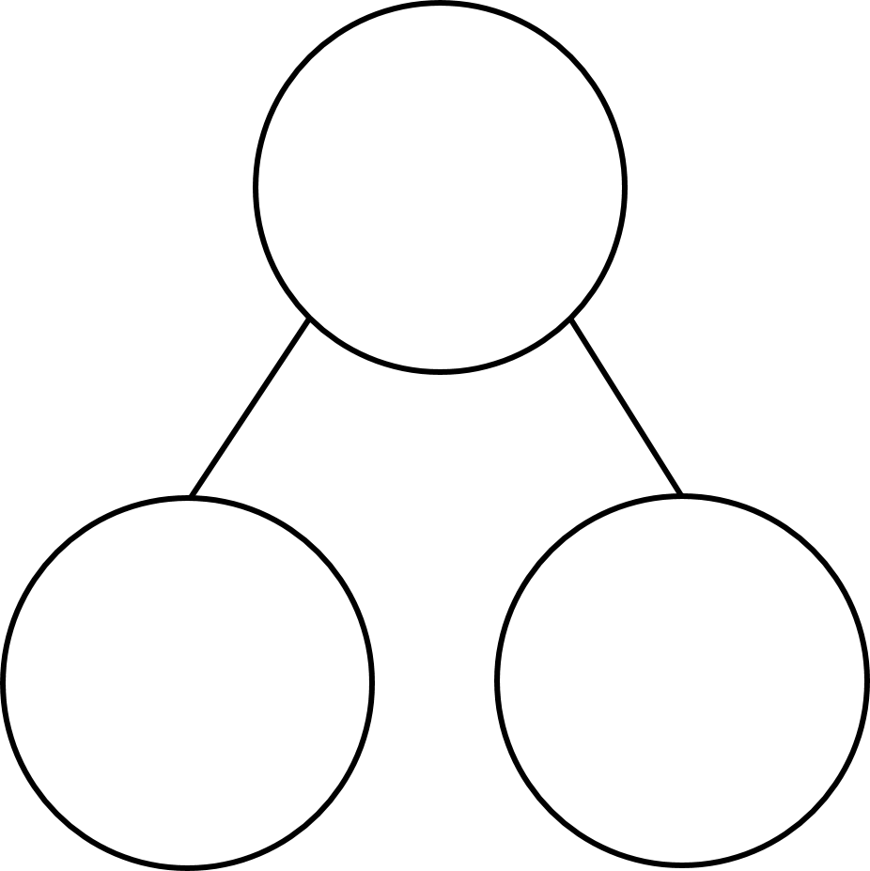
13 $÷$ 3 $=$
Complete the part whole models
5 $+$ 4 $=$ 10 $+$ 4 $=$
15 $+$ 4 $=$ 20 $+$ 4 $=$
25 $+$ 4 $=$ 30 $+$ 4 $=$
35 $+$ 4 $=$
73
73
3
60

Slide 4
13 $÷$ 3 $=$
Complete the part whole models
5 $+$ 4 $=$ 10 $+$ 4 $=$
15 $+$ 4 $=$ 20 $+$ 4 $=$
25 $+$ 4 $=$ 30 $+$ 4 $=$
35 $+$ 4 $=$
4 remainder 1
73
13
73
70
3
60
9
14
19
24
29
34
39

Slide 5
Think back to yesterday’s lesson when we looked at division with remainders. We are going to continue with this work today and make sure that we all understand what we are doing.

Slide 6
87 ÷ 4 =
21
remainder 3
87
Tens | Ones
80
7
$÷$ 4
$÷$ 4
20
1 r 3

Slide 7
73 ÷ 3 =
24
remainder 1
Have a think
73
Tens | Ones
60
13
$÷$ 3
$÷$ 3
20
4 r 1

Slide 8
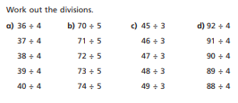
Have a go at questions 1 – 3 on the worksheet
Have a go at these divisions. Use your place value counters to help you.

Slide 9
Have a think
72 ÷ 3 $=$
73 ÷ 3 $=$ 24 r 1
74 ÷ 3 $=$
75 ÷ 3 $=$
76 ÷ 3 $=$
92 ÷ 4 $=$
93 ÷ 4 $=$
94 ÷ 4 $=$
95 ÷ 4 $=$
96 ÷ 4 $=$
97 ÷ 4 $=$
23
23 r 1
23 r 2
23 r 3
24
24 r 1
24
24 r 2
25
24 r 3
25 r 1
The remainder must be less than the divisor.

Slide 10
72 ÷ 3 $=$
73 ÷ 3 $=$ 24 r 1
74 ÷ 3 $=$
75 ÷ 3 $=$
76 ÷ 3 $=$
92 ÷ 4 $=$
93 ÷ 4 $=$
94 ÷ 4 $=$
95 ÷ 4 $=$
96 ÷ 4 $=$
97 ÷ 4 $=$
23
23 r 1
23 r 2
23 r 3
24
24 r 1
24
24 r 2
25
25 r 1
Have a think
The remainder must be less than the divisor.
If 75 $÷$ 5 $=$ 15, what will 78 $÷$ 5 be?
15 r 3
If 92 $÷$ 7 $=$ 13 r 1, what will 99 $÷$ 7 be?
14 r 1

Slide 11
79 $÷$ $=$ 19 remainder 3
4
Have a think

Slide 12
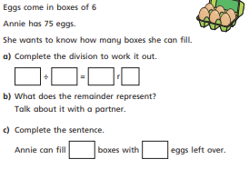
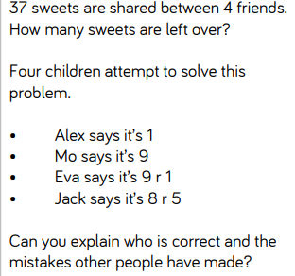
Now answer questions 2 and 3 from your worksheet.

Slide 13
I’m thinking of a number less than 40
It is divisible by 2
When it is divided by 3 there is 1 remainder.
When it is divided by 5 there is a remainder of 4
What is my number?
5
$+$ 4
$=$ 9
10
$+$ 4
$=$ 14
r 2
34
19
24
r 0
29
34
r 1
39

Slide 14
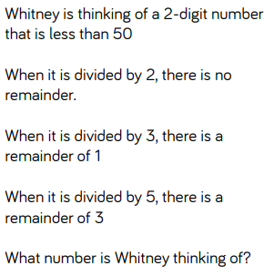
Answer this problem in the same way that we answered the previous question on this PowerPoint.
If you complete this, there is one more challenge question.

