Slide 1
Tuesday 1st February L.O. – I can write creatively about an image.

Slide 2
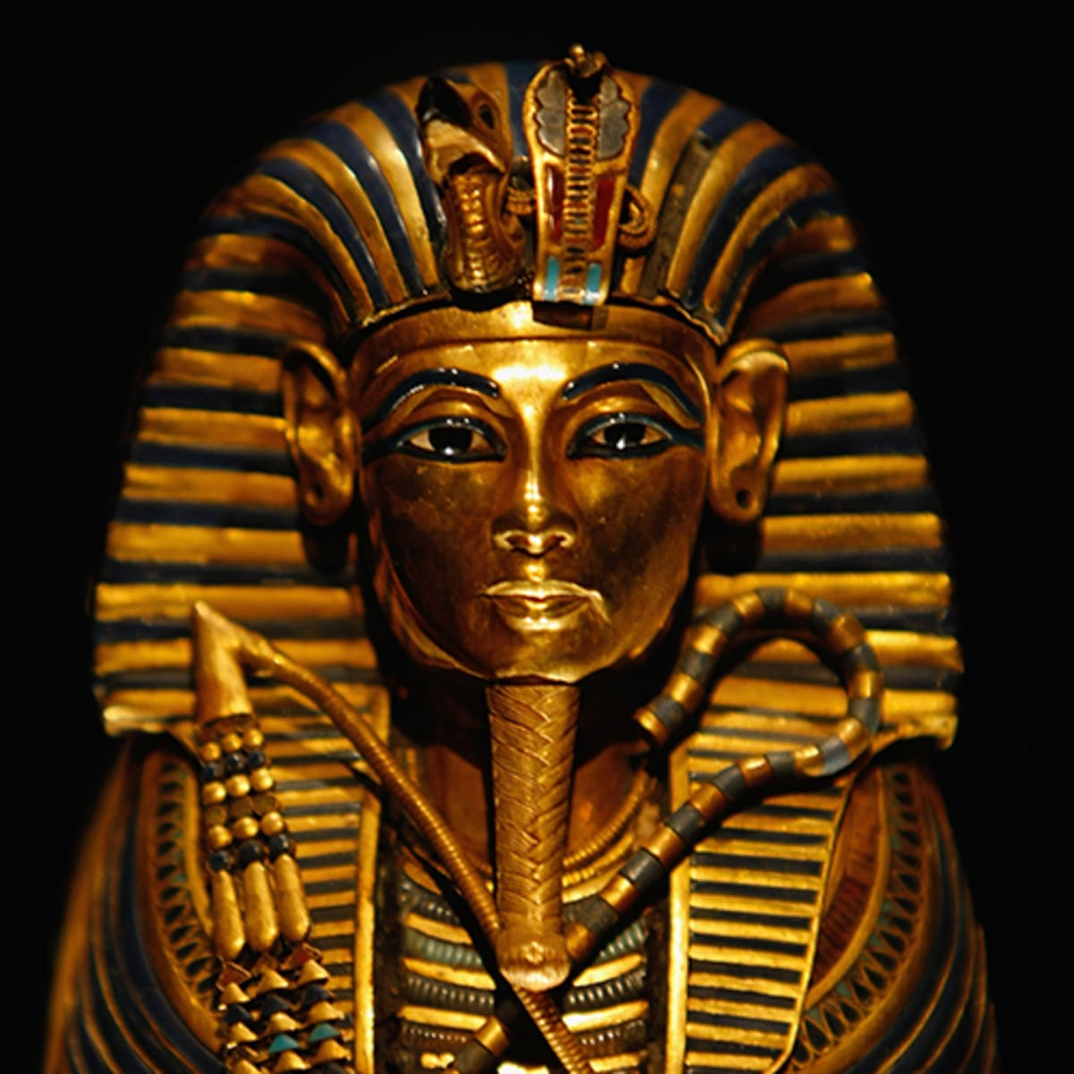
Create a thought shower in your books about this image. Who do you think it is? Where might this be? What else might be in the room? Think about your senses- what can you feel, hear, smell?

Slide 4
golden like the sun
hear metal clanging
pharaoh
intricate details
evil eyes watching over

Slide 5
Evil eyes guard the room, full of treasure.
The glistening golden face shines like the sun.

Slide 6
Now, using the ideas from your thought shower, and our class one, write your own short burst about this image. Focus on 5 key things from the image and try to make every word count.

