Slide 1
PSHE
This half term, our PSHE topic is
Changing Me

Slide 2
LO: To know lots of changes happen in humans and animals as a baby grows into an adult.
LO: To express how I feel when I see babies or baby animals.

Slide 3
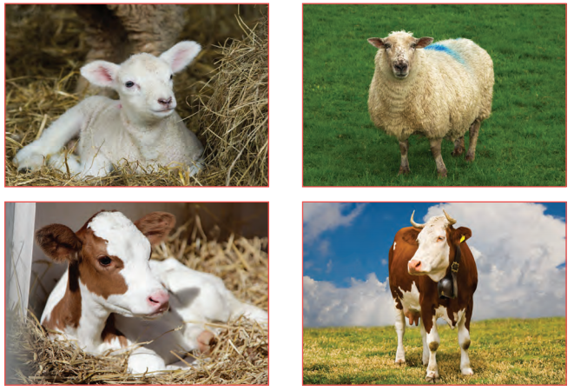
Pairs Game: Name one thing that changes from baby to adult.

Slide 4
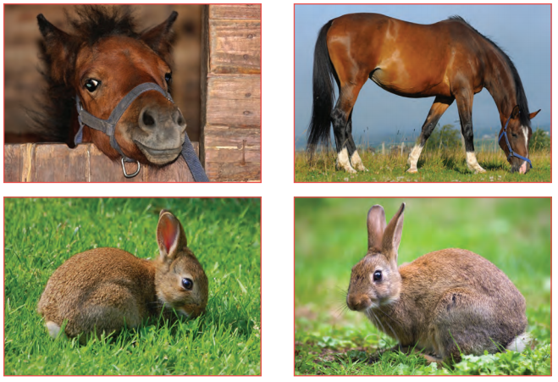

Slide 5
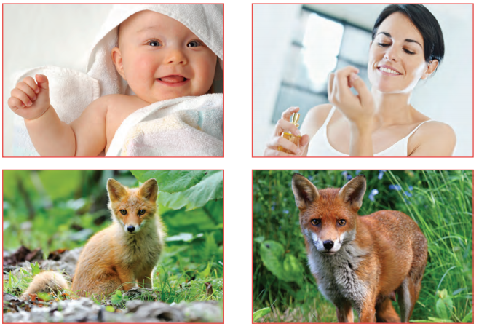

Slide 6
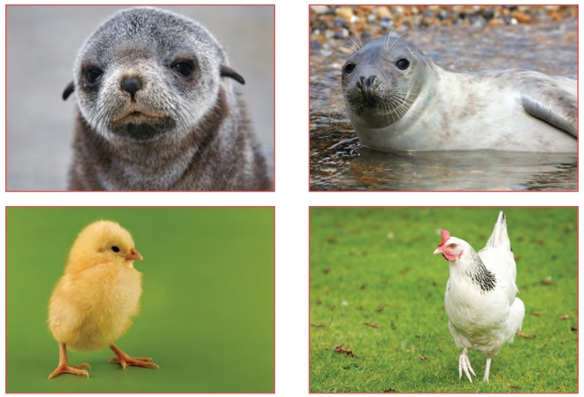

Slide 7
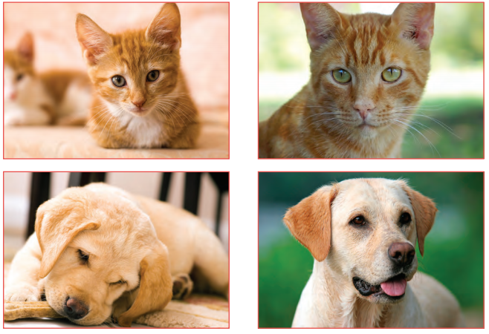

Slide 8
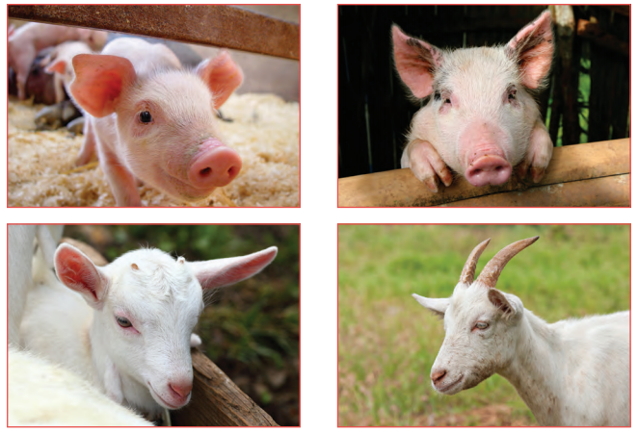

Slide 9
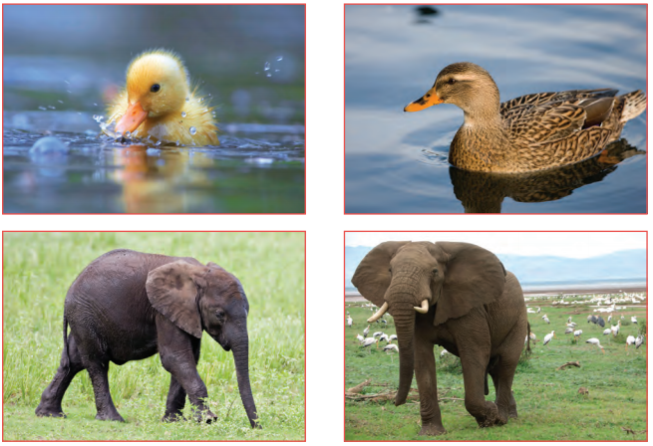

Slide 10
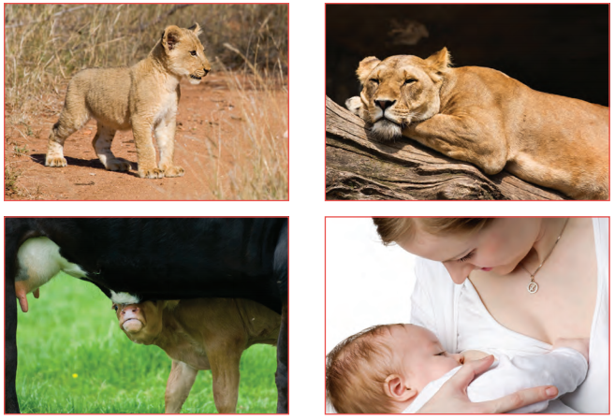

Slide 11
Calm Me:
Year 3 children. Come with me as we go into our Calm Me time. In this Puzzle we are learning about all sorts of changes that happen to us and our bodies. Being able to calm down and watch our thoughts and feelings is an important part of being able to handle changes when they happen.

Slide 12
Calm Me:
So let’s start our Calm Me time by sitting in our Calm Me way, nice and straight in the chair, feet flat on the floor and spine all straight and proud. Shoulders are relaxed and eyes are gently closed. Now listen to our chime until you can no longer hear any sound…….

Slide 13
Calm Me:
In this quietness bring your attention to focus on your breathing. Breathe in through your nose with nice long, gentle breaths and feel your tummy expand as the air fills your lungs. Hold your breath for just a couple of seconds and then gently and slowly release the air back out again. Breathing like this we feel calm and gentle….

Slide 14
Calm Me:
Breathing in and silently counting 1,2,3……..breathing out silently hearing the words “Look at the changing me”. Repeat several times feeling grateful that your body is growing and changing just as it is meant to and you are learning all the time.

Slide 15
Calm Me:
As you breathe out let any tension or worries fizzle down through your body and out through your feet…. fizzle away your worries and tension……It is good to be you right now.

Slide 16
Calm Me:
Then as you listen to the chime fade away, bring your body and mind back into the classroom in this present moment, nice and peaceful, ready to learn.

Slide 17
Calm Me:
Then as you listen to the chime fade away, bring your body and mind back into the classroom in this present moment, nice and peaceful, ready to learn.

Slide 18
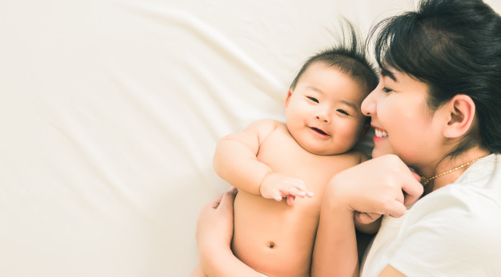
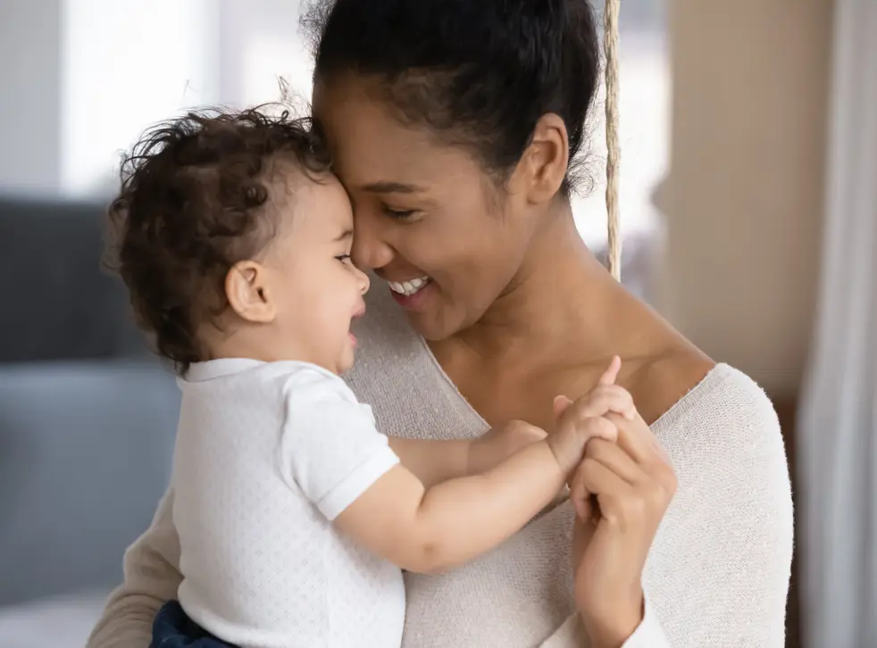
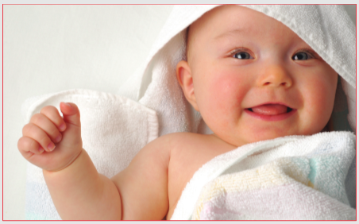
Open my mind
What do you think or feel when you see these pictures?

Slide 19
Open my mind
It is usually the female who has the baby and looks after it whilst it is very young, but often the males (dads) have an important role to play too, e.g. for humans, penguins.

Slide 20
Tell me or show me
Have any of you ever had a new baby brother or sister? How did it feel?
How did the baby need to be looked after?

Slide 21
Your task
Choose 3 (1 x human and 2 x animals) and draw them as a baby and as an adult. Write about the changes that occur from baby to adult for each one.

Slide 22
Thursday 10th June 2021
LO: To know lots of changes happen as a baby grows into an adult.

Slide 23
Challenge
Can you think of two ways that you are more independent now than you were as a baby?

