Slide 1
Monday 29th November 2021
LO: To use our imagination and consider what might be in the box.
LO: To write a short article for the website.

Slide 2
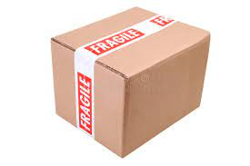
Early this morning, we had a special delivery to school.
The tape said ‘fragile’.

Slide 3
On the back of the box there were some small holes.

Slide 4
What do you think might be in the box?

Slide 5
On the outside of the box there was an envelope. It came from
Europaisches Drachenmuseum
Museumsstraße
Hesse
Deutschland
What does this mean? It is not in English?
Thankfully, we have Mrs Richter in school who is German. She told us that it means...

Slide 6
European Dragon Museum
Museum Street
Hesse
Germany

Slide 7
Then we noticed something else written on the envelope. It said
credimus in dracones
We asked Mrs Richter to help us again, but she said this wasn’t German. How can we find out what it says?

Slide 8
So we put
credimus in dracones
into Google translate.
This is what we got…

Slide 10
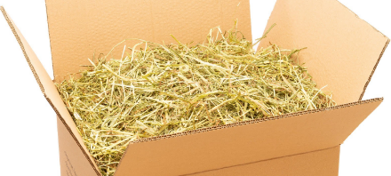
When we opened the box we found some hay.
What could it be?

Slide 11
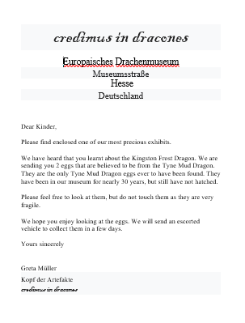
Next, we opened the letter and read it.
We have sent you a copy of this letter which you can read now.

Slide 12
We moved the hay in the box very carefully and found an egg shaped object.
How exciting!

Slide 13
Can you write a short article for our school website to say what has happened today?

