Slide 1
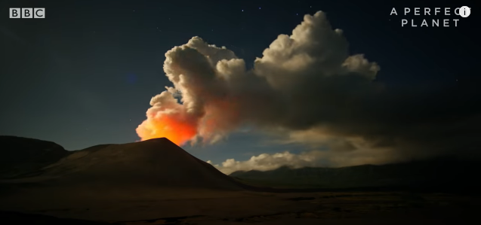
Earth's Hidden Volcanos | A Perfect Planet | BBC Earth https://www.youtube.com/watch?v=ibC5LT3CSyI

Slide 2
Vocabulary Check
architects - a person who designs buildings and directs their construction.
fertile - producing or able to produce farm crops or other plant life.
abundant - large in amount or number.

Slide 3
Quick Start
How many active volcanoes are there world wide?
How many stories tall can they chimneys be?
Can you name any of the animals that live around the main vents?
How much can giant tube worms grow in one year?
What is so special about the underwater vents?

Slide 4
Partnered Talk
‘Volcanoes. The architects of our planet.’
What do you think the narrator means by this? Can you give any evidence from the video?

Slide 5
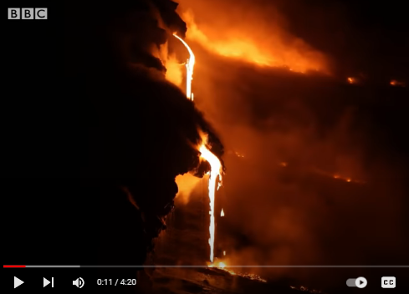
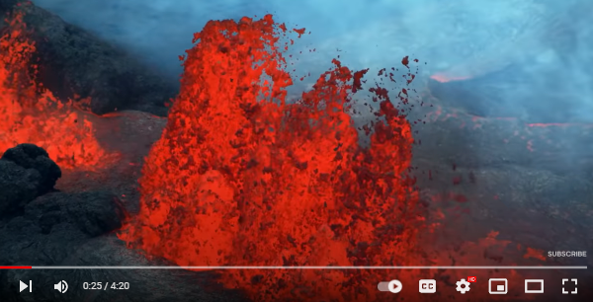
Individual Thinking
Look at some of the images from the video. Can you think of a sentence to describe the eruptions with some challenging vocabulary.

Slide 6
Solo Work
Can you summarise why volcanoes are so important to our planet?
Try to do this in 2 sentences.

