Slide 1
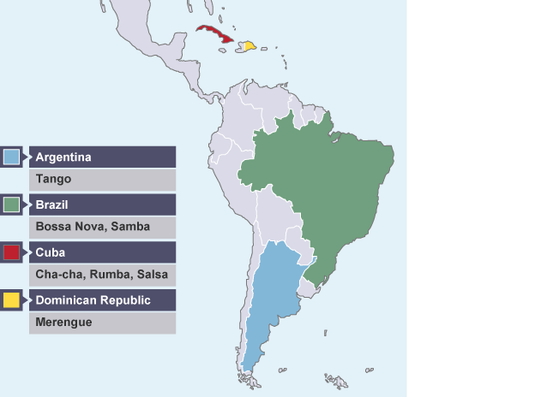
Whole School Genre of the Week Types of Dances: Latin Music: Tango, Salsa and Rumba
Tango
I Can Tango – Children’s song
https://www.youtube.com/watch?v=Vhfx2D7Q0qI
Tango on Strictly Come Dancing
https://www.youtube.com/watch?v=SnIu3DQahWI
https://www.youtube.com/watch?v=lvS0NfIlkFU
Argentina:Tango Libertango by Piazzolla
https://www.youtube.com/watch?v=kdhTodxH7Gw
Instrumental Tango Music
Background information.
https://www.bbc.co.uk/bitesize/guides/zg4hb82/revision/5
Salsa
How to Salsa – the basic steps
https://www.youtube.com/watch?v=F758q-jifJI
Salsa on Strictly Come Dancing
https://www.youtube.com/watch?v=XGIWHAwuT5Y
Instrumental Salsa music
https://www.youtube.com/watch?v=1LOsAVuNPf8
Rumba
Children’s activity in the style of Rumba
https://www.youtube.com/watch?v=7R64sBEi-7I
Instrumental Rumba music
https://www.youtube.com/watch?v=h7os4KpEwno

Slide 2
Whole School Song of the Week
Local Songs and Songs from around the World
La Bamba – Mexican Folk Song | Resources Folder– Hymns and Songs-Songs from musicals, shows pop.
Performance:
https://www.youtube.com/watch?v=jSKJQ18ZoIA
Lyrics:
https://www.youtube.com/watch?v=AZ_GFkvfBHc

Slide 3
Reception Music:- Linked with Little Red Riding Hood linked text.
https://www.bbc.co.uk/programmes/articles/3Qq9cBQHpg6FJqTRsnqbGB6/primary-music-ks1-little-red-riding-hood-info
There are lots of things musical activities on this website that you could do!
Perhaps you could try the Warm-up:- Vocal Warm-up
https://www.bbc.co.uk/teach/school-radio/music-ks1-little-red-riding-hood-vocal-warm-up/zhxg382
Perhaps you could learn the song about your favourite part of the story?
There are seven to choose from.

