Slide 4
1) Without calculating, in what column will the exchange happen?
8,322 + 1,294
2) Ten 1,000s equals _____ ten thousand.
3) _____ + 4,135 = 6,352

Slide 5
1) Without calculating, in what column will the exchange happen?
8,322 + 1,294
Tens column
1
2) Ten 1,000s equals _____ ten thousand.
2,217
3) _____ + 4,135 = 6,352

Slide 7
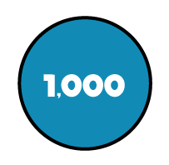
 | Th | H | T | O
TTh
Th | H | T | O
7 | 7 | 7 | 5
4 | 4 | 2 | 0
TTh
1
2
1
9
5
1
1
1
2
1
9
5
12,195

Slide 8
Have a think
TTh | Th | H | T | O
 | 7 | 2 | 4 | 0
 | 2 | 8 | 1 | 9
TTh | Th | H | T | O
2 | 2 | 0 | 5 | 6
+
+
3
1
7
1
0
0
5
9
2
2
3
7
3
1
1
1

Slide 9
Have a go at questions 1 and 2 Write the sum and answers into your books.

Slide 10
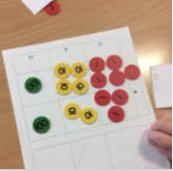
6,412 + = 9,975
3,563
Th | H | T | O
6 | 4 | 1 | 2
9 | 9 | 7 | 5
 | Th | H | T | O
+
3
3
5
6
9
9
7
5

Slide 11
582 cm + 63,070 cm + 76 m =
582 cm + 63,070 cm + 7,600 cm =
71,252 cm
TTh | Th | H | T | O
6 | 3 | 0 | 7 | 0
 | 7 | 6 | 0 | 0
 |  | 5 | 8 | 2
+
7
1
2
5
2
1
1
1
Notes:
Bar model and calculation- show conversion. Largest number on top to smallest number.

Slide 12
TTh | Th | H | T | O
3 | 7 | 8 |  | 1
6 | 1 | 0 | 1 | 5
 | 9 | 1 | 1 | 4
TTh | Th | H | T | O
2 | 7 | 8 |  | 7
6 | 2 | 7 | 1 | 5
 |  | 6 | 2 | 2
1
0
9
0
\
+
2
3
+
5
8
9
9
0
1
1
1
hundreds + 7 hundreds = 6 hundreds
7 + = 2
hundreds + 7 hundreds = 16 hundreds
7 + = 12
9
5

Slide 13
Have a go at the rest of the questions Write the answers in your book Stick questions 6 an 8 in your book

