Slide 1
9.11.21
L.O. – I can subtract two 4 digit numbers with one exchange.

Slide 2
1) 7,058 $−$ 3,042 $=$
2) 1,635 $−$ 601 $=$
3) 1 thousand = ______ hundreds

Slide 3
1) 7,058 $−$ 3,042 $=$
4,016
2) 1,635 $−$ 601 $=$
1,034
10
3) 1 thousand = ______ hundreds

Slide 4
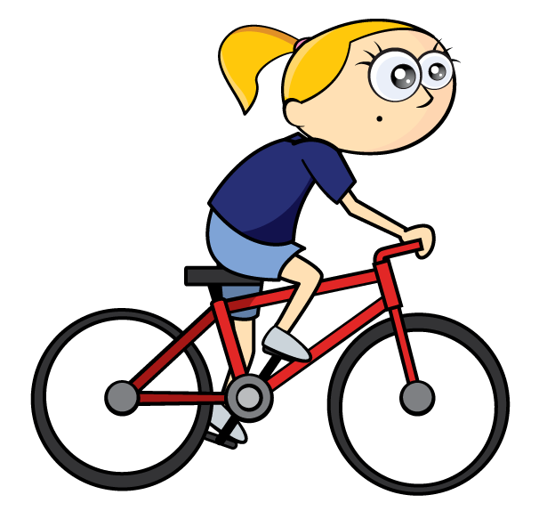
A cyclist rides 4,154 km in May.
In June she cycles 1,522 km.
How many more km does she cycle during May?
2,632 km
Th | H | T | O
Th | H | T | O
4 | 1 | 5 | 4
1 | 5 | 2 | 2
3
1
May
4,154
$$−$$
?
June
1,522
2
6
3
2
1 hundred $−$ 5 hundreds $=$
11 hundreds $−$ 5 hundreds $=$
1 thousand = 10 hundreds

Slide 5
8,229 $−$ 6,145 =
2,084
Th | H | T | O
Th | H | T | O
8 | 2 | 2 | 9
6 | 1 | 4 | 5
1
1
2
0
8
4

Slide 6
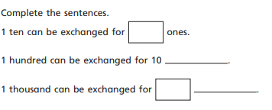
Write these sentences out in your books.
Can you think of any other number sentences we could write about exchanges?

Slide 7
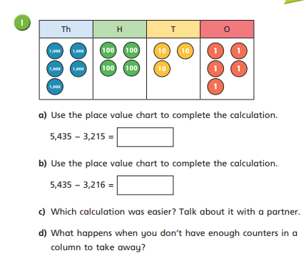
Stick this problem in your book and have a go.

Slide 8
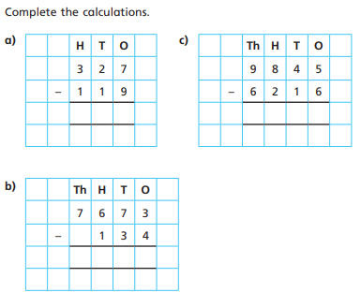
Now, stick this problem in your book and work through each question.
We will do the first one together.

Slide 9
2,534 $−$ 1,702 =
832
Th | H | T | O
2 | 5 | 3 | 4
1 | 7 | 0 | 2
1 | 2 | 3 | 2
Th | H | T | O
2 | 5 | 3 | 4
1 | 7 | 0 | 2
 |  | 3 | 2
Have a think
1
1
$$−$$
$$−$$
I think there is a mistake!
0
8
15 hundreds $–$ 7 hundreds
5 hundreds – 7 hundreds
7 hundreds – 5 hundreds

Slide 10
Have a think
The answer to 1,364 $−$ 630 will have 1 thousand because in 630 there are no thousands to subtract.
Dexter is incorrect because we exchange one thousand for ten hundreds. There are no thousands in the answer.
Explain why Dexter is not correct.
Th | H | T | O
1 | 3 | 6 | 4
 | 6 | 3 | 0
 |  | 3 | 4
0
1
$$−$$
7

Slide 11
During a day, Ron scores a total of 3,527 points. He scores 1,447 points in the morning.
How many points does he score in the afternoon?
2,080 points
3,527 Total points
Th | H | T | O
3 | 5 | 2 | 7
1 | 4 | 4 | 7
4
1
$$−$$
1,447
?
2,080
2
0
8
0
Morning
Afternoon

Slide 12
Now, answer the rest of the questions on your worksheet.
There is a challenge question if you need it.

Slide 13
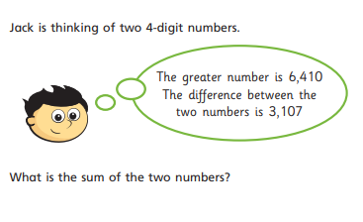
Let’s look at this plenary question together.

