Slide 1
Shang Dynasty
LO: To find out about the Shang Dynasty of China and explore how we know about it

Slide 2
LO: To find out about the Shang Dynasty of China and explore how we know about it
Look at your atlas and locate China.
Which continent is China in?
What do you already know about it?

Slide 3
This year in some of our history lessons, we will be exploring the Shang Dynasty of ancient China. What is a Dynasty?

Slide 6
The Shang Dynasty 1600 – 1046 BC

Slide 10
In our history lessons so far, we have already learnt quite a lot about the first World War; what evidence did we use to find out our information?
Discuss with your partner and list all the different ways in which we can find out about WWI.

Slide 11
Did you think of these?
Written records – from people who lived through the war (politicians, commanders, soldiers, historians, ordinary people)
Poetry written by soldiers
Photographs taken of real events
Video/audio recordings of people who were there at the time
Battle sites and museums
As we now know, the Shang Dynasty happened during the bronze age – much, much earlier in time than WWI, over 3000 years ago.

Slide 15
What are oracle bones?

Slide 17
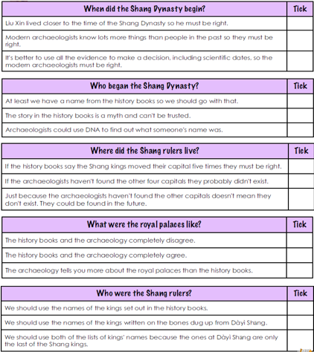
LO: To find out about the Shang Dynasty and explore how we know about it. History books about the Shang Dynasty were not written until long after the Shang Dynasty had ended. It wasn’t until much later still that archaeologists discovered evidence of the Shang Dynasty. The evidence they found didn’t always support the writings in the history books. Work with your partner. Read the information sheet then use what you have found out to decide which of these statements is true.

