Slide 1
5.11.21
LO. I can subtract a 3-digit number from a 3-digit number with 1 exchange.

Slide 2
Recap Place Value.
Place these numbers along the number line
475, 490, 425, 401, 450
500
Draw the number line on your whiteboard.

Slide 3
Recap Place Value.
Place these numbers along the number line
475, 490, 425, 401, 450
400 425 450 475 500
401 490

Slide 4

1) Complete the part-whole models.
2) 375 $=$ 200 $+$ _____ $+$ 5
3) Find the difference between 184 and 72
562
562
500
2
500
12

Slide 5
1) Complete the part-whole models.
2) 375 $=$ 200 $+$ _____ $+$ 5
3) Find the difference between 184 and 72
562
562
500
2
500
12
60
50
170
112

Slide 6

Use your whiteboard and place value charts to help you work out this problem over the next three slides.
Tommy has £451
He spends £325 on a holiday.
How much money does he have left?
H | T | O
4 | 5 | 1
3 | 2 | 5
$$−$$
1 – 5 =

Slide 7







Hundreds | Tens | Ones
451
£126 left
H | T | O
4 | 5 | 1
3 | 2 | 5
4
1
451
400
1
$$−$$
50
$−$300
$−$5
$−$20
1
2
6
400
40
11
$−$300
$−$5
$−$20

Slide 8




Hundreds | Tens | Ones
H | T | O
4 | 0 | 1
2 | 3 | 9
401
9
3
1
1
$$−$$
300
11
90
1
6
2
Notes:
Can we simplify?
Discuss reduction structure – take away

Slide 9
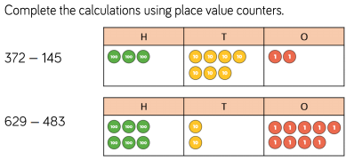
TTYP and use your whiteboards and place value charts to help you work out these problems.
Let’s share our working with the class so we can address any misconceptions.
Continue onto the next slide.

Slide 10
We start with the ones column. Can we subtract 5 from 2?
No, so we have to exchange 1 ten for 10 ones.
Hundreds | Tens | Ones
3 hundreds – 1 hundred =2 hundreds
6 tens – 4 tens =2 tens
12 ones – 5 ones = 7 ones

Slide 11
Where is our exchange going to take place in this question?
We cannot take 8 tens from 2 tens so we need to exchange 1 hundred for 10 tens.
Hundreds | Tens | Ones
5 hundreds – 4 hundred = 1 hundreds
12 tens – 8 tens = 4 tens
9 ones – 3 ones = 6 ones

Slide 12
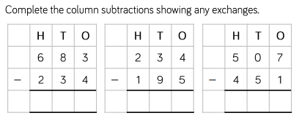
Stick these problems in your book.
Write out each question.
Show your working.
Use your place value chart to help you if you need to.

Slide 13


Plenary. Using different methods.
H | T | O
4 |  | 7
 | 3 | 4
2 | 9
? $−$ 3 tens = 9 tens
3
1
?
2
12 tens
$$−$$
1
9 tens
3 tens
3
Hundreds | Tens | Ones

Slide 14


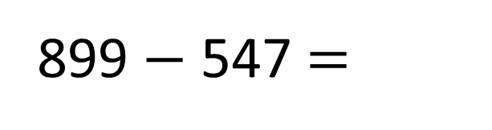
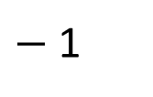
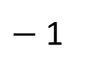
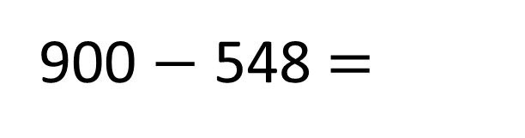
547
548
899
900
$−$ 1
$−$ 1
What is the difference between the two numbers?
900 $−$ 548 =
899 $−$ 547 =
352
H | T | O
9 | 0 | 0
5 | 4 | 8
H | T | O
8 | 9 | 9
5 | 4 | 7
9
8
1
1
$$−$$
$$−$$
3
5
2
3
5
2
3

Slide 15

287
194 + ____ = 481
481
H | T | O
4 | 8 | 1
1 | 9 | 4
3
1
7
1
$$−$$
287
2
8
7
194
?

