Slide 1

11.1.22
LO – I can use formal methods of multiplication to multiply 2-digit by 1-digit numbers.

Slide 2
Let’s warm up together now. Answer the following questions on your whiteboards.

Slide 3
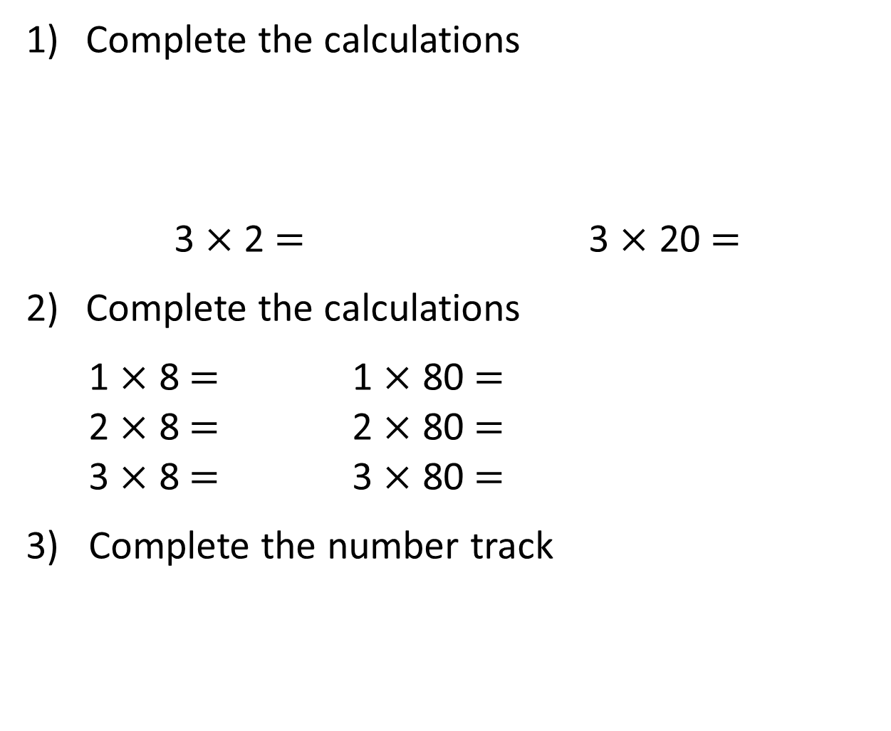
Complete the calculations
3 $×$ 2 $=$ 3 $×$ 20 $=$
Complete the calculations
1 $×$ 8 $=$ 1 $×$ 80 $=$
2 $×$ 8 $=$ 2 $×$ 80 $=$
3 $×$ 8 $=$ 3 $×$ 80 $=$
3) Complete the number track
20 | 40 | 60 |  | 100 |  | 140 | 160

Slide 4
Complete the calculations
3 $×$ 2 $=$ 3 $×$ 20 $=$
Complete the calculations
1 $×$ 8 $=$ 1 $×$ 80 $=$
2 $×$ 8 $=$ 2 $×$ 80 $=$
3 $×$ 8 $=$ 3 $×$ 80 $=$
3) Complete the number track
6
60
8
80
16
160
24
240
20 | 40 | 60 |  | 100 |  | 140 | 160
80
120
180
200

Slide 5
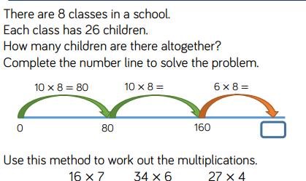

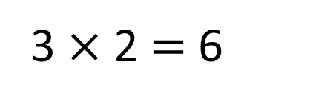
As a class let’s look at the top example and
work out the answer together. Now use the
same method to answer the 3 examples.
Child 1
Child 2
Child 3
3 $×$ 2 $=$ 6
There are 6 pears in total.

Slide 6
3 $×$ 25
$=$ 75
T | O
3 $×$ 5 $=$ 15
3 $×$ 20 $=$ 60
15 $+$ 60 $=$ 75

Slide 7

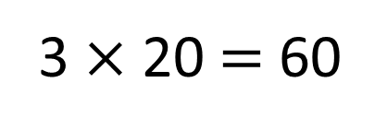
Answer 15 x 3 =
and 24 x 5 on your whiteboards.
Think about the efficient multiplication lesson on Friday and yesterday’s lesson too.
.
Each class has 20 pears.
How many pears are there in total?
Class 1
Class 2
Class 3
3 $×$ 20 $=$ 60
There are 60 pears in total.

Slide 8



4 $×$ 24
$=$ 96
T | O
T O
2
4
$×$
4
1 6
(4 $×$ 4)
8 0
(4 $×$ 20)
9 6
Have a think

Slide 9
Now let’s look at a formal method of multiplication. This should make it even easier as you can use your multiplication knowledge without having to add.
.
Each class has 20 pears.
How many pears are there in total?
Class 1
Class 2
Class 3
3 $×$ 20 $=$ 60
There are 60 pears in total.

Slide 10
4 $×$ 24
$=$ 96
T O
T | O
T O
2
4
2
4
4 $×$ 4 $=$ 16
4
$×$
4
$×$
4 $×$ 20 $=$ 80
9
6
1 6
(4 $×$ 4)
8 0
1
(4 $×$ 20)
16 $+$ 80 $=$ 96
9 6

Slide 11
3 $×$ 16
$=$ 48
Have a think
T | O
T O
1
6
$×$
3
4
8
1

Slide 12

3 $×$ 71
$=$ 213
Have a think
T | O
T O
7
1
$×$
3
2
1
3
2

Slide 13
Work with your partner using a place value card or your whiteboard and place value counters to work out the following questions.
1.43 x3 =
2.36 x 4 =
3.74 x 5 =
.
Each class has 20 pears.
How many pears are there in total?
Class 1
Class 2
Class 3
3 $×$ 20 $=$ 60
There are 60 pears in total.

Slide 14
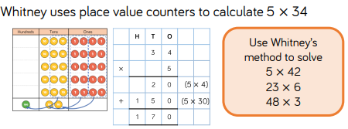
Let’s look at Whitney’s method. Can you solve the questions using this method?
.
Each class has 20 pears.
How many pears are there in total?
Class 1
Class 2
Class 3
3 $×$ 20 $=$ 60
There are 60 pears in total.

Slide 15
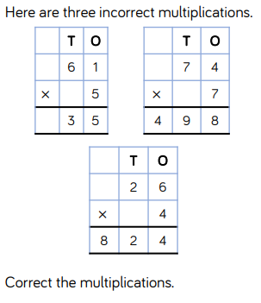
Have a go at the challenge sheet if you can. Keep thinking of the formal method to help you. Use your place value counters, if it helps.
.
Each class has 20 pears.
How many pears are there in total?
Class 1
Class 2
Class 3
3 $×$ 20 $=$ 60
There are 60 pears in total.

