Slide 1
This week our English is all about Oracy.
Who can remember what Oracy is?
Talk to your partner.

Slide 2
That’s right, it means:
Being able to speak clearly so that others can understand you
Being able to understand what others say to you
So that you can communicate ☺

Slide 3
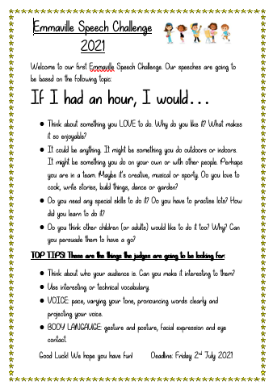
Our Oracy this week is going to focus on Presentational Talk. We are all going to be taking part in the
Emmaville Speech Challenge 2021
You have probably seen the poster in your classroom.

Slide 4
Over the course of the week, you are going to prepare and practice a speech.
There will be a winner from each class and overall school winners 1st, 2nd and 3rd.

Slide 5
First of all we have to plan and then practise, practise, practise.

Slide 6
Monday 28th June 2021
LO: To plan a speech.
In today’s lesson, we are going to plan our speech.

Slide 7
The theme of the competition is:
If I had an hour, I would…
If you had an hour, what would YOU do?

Slide 8
Think about something you LOVE to do. It could be anything. It might be something you do outdoors or indoors. It might be something you do on your own or with other people. Perhaps you are in a team. Maybe it’s creative, musical or sporty. Do you love to cook, write stories, build things, dance or garden?
Have a look at the next slide if you need some ideas…
Then go through the questions on the slide after that.

Slide 9
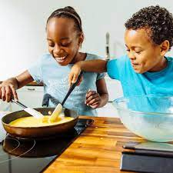
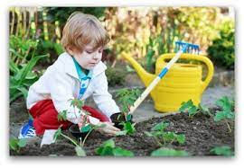
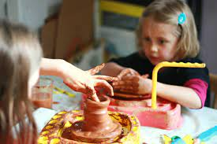
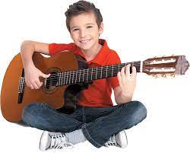
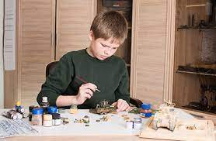
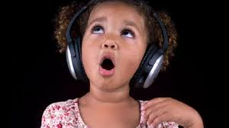
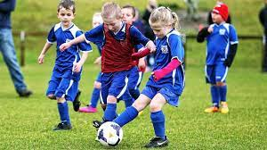
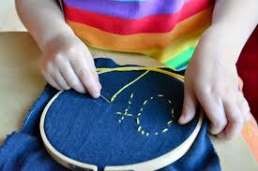
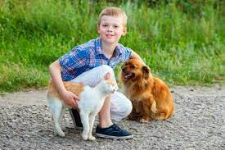
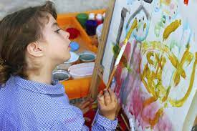
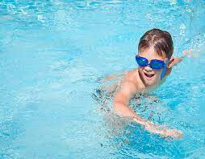

Slide 10
Why do you like it? What makes it so enjoyable?
Do you need any special skills to do it? Do you have to practise lots? How did you learn to do it?
Do you think other children (or adults) would like to do it too? Why? Can you persuade them to have a go?

Slide 11
We are now going to use the ideas sheet and planning sheet to write down our ideas.
Your speech should last about 2 minutes.

Slide 12
TOP TIPS! These are the things the judges are going to be looking for:
Think about who your audience is. Can you make it interesting to them?
Use interesting or technical vocabulary.

Slide 13
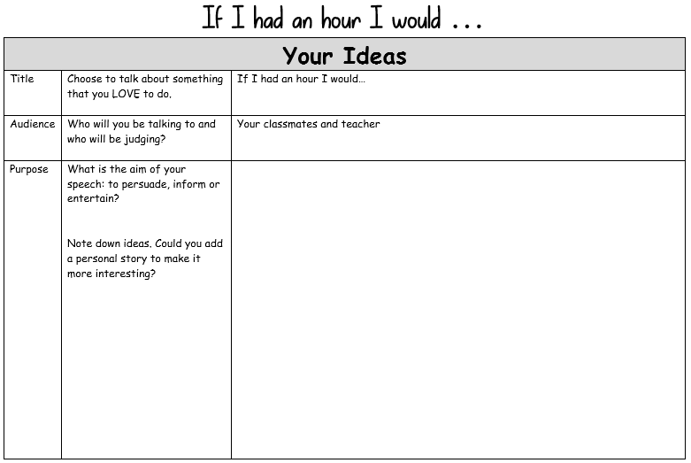
First let’s start with your ideas…

Slide 14
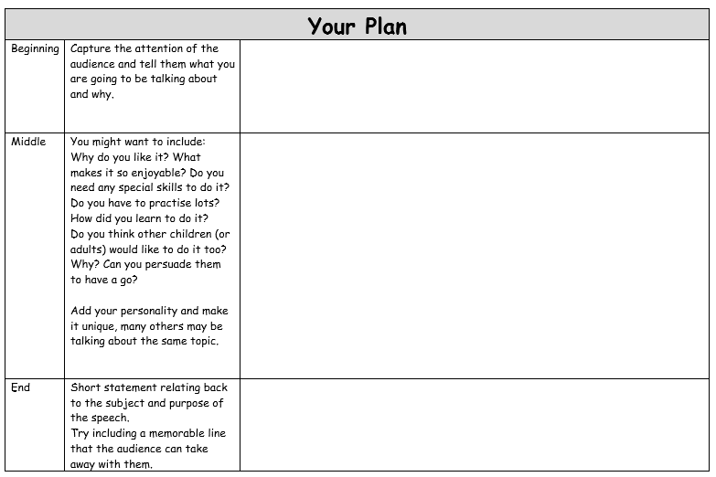
And now for your plan.

