Slide 1
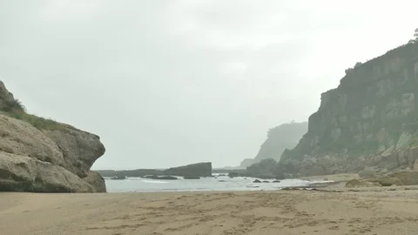
Adventure at Sandy Cove

Slide 2
Way back in January, we started the story of
Adventure at Sandy Cove
We know you really enjoyed it, so we thought it would be nice to pick up where we left off.

Slide 3
First of all, let’s remind ourselves of the story:
We can listen to the text here and follow along with the text on the slides.
Adventure at Sandy Cove
“Hurry up,” shouted Joe as he climbed over the rocks. Carefully, Rahul followed. The two boys stopped at a rock pool and began to search for shells. “Hey, what’s this?” shouted Joe to Rahul. In the rock pool was a small, black box wrapped in plastic. The boys tugged it loose. What was inside? Joe pressed the silver catch and the lid popped open. It was full of jewels!

Slide 4
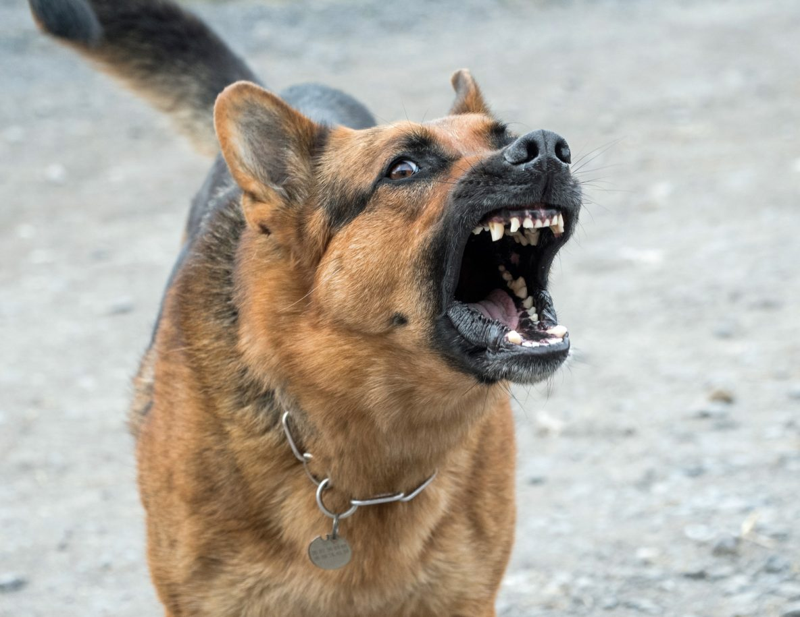
At that moment, a scruffy old man shouted at the boys. His wolf-like dog barked menacingly. Joe snapped the lid down, picked up the box and the two boys began to scramble over the rocks. They slipped and struggled towards the cliffs.

Slide 5
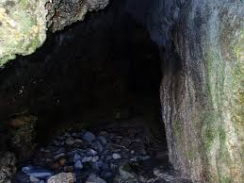
“Quick! Let’s hide in here,” said Joe, rushing into a cave. It was dark and damp inside and they could hear water dripping. They felt their way further in and crouched behind a rock. Rahul’s heart pounded. All at once, the scruffy man appeared at the cave mouth. He shone a torch around. The light cast shadows on the cave wall. The children ducked down and kept as still as stone, but the dog could sense them. It padded closer and closer, growling menacingly. Rahul gripped Joe’s arm. They could see its white teeth, smell its damp hair and feel its hot meaty breath.

Slide 6
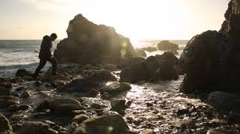
Suddenly there was a distant shout. ‘Here Dog!’ hissed the man, roughly grabbing its collar. “Those boys have got away. Quick. After them!” Joe and Rahul held their breath until they could hear the sound of the man and his dog stumbling back across the rocks. They waited for a long while before creeping out. Even though the beach was empty, the boys ran home as fast as they could.

Slide 7
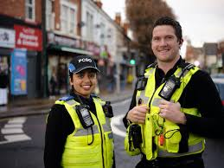
At first Mum didn’t believe them. It was only when Joe opened the box that she decided to call the police. When the police arrived they told Mum that the big house up the road had been burgled only the night before. They had spent all day searching for a trace of the jewels. Their only clue had been the footprints of a large dog. Joe shut his eyes. He could imagine the headlines: ‘PRICELESS JEWELS FOUND BY SCHOOLBOY DETECTIVES. And there was a reward too!

Slide 8
Now we are going to practise saying the text all together, with actions. Next, you are going to practise the text with your learning partner. Remember to include the actions too as that will help you to remember it.
If you are at home, maybe you could say it to someone in your household.

Slide 9
How do you think Joe and Rahul felt at different points in the story?
when they found the box
when they looked inside the box
when the man shouted and the dog barked at them
when they were hiding in the cave and the dog came closer
when the man and the dog left
when they came out of the cave
when they got home
when mum didn’t believe them
when the police told them the jewels had been stolen

Slide 10
Today you are going to write some extended sentences using to say how the boys felt. You are going to use when or because.
Example:
The boys were terrified when the fierce dog came close to them.
Joe and Rahul were relieved because mum knew what to do.

