Slide 2
What is Diwali (Divali)?
Let’s recap what we’ve learnt so far…

Slide 3
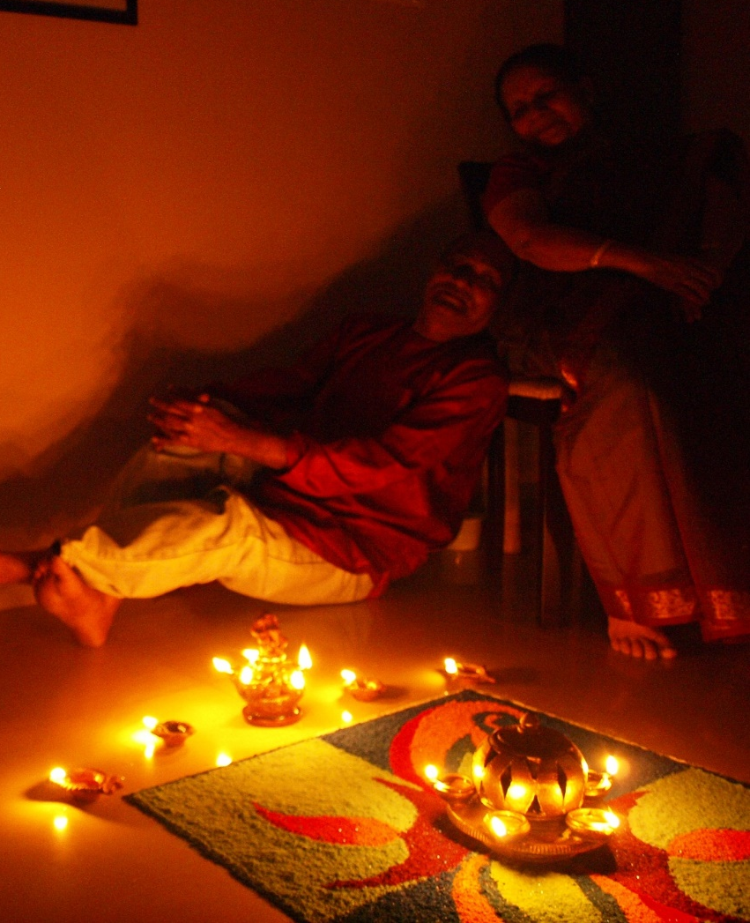
What is Diwali?
Diwali is a very important holiday in India.
It is a Hindu ‘festival of lights’ which celebrates the New Year.
The word Diwali means ‘row of lighted lamps’.
Photo courtesy of siddhu202 (@flickr.com) granted under creative commons licence

Slide 4
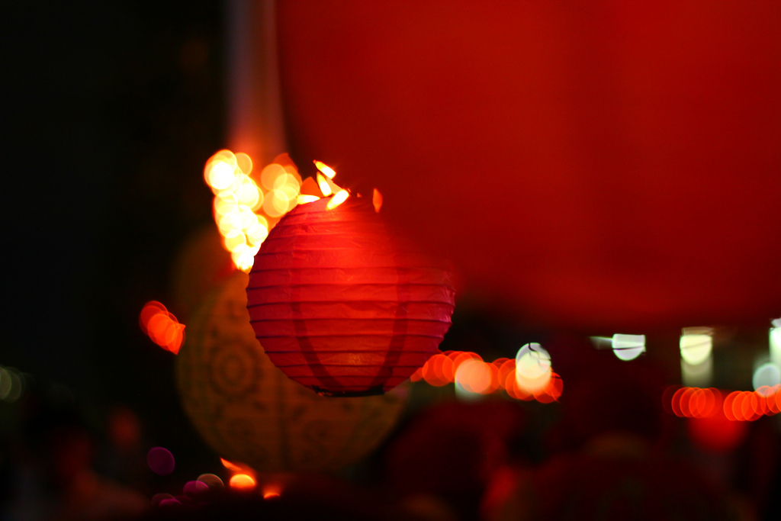
Photo courtesy of nasikabatrachus (@flickr.com) granted under creative commons licence

Slide 5
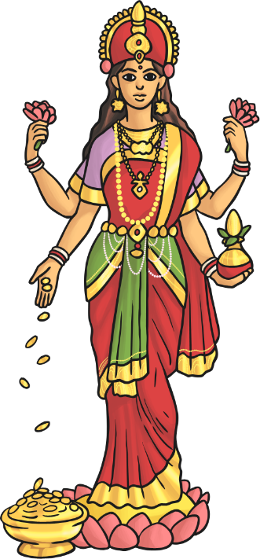
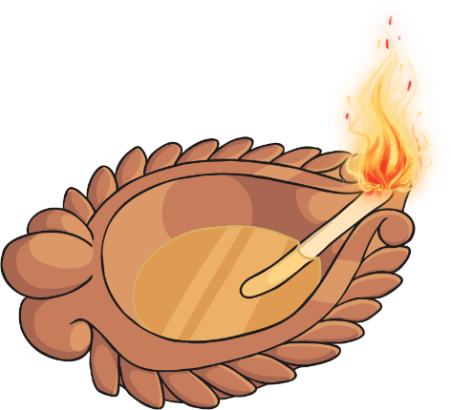
Celebrating Diwali
The festival usually honours Lakshmi, the goddess of wealth.
Lamps are lit to help Lakshmi find her way into people’s homes.
Lakshmi
They also celebrate a Diwali legend, the story of the return of Rama and Sita to Rama’s kingdom after fourteen years of exile.
Diva lamp

Slide 6
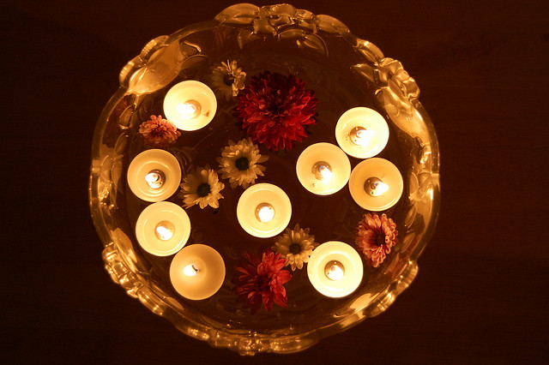
Photo courtesy of subharnab (@flickr.com) granted under creative commons licence

Slide 7
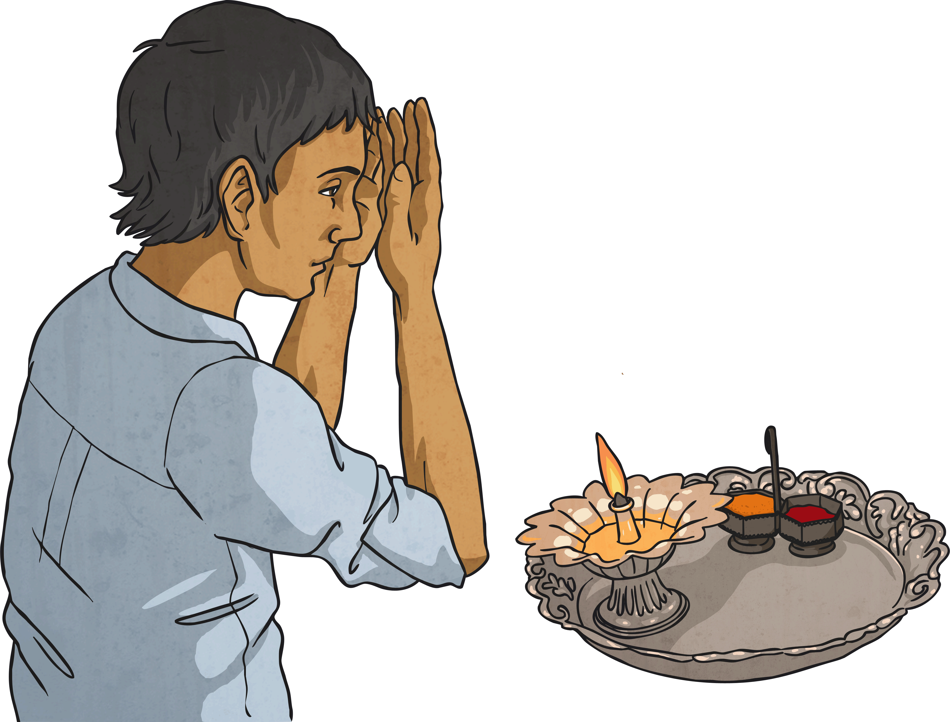
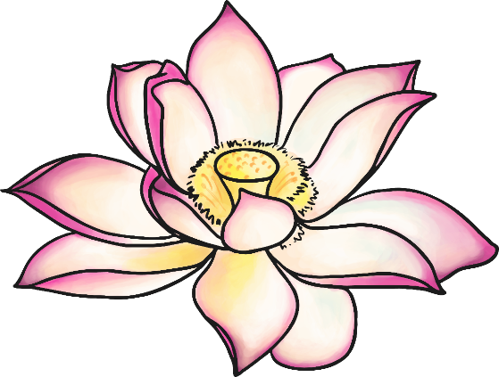
Celebrating Diwali
In India, Hindus leave the windows and doors of their houses open so that Lakshmi can come in.
Rangoli are drawn on the floors of the house. These are patterns and the most popular subject is the lotus flower.
Lotus flower

Slide 8
The Meaning of Diwali
The festival celebrates the victory of good over evil, light over darkness and knowledge over ignorance.
The legends that go with the festival differ depending on where you are:
In northern India, Diwali celebrates Rama and Sita’s return from exile.
In Nepal, Diwali commemorates the victory of Lord Krishna over the demon king Narakaasura.
In Bengal, it is associated with the goddess Kali.
Rama and Sita

Slide 9
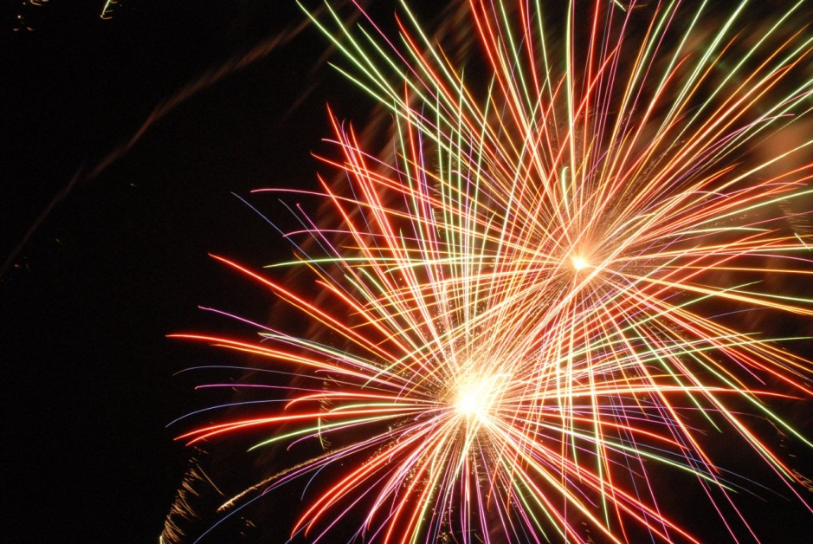
Photo courtesy of tsuacctnt (@flickr.com) granted under creative commons licence

Slide 10
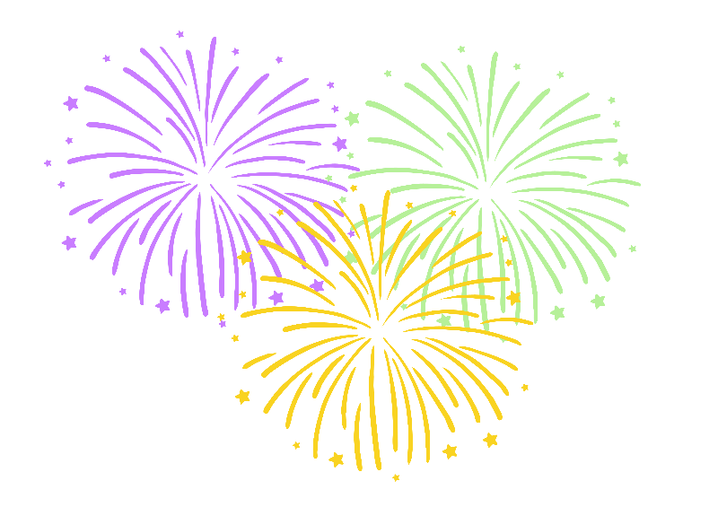
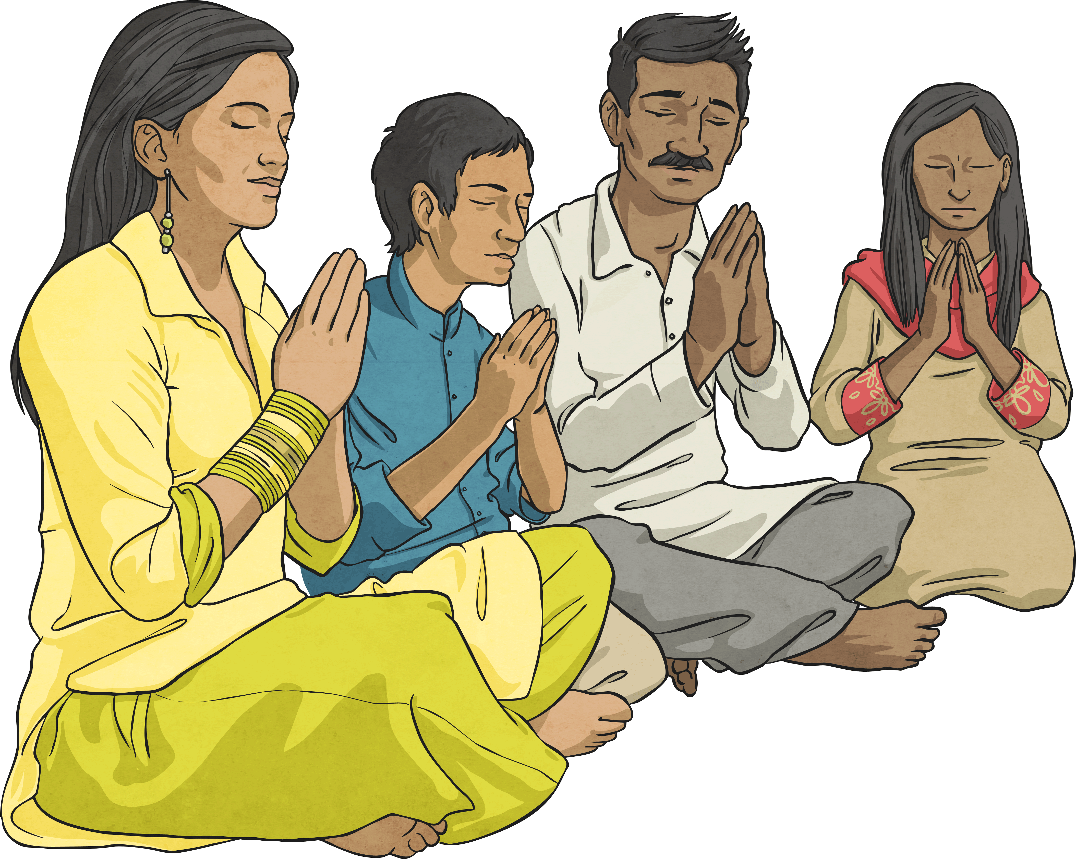
Celebrating Diwali
The festival is a time for:
spring cleaning
decorating the home with lots of lights
wearing new clothes
exchanging gifts
preparing festival meals
putting on huge fireworks displays
Hindu family praying

Slide 11
Questions to think about
How might it feel for a Hindu child to celebrate Divali with their family?
Would celebrating Divali at home and in their community bring a feeling of belonging to a Hindu child?

Slide 12
Activity
Look at the picture of the Hindu children celebrating Divali. How do you think they are feeling?
Complete the thoughts/feelings bubbles about their thoughts and feelings during Divali.

