Slide 1
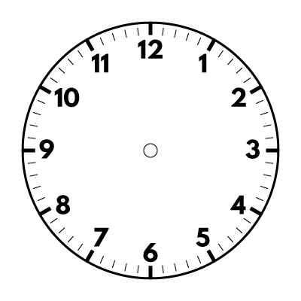
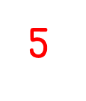
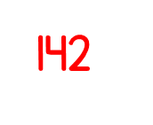
Year 5 | Week 3 | Day 3

Slide 4
Circle the non-unit fractions
$\frac{\text{2}}{\text{5}}$ $\frac{\text{1}}{\text{7}}$ $\frac{\text{4}}{\text{5}}$ $\frac{\text{5}}{\text{6}}$ $\frac{\text{1}}{\text{9}}$
2) What fraction of the bar is shaded orange?
3) What fraction of the bar is shaded blue?

Slide 5
Circle the non-unit fractions
$\frac{\text{2}}{\text{5}}$ $\frac{\text{1}}{\text{7}}$ $\frac{\text{4}}{\text{5}}$ $\frac{\text{5}}{\text{6}}$ $\frac{\text{1}}{\text{9}}$
2) What fraction of the bar is shaded orange?
3) What fraction of the bar is shaded blue?
$$\frac{\text{2}}{\text{5}}$$
$$\frac{\text{4}}{\text{10}}$$

Slide 7
Equivalent fractions
Equivalent means the same value or amount.
is equivalent to

Slide 8
Have a think
Here is a strip of paper.
I cut it into 4 equal pieces.
Here is a strip of paper.
I cut it into 2 equal pieces.
What do you notice?

Slide 9
$\frac{\text{1}}{\text{2}}$
$\frac{\text{1}}{\text{2}}$
$\frac{\text{1}}{\text{2}}$
$\frac{\text{1}}{\text{4}}$ | $\frac{\text{1}}{\text{4}}$
$\frac{\text{1}}{\text{4}}$ | $\frac{\text{1}}{\text{4}}$
$\frac{\text{1}}{\text{4}}$ | $\frac{\text{1}}{\text{4}}$
$\frac{\text{1}}{\text{2}}$ is equivalent to $\frac{\text{2}}{\text{4}}$

Slide 10
$$\frac{\text{1}}{\text{2}}$$
$$\frac{\text{2}}{\text{4}}$$
$×$ 2
$÷$ 2
$÷$ 2
$×$ 2
$\frac{\text{1}}{\text{2}}$
$\frac{\text{1}}{\text{2}}$
$\frac{\text{1}}{\text{2}}$
$\frac{\text{1}}{\text{4}}$ | $\frac{\text{1}}{\text{4}}$
$\frac{\text{1}}{\text{4}}$ | $\frac{\text{1}}{\text{4}}$
$\frac{\text{1}}{\text{4}}$ | $\frac{\text{1}}{\text{4}}$

Slide 11
$\frac{\text{1}}{\text{4}}$
$\frac{\text{2}}{\text{4}}$
$\frac{\text{3}}{\text{4}}$
0
1
$\frac{\text{2}}{\text{8}}$
is equivalent to $\frac{\text{1}}{\text{4}}$

Slide 12
$\frac{\text{1}}{\text{4}}$
$\frac{\text{2}}{\text{4}}$
$\frac{\text{3}}{\text{4}}$
0
1
$\frac{\text{2}}{\text{8}}$
$\frac{\text{5}}{\text{20}}$

Slide 13
$\frac{\text{1}}{\text{4}}$
$\frac{\text{2}}{\text{4}}$
$\frac{\text{3}}{\text{4}}$
0
1
$\frac{\text{2}}{\text{8}}$
$\frac{\text{5}}{\text{20}}$
$\frac{\text{3}}{\text{12}}$

Slide 14
Have a think
$$\frac{\text{1}}{\text{4}}$$
$$\frac{\text{2}}{\text{8}}$$
$$\frac{\text{3}}{\text{12}}$$
$$\frac{\text{5}}{\text{20}}$$
$$\frac{\text{?}}{\text{?}}$$
$$\frac{\text{4}}{\text{16}}$$
$$\frac{\text{10}}{\text{40}}$$
$$=$$
$$=$$
$$=$$
$$=$$

Slide 15
Have a think
What do you notice?
$×$ 2
$×$ 3
$×$ 5
$×$ 10
$$\frac{\text{1}}{\text{4}}$$
$$\frac{\text{2}}{\text{8}}$$
$$\frac{\text{3}}{\text{12}}$$
$$\frac{\text{5}}{\text{20}}$$
$$\frac{\text{10}}{\text{40}}$$
$×$ 4
$$=$$
$$=$$
$$=$$
$$=$$
$÷$ 4
$×$ 2
$×$ 3
$×$ 5
$×$ 10

Slide 16
$×$ 4
$$\frac{\text{3}}{\text{4}}$$
$$\frac{\text{12}}{\text{16}}$$
$$=$$
$×$ 4

Slide 17
$×$ 3
Have a think
$$\frac{\text{3}}{\text{4}}$$
$$\frac{\text{9}}{\text{12}}$$
$$=$$
$×$ 3
$÷$ 3
$$\frac{\text{3}}{\text{5}}$$
$$\frac{\text{9}}{\text{15}}$$
$$=$$
$÷$ 3

Slide 18
Have a go at questions 1 - 4 on the worksheet Stick in 1, copy the rest into your books

Slide 19
$×$ 3
Have a think
$$\frac{\text{2}}{\text{3}}$$
$$\frac{\text{6}}{\text{9}}$$
$$\frac{\text{8}}{\text{9}}$$
I added 6 to both the numerator and denominator.
$$=$$
$×$ 3

Slide 20
$×$ 10
$÷$ 3
$$\frac{\text{12}}{\text{15}}$$
$$\frac{\text{40}}{\text{50}}$$
$$\frac{\text{4}}{\text{5}}$$
$$=$$
$$=$$
$×$ 10
$÷$ 3

Slide 21
Have a go at the rest of questions on the worksheet

