Slide 1
1.12.21
L.O. – I can multiply by 10.

Slide 2
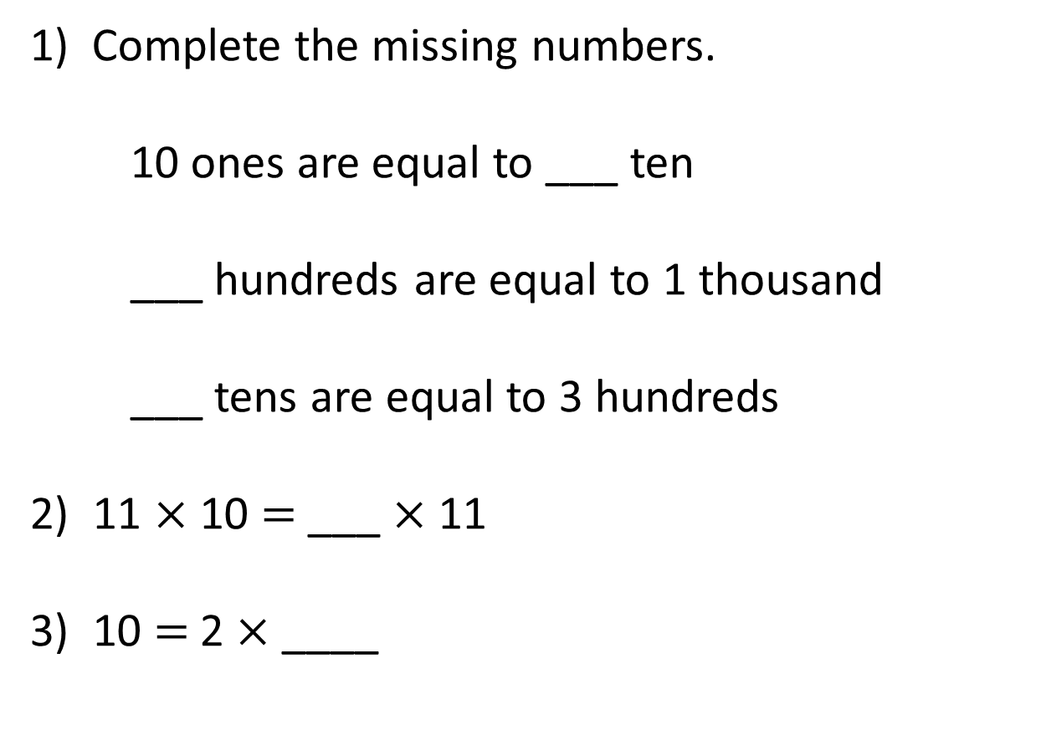
1) Complete the missing numbers.
10 ones are equal to ___ ten
___ hundreds are equal to 1 thousand
___ tens are equal to 3 hundreds
2) 11 $×$ 10 $=$ ___ $×$ 11
3) 10 $=$ 2 $×$ ____
If you finish, please look over your 9x tables, we will play hit the button next.

Slide 3
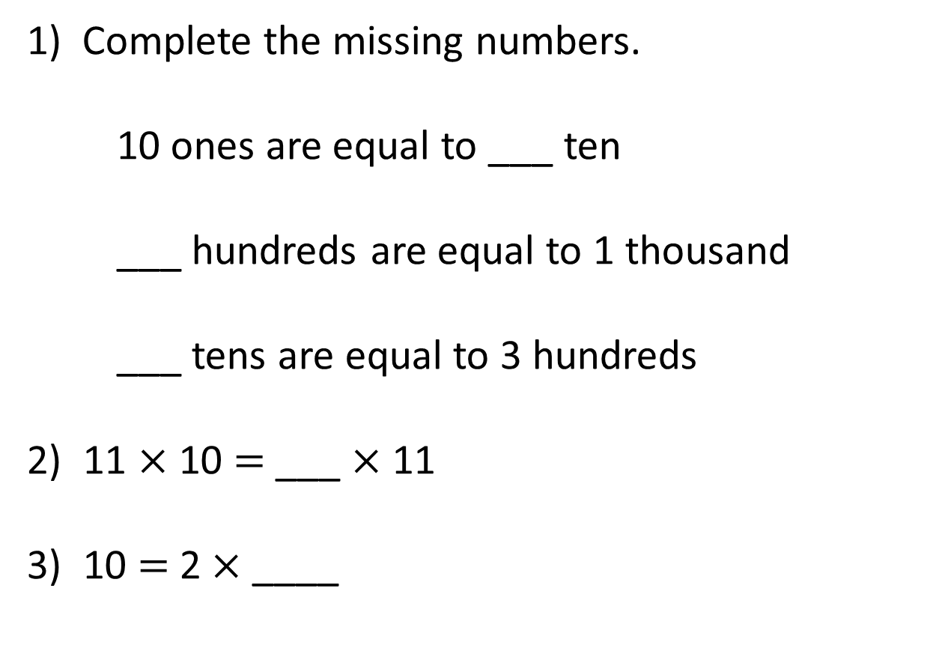
1) Complete the missing numbers.
10 ones are equal to ___ ten
___ hundreds are equal to 1 thousand
___ tens are equal to 3 hundreds
2) 11 $×$ 10 $=$ ___ $×$ 11
3) 10 = 2 × ____
1
10
30
10
5
https://www.topmarks.co.uk/maths-games/hit-the-button

Slide 4
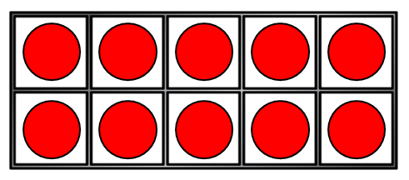

4 groups of 10
10 | 10 | 10 | 10
4 × 1 ten =
4 tens
4 × 10 =
40

Slide 5
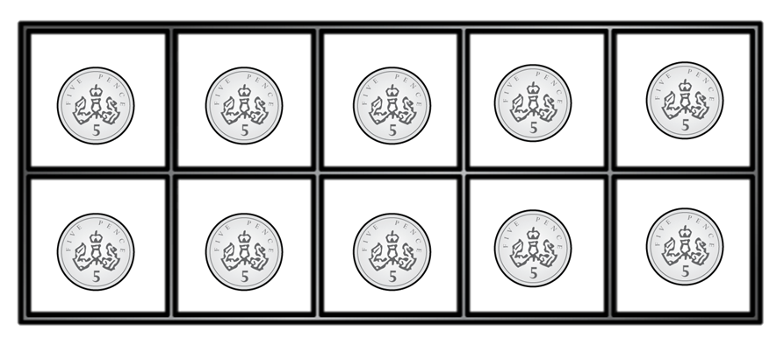

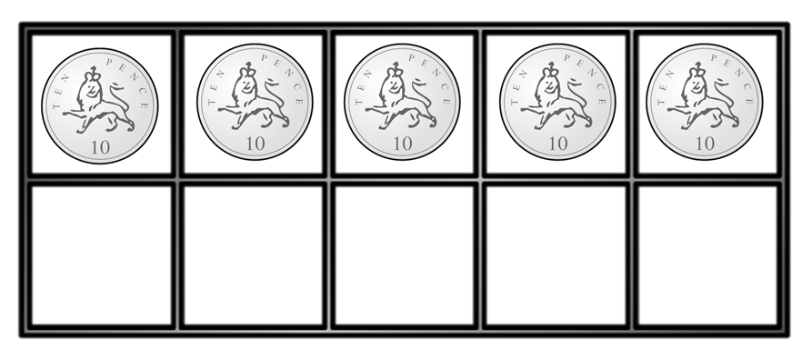
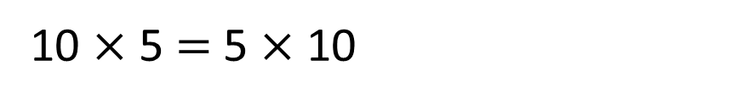
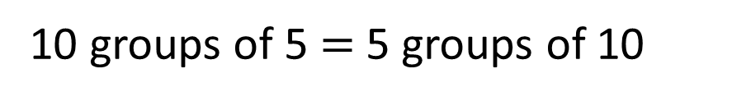
Have a think
What’s the same?
What’s different?
10 groups of 5 $=$ 5 groups of 10
5 | 5 | 5 | 5 | 5 | 5 | 5 | 5 | 5 | 5
10 $×$ 5 $=$ 5 $×$ 10
10 | 10 | 10 | 10 | 10

Slide 6
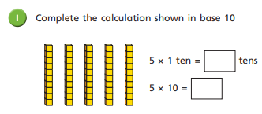
Complete question 1 from your worksheet.

Slide 7
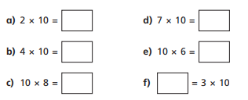
Please complete these number sentences in your book.

Slide 8
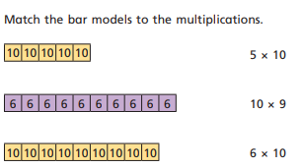
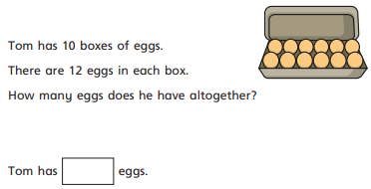
Now, work through questions 3 and 4 on you worksheets.

Slide 9


H | T | O
Each row has 2 tens and 1 one.
Each row has 21
There are 10 rows.
The calculation is
21 × 10 =
2
1
0

Slide 10
Have a think
H | T | O
3
Each row has ___ tens
and ___ ones.
2
32
Each row has _____
10
There are ___ rows.
The calculation is
___ × ____ = ______
32
10
320

Slide 11
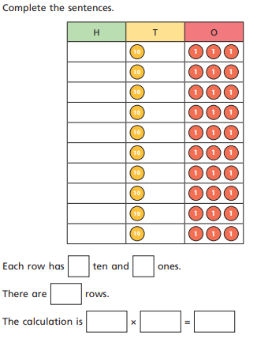
Let’s discuss this example as a class.

Slide 12
1 ten is 10 times the size of 1 one
1 hundred is 10 times the size of 1 ten
1 thousand is 10 times the size of 1 hundred

Slide 13
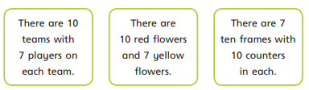
Which one of these is the odd one out?
Talk to your partner about this.

Slide 14
Th | H | T | O
10 times
the size
10 times
the size
10 times
the size
2
4
0
24 × 10 =

Slide 15
Th | H | T | O
10 times
the size
10 times
the size
10 times
the size
4
2
0
42 × 10 =

Slide 16
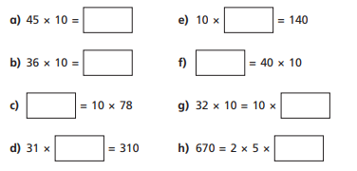
Complete these calculations in your book.

Slide 17
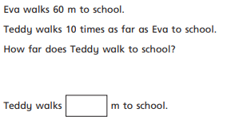
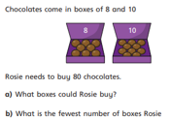
Now, finish the questions on your worksheet. If you complete these, there is a challenge question.

