Slide 1
Year 2 Whole Class Reading
Narrative

Slide 2
Reading Skills Key Stage 2

Slide 3
Year 3 Whole Class Reading
Narrative

Slide 4
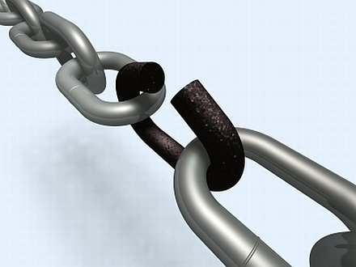
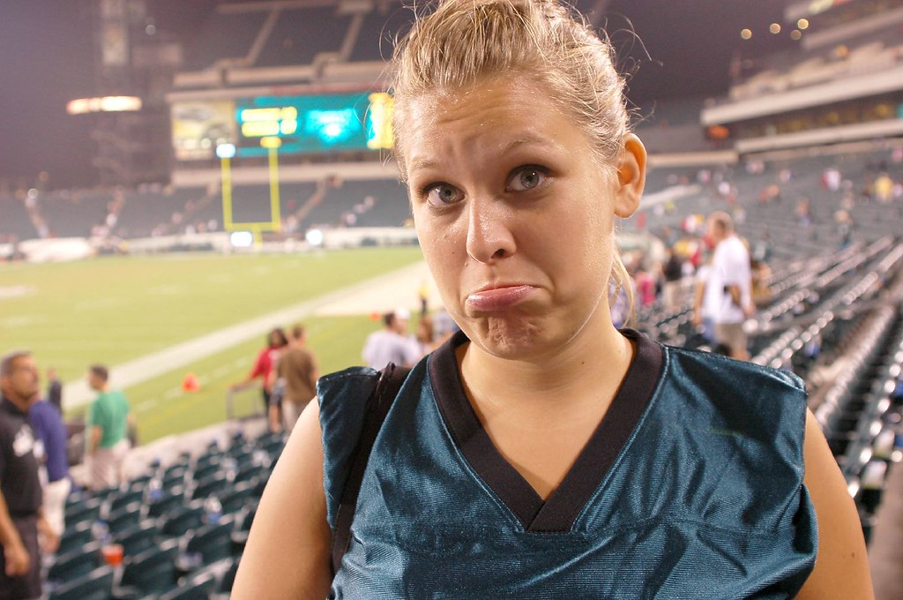
virtually
(nearly or almost)
lame
(feeble or weak)
Week 1
exasperated
(intensely frustrated)
reluctantly
(unwilling)

Slide 5
Reading Skills Key Stage 2
Week 1

Slide 6
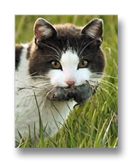
Week 1
Diary of a Killer Cat week 1
Tuffy was a cat. Not just any old cat, but a killer cat. He had recently biffed a bird hard enough to kill it but had excused himself as it had flown virtually in his mouth. He made the lame excuse to Ellie that it could have ‘hurt’ him if he hadn’t defended himself.
Ellie was so exasperated by him that she burst into tears. Her dad had reluctantly fetched a bucket of soapy water and a scrubbing brush into the hallway, muttering under his breath about the cost of home furnishings. He frowned and scowled at Tuffy, not looking at what he was doing, being careful with what he said whilst Ellie was there.

Slide 7
Week 1
Diary of a Killer Cat week 1
Tuffy was a cat. Not just any old cat, but a killer cat. He had recently biffed a bird hard enough to kill it but had excused himself as it had flown virtually in his mouth. He made the lame excuse to Ellie that it could have ‘hurt’ him if he hadn’t defended himself.
Ellie was so exasperated by him that she burst into tears. Her dad had reluctantly fetched a bucket of soapy water and a scrubbing brush into the hallway, muttering under his breath about the cost of home furnishings. He frowned and scowled at Tuffy, not looking at what he was doing, being careful with what he said whilst Ellie was there.

Slide 8
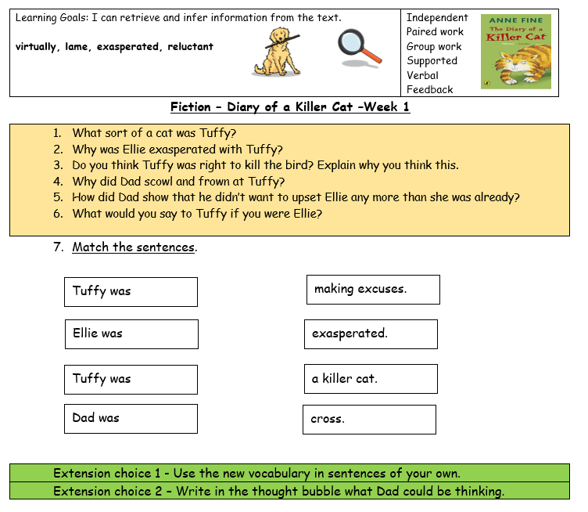
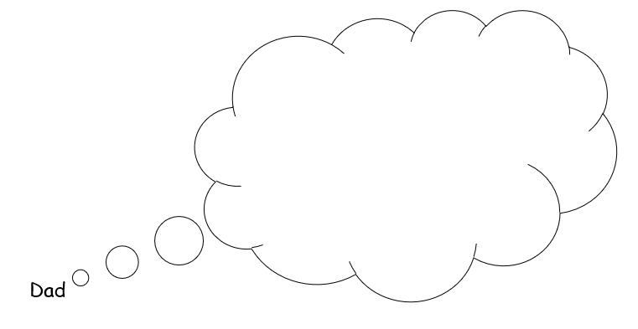
Week 1

