Slide 1
Whole School Genre of the Week
Types of Dances: Charleston/ Lindy Hop/Jive
Charleston
https://www.youtube.com/watch?v=xFlzrO-uvUQ
https://www.youtube.com/watch?v=QYOfbsuYSVE
https://www.youtube.com/watch?v=f2IiIenn7qo
Lindy Hop
https://www.youtube.com/watch?v=Xu6Y9cAQqIs
https://www.youtube.com/watch?v=UfpDfBJuZ-k
https://www.bbc.co.uk/programmes/p00wgjmy
Jive
https://www.youtube.com/watch?v=WA3nkbXZVYs
https://www.youtube.com/watch?v=wcOEHvWi1rY

Slide 2
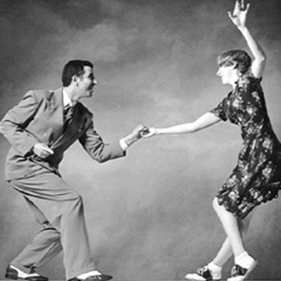
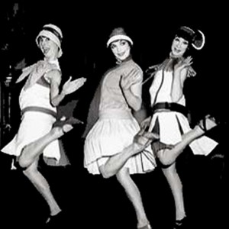
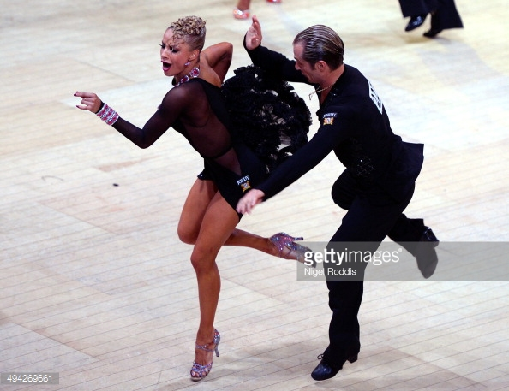
Lindy Hop
Lindy Hop, the Grand Daddy of Swing, is a jazzy, energetic dance which was primarily born out of Harlem ballrooms in the late 1920s and 30s. It was claimed the term 'Lindy Hop' was first coined by George "Shorty" Snowden, drawing inspiration from Lindbergh's pioneering aeroplane flight across the Atlantic in 1927. Characterized by imaginative combinations of 6 & 8 count moves, acrobatic lifts and "breakaways" in which partners separate and improvise steps individually, the dance is free spirited and fun, encouraging creativity and innovation.
Charleston
Think of the 20s and you immediately think of Charleston capturing the exuberant spirit of the age. (Not to be confused with the swing era 'Lindy Charleston' steps which are part of swing dance family). Fast (frantic even!) with shimmying flappers, swiveling footwork and no inhibitions, whether it's solo or partnered, this dance is about having fun and going wild!
Considered reckless and decadent in an age of prohibition, traditional ballrooms displayed signs reading "Please Charleston Quietly".
The Jive originated in the United States in the 1930's and refers to a style of ballroom dancing included in DanceSport categories of competition. African Americans began performing a series of steps to Swing and Rock & Roll music and therefore created what we know today as the Jive.
(Background information for adults.)

Slide 3
Whole School Song of the Week
Spring 1 | Song | Resource | Link
Week 1 | This Little Light of Mine | https://www.youtube.com/watch?v=QCN893hzueQ | Jigsaw PHSE Unit:- Dreams and Goals

Slide 4
Reception Music:- Peter and the Wolf – linked with our Talk for Writing Unit.
https://www.youtube.com/watch?v=9ueGfjBKbiE
0 to 2mins 27 sec:
Listen to the introduction of the instruments used to represent the characters in the story.
The Bird is represented by the sound of a Flute, the Duck by the Oboe, the Cat by the Clarinet, the Grandfather by the Bassoon, the Wolf by three French Horns, the Hunters by timpani (drums) and Peter by the Strings section.
2 mins 27sec to 14 mins:
Talk about how the sounds contrast and give us an impression of character.
Listen to the story, told with the music. Move to the music.
Find out more about conductor and the Strings section of the Orchestra. What can you remember from last term’s work?
George meets the Orchestra:
https://www.youtube.com/watch?v=M0Jc4sP0BEE -the first 3 mins.

