Slide 1
Monday 24th January 2022
LO: To predict what might happen

Slide 2
This week we are going to be basing all our writing around a short film. We are going to have lots of opportunities for free writing linked to the film.
The film is called…

Slide 3
Girl and Robot
What do you think the film might be about? What might happen in the film?

Slide 4
The film is on the next slide.
Watch up to 13 seconds. Then pause. What do you think the film is about?
Then watch up to 47 seconds. Now what do you think? Do not watch any further.

Slide 5
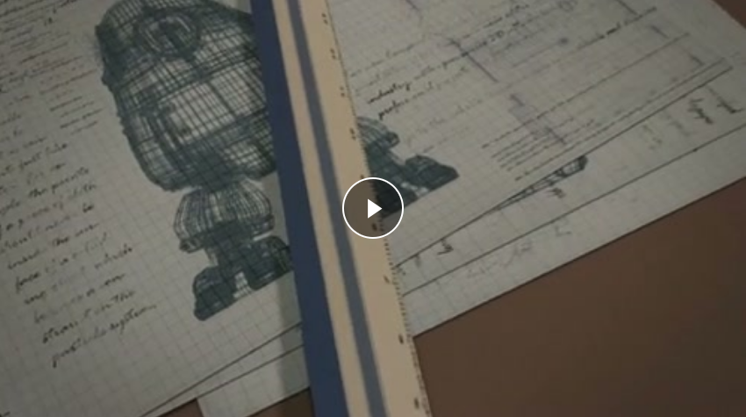
Girl and Robot

Slide 6
Next watch the film again, but this time watch up to
3 minutes and 8 seconds.

Slide 7
Now, we are going to work in teams. For the next 5 minutes, I would like you to think of as many questions as possible to ask about the film.
For example:
Where are her parents?
Why is she building it?
I would like you to think of questions that perhaps the other teams don’t have.

Slide 8
Now let’s share our questions. If another team has the same question as you, you must cross it off.
Which team has the most questions that no-one else has?

Slide 9
Now we are going to watch the video to the end.

Slide 10
What happened?
What do you think about the unseen scene? (The bit that happens between the girl falling on the floor and waking up). In the clip, this is a second or so but it could actually have been several minutes or longer.
What have you seen? What do you think happened?

Slide 11
Your task
Write a prediction about what happened in the minutes when the screen went blank.
Think of lots of little things that might have happened. e.g. The first dial burst and filled the room with steam. Behind the robot, the large wheel ceased turning. There was a loud hissing noise.

Slide 12
Share your prediction with your partner.
Does what you have written fit into the story?
Does it make sense based on what you could see?

