Slide 1
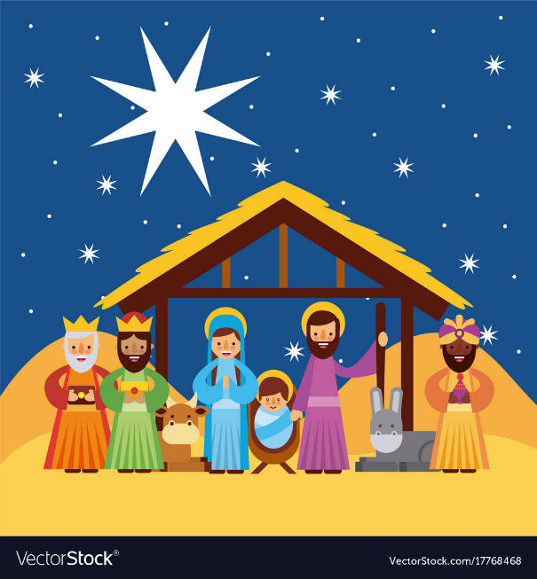
Whole School Genre of the Week:
Christmas Music – Choral
This Little Babe – Benjamin Britten
https://www.bbc.co.uk/programmes/p02f9xhn
Ring Christmas Bells
https://www.youtube.com/watch?v=1lNfJYWLMv8
Rumours of Angels – Graham Kendrick
You Came from the Highest
https://www.youtube.com/watch?v=bD8f_w_XNic
Can you Believe it
https://www.youtube.com/watch?v=gYKJcl_sakk
Once in Royal David’s City
https://www.youtube.com/watch?v=NMGMV-fujUY&feature=emb_title
Silent Night
https://www.youtube.com/watch?v=n036kBC1HEw
Like a Candle Flame
https://www.youtube.com/watch?v=XmwdZyTGa_A
Handel’s Messiah – For unto us a Child is Born
https://www.youtube.com/watch?v=rbglWu_3pi0&list=RDHMart4wXsI0&index=8
Laudate Dominum – Mozart
https://www.youtube.com/watch?v=q9rvyvssvuI
Gaudete
https://www.youtube.com/watch?v=J-NhdkpWJoI
Carols from Kings- audio only
https://www.youtube.com/watch?v=RVguSWYwSsA

Slide 2
Whole School Song of the Week: It was on a Starry Night and Calypso Carol
It was on a Starry Night
https://www.youtube.com/watch?v=MCHL2t7xxus
Calypso Carol
https://www.youtube.com/watch?v=_h0pRiEZIlE
Reception Music
We Wish You a Merry Christmas
https://www.youtube.com/watch?v=a-PBixyD_GU

Slide 3
Jingle Bells
https://www.youtube.com/watch?v=dp1_lzKNbeA
It Was on a Starry Night
https://www.youtube.com/watch?v=MCHL2t7xxus
Other Christmas Songs
Rudolph The Red Nosed Reindeer
https://www.youtube.com/watch?v=2pt6DUn_mkQ
Calypso Carol – not Makaton
https://www.youtube.com/watch?v=_h0pRiEZIlE
Away In A Manger - Makaton Sign Language
https://www.youtube.com/watch?v=gMfyGbt43rM
We Wish You a Merry Christmas
https://www.youtube.com/watch?v=a-PBixyD_GU

