Slide 1
The Proudest Blue
A Story of Hijab and Family
Ibtihaj Muhammad – Olympic Medallist

Slide 2
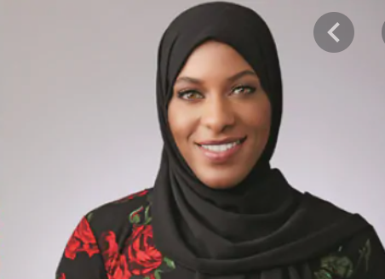
Vocabulary Check
It’s the first-day hijab
A hijab is a head covering worn in
public by many women of the Islamic
Faith.
Olympic medalist
Ibtihaj Muhammad

Slide 3
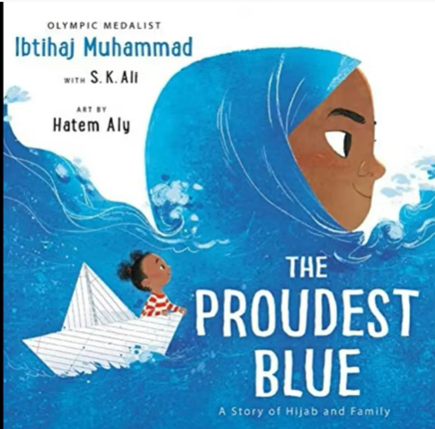

Slide 4
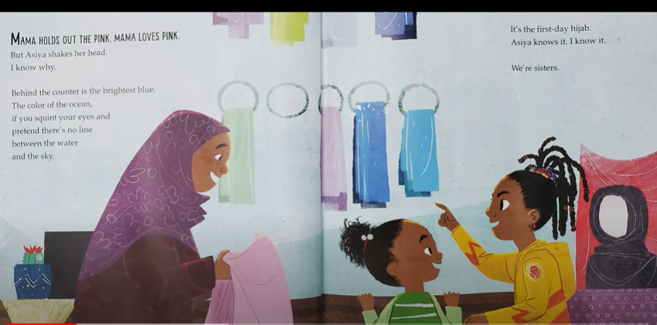

Slide 5
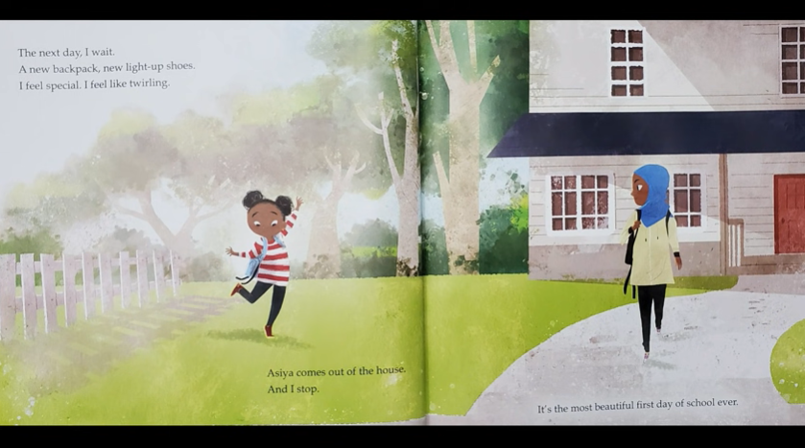

Slide 6
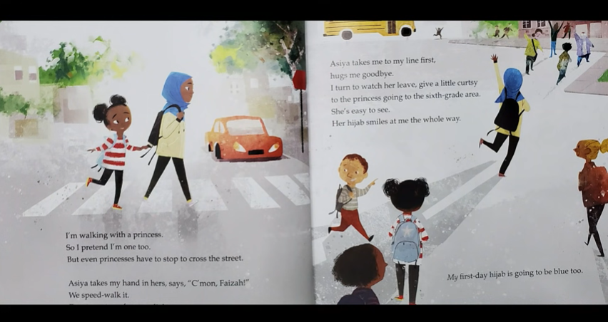

Slide 7
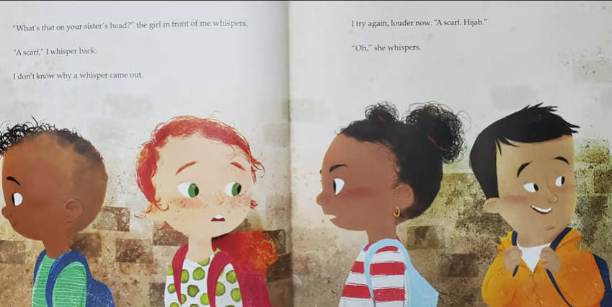

Slide 8
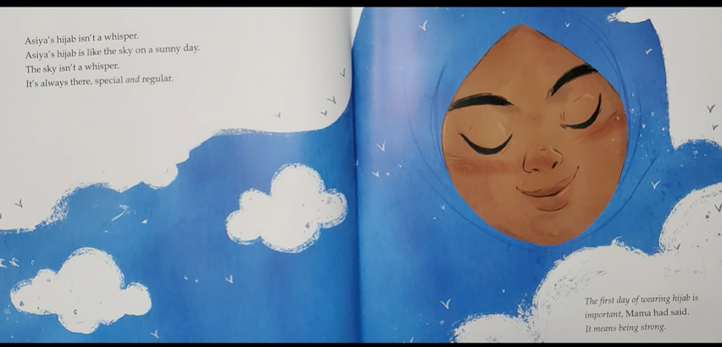

Slide 9
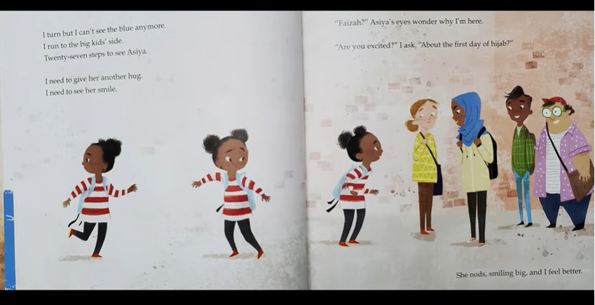

Slide 10
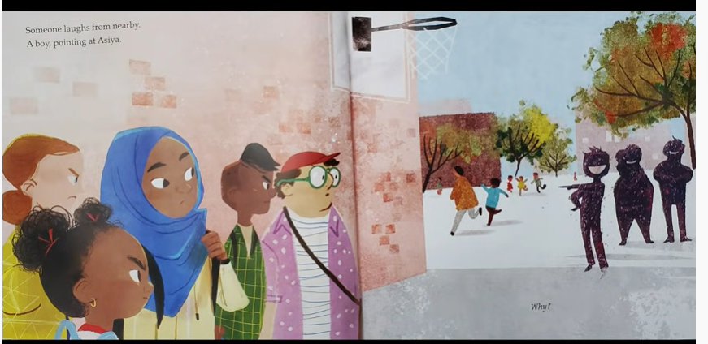

Slide 11
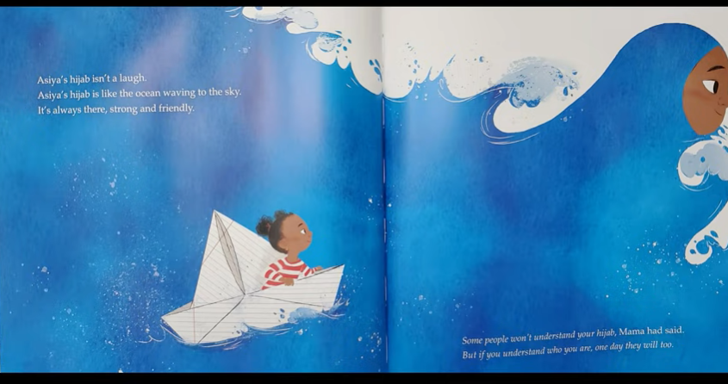

Slide 12
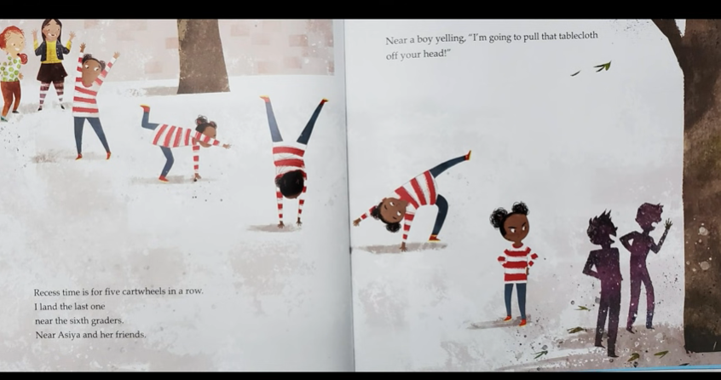

Slide 13
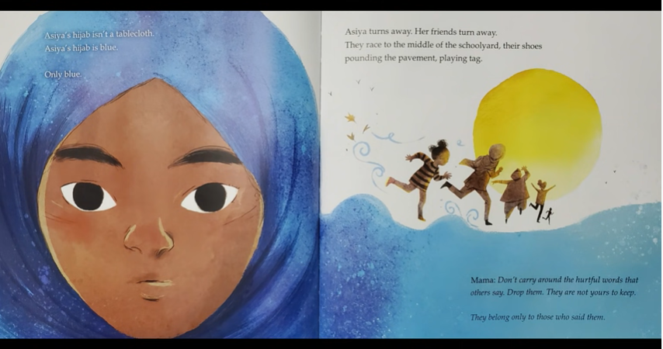

Slide 14
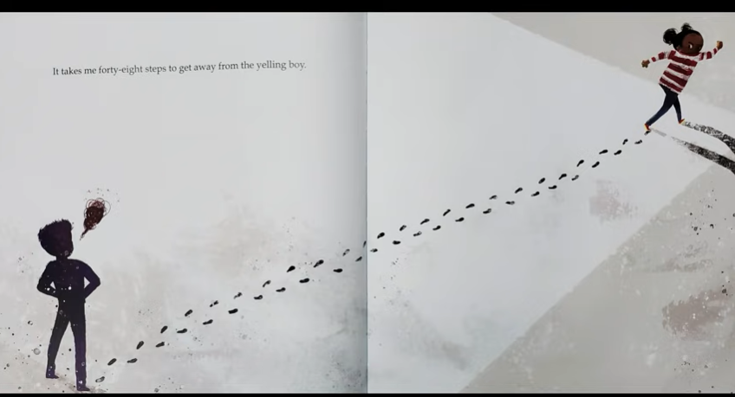

Slide 15
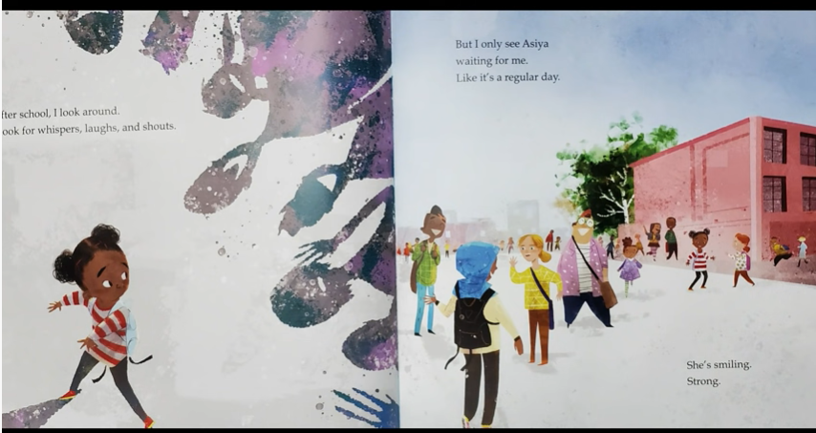

Slide 16
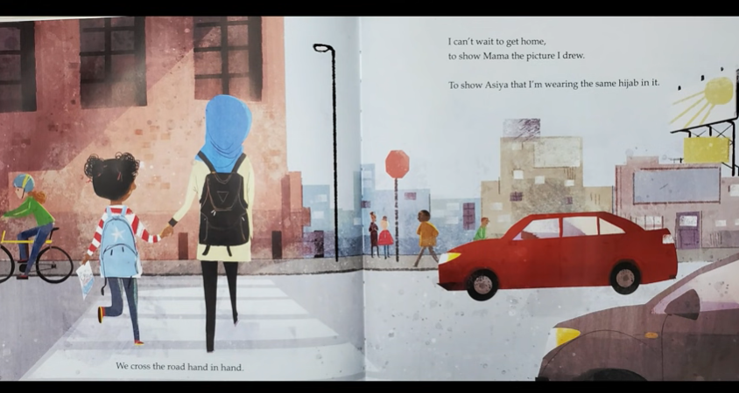

Slide 17
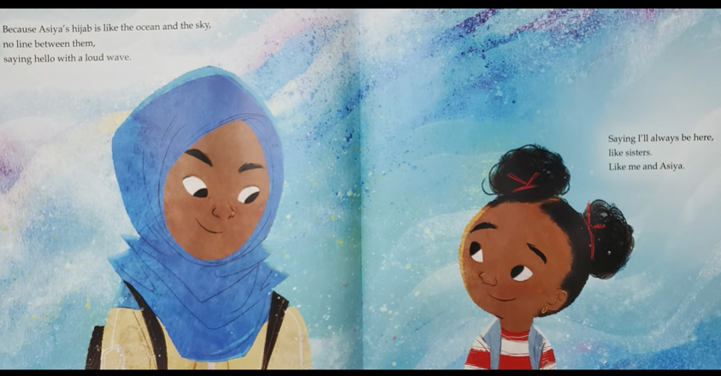

Slide 18
Quick Start
What did the girls and their mother go out to shop for?
What colour scarf did the mother first suggest?
What did the blue scarf signify?
What new items did Faizah have for her first day of school?
How does the yelling boy refer to the headscarf?

Slide 19
Partnered Talk
I’m walking with a princess.
Faizah refers to her sister as a princess. What does this imply about their sisterhood?

Slide 20
Individual Thinking
What’s that on your sister’s head?
Is it ok to ask about the way people dress or choose to appear? What must you be mindful of when asking such questions?

Slide 21
Partnered Talk
The first day of wearing hijab is important, Mama had said. It means being strong.
Why do you think wearing a hijab means being strong?

Slide 22
Individual Thinking
“Are you excited?” I ask. “About the first day of hijab?” She nods, smiling big, and I feel better.
Why does Faizah feel like she needs to ask her? Why does she feel better when she hears her sister’s response.

Slide 23
Individual Thinking
Some people won’t understand your hijab, Mama had said.
What might people misunderstand about hijab?

Slide 24
Individual Thinking
Near a boy yelling, “I’m going to pull that tablecloth off your head!”
How might Asiya and Faizah feel when they hear this comment?

Slide 25
Individual Thinking
Mama: Don't carry around the hurtful words that others say. Drop them. They are not yours to keep.
Do you think this is good advice? Why?

Slide 26
Solo Work
What advice would you give to the yelling boy?

