Slide 3
16.10.21 LO: Division using factors Year 6 Maths

Slide 5
Let’s warm up…
1) 48 $÷$ 12 $÷$ 2 $=$
2) 50 $÷$ 2 $÷$ $=$ 5
3) 100 $÷$ 2 $÷$ 5 $=$
4) 72 $÷$ 6 $÷$ $=$ 3

Slide 6
1) 48 $÷$ 12 $÷$ 2 $=$
2) 50 $÷$ 2 $÷$ $=$ 5
3) 100 $÷$ 2 $÷$ 5 $=$
4) 72 $÷$ 6 $÷$ $=$ 3
2
4
5
25
10
50
4
12

Slide 7
Vocabulary Factor A factor is a number that divides exactly into another number

Slide 9
390 $÷$
30
1 and 30
30
2 and 15
3 and 10

Slide 10
390 $÷$
30
1 and 30
30
5 and 6
2 and 15
3 and 10

Slide 11
390 $÷$
$=$ 13
30
390 $÷$
10 $=$
39
$÷$ 3 $=$
13
1 and 30
30
5 and 6
2 and 15
3 and 10

Slide 12
720 $÷$
$=$ 30
Have a think
24
720 $÷$
6 $=$
120
$÷$ 4 $=$
30
720 $÷$
12 $=$
60
$÷$ 2 $=$
30
1 and 24
24
4 and 6
2 and 12
3 and 8

Slide 13
Have a think
To work out 2,100 $÷$ 14
I can divide by 10 then divide by 4

Slide 14
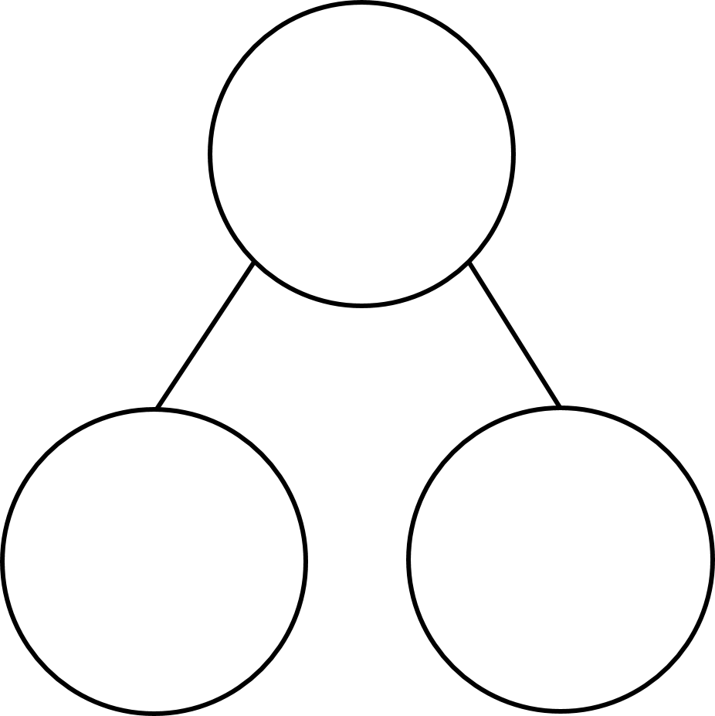
To work out 2,100 $÷$ 14
I can divide by 10 then divide by 4
2,100 $÷$
10
$÷$ 4$=$
2,100 $÷$ 40 $=$
14
1 and 14
14
10
4
2 and 7

Slide 15
To work out 2,100 $÷$ 14
I can divide by 10 then divide by 4
2,100 $÷$
7 $=$
300
$÷$ 2 $=$
150
1 and 14
14
2 and 7

Slide 16
Have a go at the questions in your book

Slide 17
Dora is calculating 5,440 $÷$ 32
Which method would give the correct answer?
5,440 $÷$ 4 $÷$ 8
5,440 $÷$ 16 $÷$ 16
4 $×$ 8 $=$ 32
16 $×$ 16 $=$
5,440 $÷$ 2 $÷$ 4 $÷$ 4
2 $×$ 4 $×$ 4 $=$ 32
Have a think

Slide 18
Calculate the value of b
8,060
a
a
a
a
b
b
b
b
b
8,060 $÷$ 4
$=$ a
$÷$ 5
$=$ b
20

Slide 19
Calculate the value of b
b $=$ 403
8,060
a
a
a
a
$=$ 403
b
b
b
b
b
8,060 $÷$ 10
$=$ 806
$÷$ 2
1 and 20
20
4 and 5
2 and 10

Slide 20
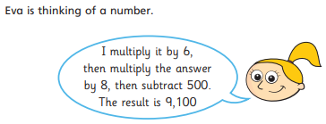
And finally…

