Slide 1
Michael Morpurgo
Slides 1-8 contain some background information you might like to read before our live session at 1:30.
The information tells us about Michael’s childhood, how he got into writing and where his inspiration comes from.
Slides 9 – 16 contain the information about our Butterfly Lion writing task
Enjoy!
☺

Slide 2
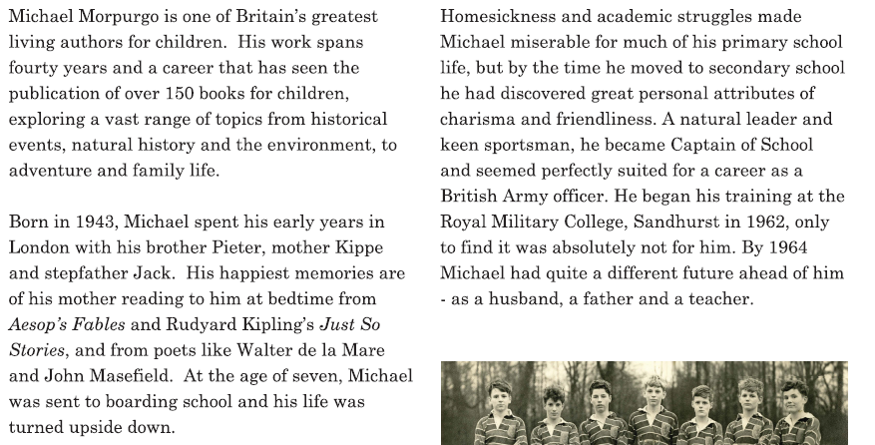
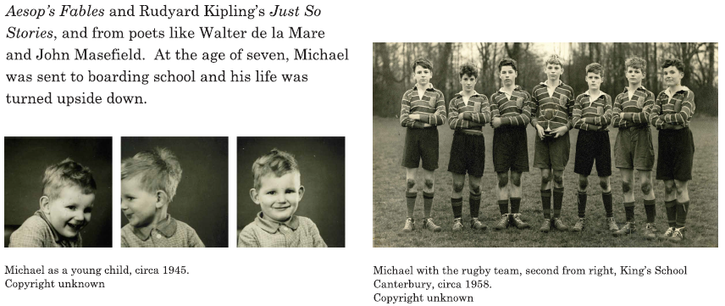

Slide 3
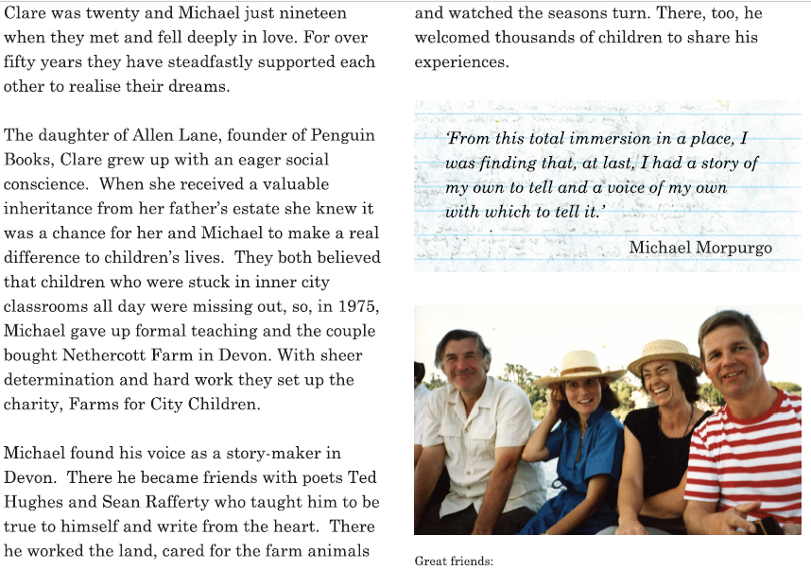

Slide 5
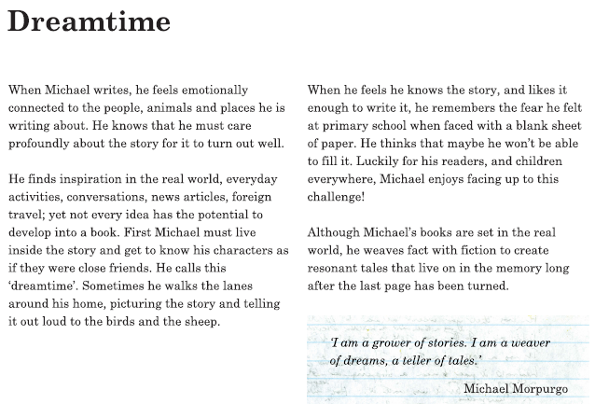

Slide 6
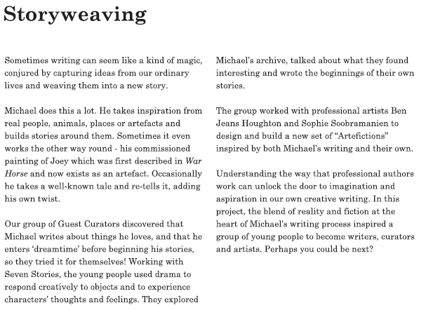

Slide 7
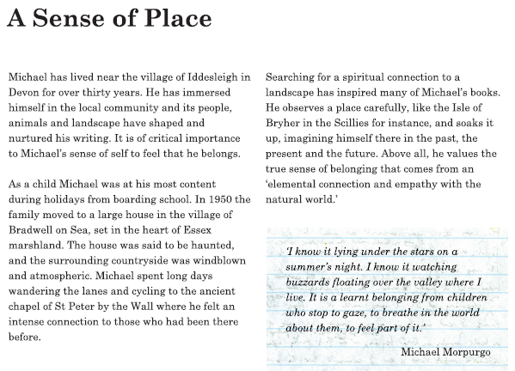

Slide 8
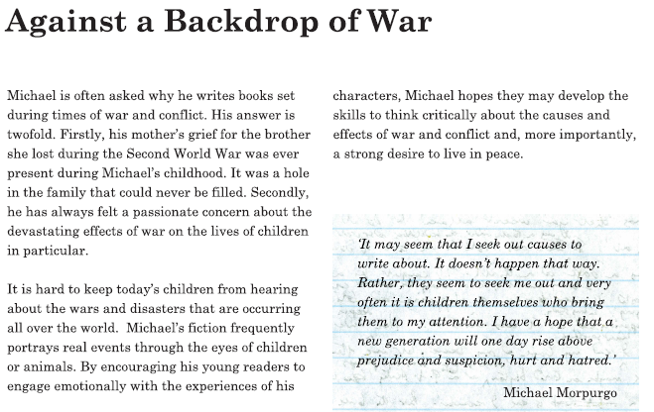

Slide 9
Teaching Resources – PowerPoint Presentation
presents
The Butterfly Lion

Slide 10
Kensuke’s Kingdom
I heard the wind above me in the sails. I remember thinking, this is silly, you haven't got your safety harness on, you haven’t got your lifejacket on. You shouldn't be doing this . . . I was in the cold of the sea before I could even open my mouth to scream.
Washed up on an island in the Pacific, Michael struggles to survive on his own. With no food and no water, he curls up to die. When he wakes, there is a plate beside him of fish, of fruit, and a bowl of fresh water. He is not alone…
The Butterfly Lion
‘All my life I'll think of you, I promise I will. I won’t ever forget you.’
Michael escapes from his strict boarding school and meets an old lady who lives nearby. She tells a remarkable story.
Bertie rescues an orphaned white lion cub from the African veld. They are inseparable until Bertie is sent to boarding school far away in England and the lion is sold to a circus. Bertie swears that one day they will see one another again, but it is the butterfly lion which ensures that their friendship will never be forgotten.

Slide 11
Kensuke’s Kingdom
I heard the wind above me in the sails. I remember thinking, this is silly, you haven't got your safety harness on, you haven’t got your lifejacket on. You shouldn't be doing this . . . I was in the cold of the sea before I could even open my mouth to scream.
Washed up on an island in the Pacific, Michael struggles to survive on his own. With no food and no water, he curls up to die. When he wakes, there is a plate beside him of fish, of fruit, and a bowl of fresh water. He is not alone…
Escape From School
I was still deciding which direction to take when I heard a voice from behind me.
“Who are you? What do you want?”
I turned.
“Who are you?” she asked again. The old lady who stood before me was no bigger than I was. She scrutinised me from under the shadow of her dripping straw hat. She had piercing dark eyes that I did not want to look into.
“I didn’t think it would rain,” she said, her voice gentler. “Lost, are you?”
Q: What do we know after reading the extract?

Slide 12
Kensuke’s Kingdom
I heard the wind above me in the sails. I remember thinking, this is silly, you haven't got your safety harness on, you haven’t got your lifejacket on. You shouldn't be doing this . . . I was in the cold of the sea before I could even open my mouth to scream.
Washed up on an island in the Pacific, Michael struggles to survive on his own. With no food and no water, he curls up to die. When he wakes, there is a plate beside him of fish, of fruit, and a bowl of fresh water. He is not alone…
Escape From School
I said nothing. She had a dog on a leash at her side, a big dog. There was an ominous growl in his throat, and his hackles were up all along his back.
She smiled. “The dog says you’re on private property,” she went on, pointing her stick at me accusingly. She edged aside my raincoat with the end of her stick. “Run away from that school, did you? Well, if it’s anything like it used to be, I can’t say I blame you.”
Q. What do we know after reading the extract?

Slide 13
Kensuke’s Kingdom
I heard the wind above me in the sails. I remember thinking, this is silly, you haven't got your safety harness on, you haven’t got your lifejacket on. You shouldn't be doing this . . . I was in the cold of the sea before I could even open my mouth to scream.
Washed up on an island in the Pacific, Michael struggles to survive on his own. With no food and no water, he curls up to die. When he wakes, there is a plate beside him of fish, of fruit, and a bowl of fresh water. He is not alone…
Exploring Vocabulary
She had a dog on a leash at her side, a big dog. There was an ominous growl in his throat, and his hackles were up all along his back.
Q: What does the word ominous mean? Why might Michael Morpurgo have chosen to use this word?

Slide 14
Kensuke’s Kingdom
I heard the wind above me in the sails. I remember thinking, this is silly, you haven't got your safety harness on, you haven’t got your lifejacket on. You shouldn't be doing this . . . I was in the cold of the sea before I could even open my mouth to scream.
Washed up on an island in the Pacific, Michael struggles to survive on his own. With no food and no water, he curls up to die. When he wakes, there is a plate beside him of fish, of fruit, and a bowl of fresh water. He is not alone…
The Butterfly Lion
‘All my life I'll think of you, I promise I will. I won’t ever forget you.’
Michael escapes from his strict boarding school and meets an old lady who lives nearby. She tells a remarkable story.
Bertie rescues an orphaned white lion cub from the African veld. They are inseparable until Bertie is sent to boarding school far away in England and the lion is sold to a circus. Bertie swears that one day they will see one another again, but it is the butterfly lion which ensures that their friendship will never be forgotten.

Slide 15
Writing Activity.
Read the paragraph below, then follow the instructions on the next slide.

Slide 16
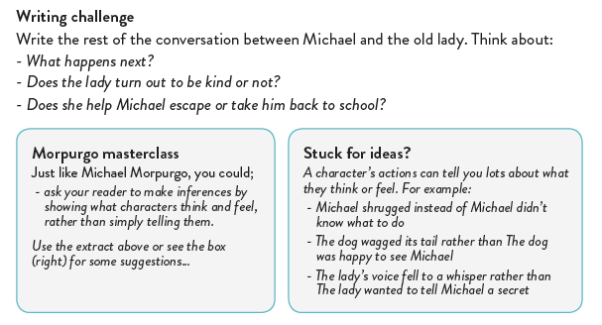
Think about the last line the lady says in the paragraph to help you with your ideas.
We look forward to seeing what you come up with!

Slide 17
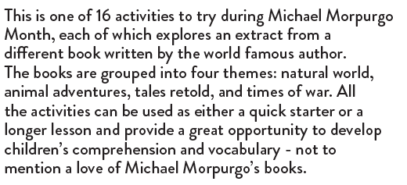
We know how many of you love Michael Morpurgo books.
This month is Michael Morpurgo Month!
If you would like to look at any other activities you can access them at https://www.michaelmorpurgo.com/morpurgomonth/

