Slide 1
12.1.2022
LO – I can use formal methods for multiplication (3 digit by 1 digit numbers).

Slide 2
Quick warm up questions:
Use the counting stick and practise the 11 x tables.

Slide 3
1) 2 × 2 =
2) 40 × 2 =
3) 2 × 300 =
4) 342 × 2 =

Slide 4
1) 2 × 2 =
2) 40 × 2 =
3) 2 × 300 =
4) 342 × 2 =
4
80
600
684

Slide 5
Starter: Hit the button. Ravenclaw and Slytherin against Gryffindor and Hufflepuff.
Good luck ☺

Slide 6
Hundreds | Tens | Ones
243
4 times
243 × 4 =
9
7
2

Slide 7
Have a think
Hundreds | Tens | Ones
150 × 3 =
450
I think the answer is 45

Slide 8
123 × 4 =
492
H | T | O
1 | 2 | 3
 |  | 4
Hundreds | Tens | Ones
$$×$$
1 2
(3 × 4)
8 0
(20 × 4)
$$+$$
4 0 0
(100 × 4)
4
9
2

Slide 9
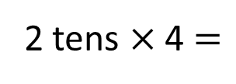
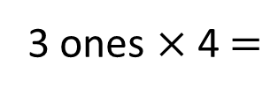
123 × 4 =
492
H | T | O
1 | 2 | 3
 |  | 4
Hundreds | Tens | Ones
$$×$$
4
9
2
1
3 ones × 4 $=$
12 ones
2 tens × 4 $=$
8 tens
8 tens + 1 ten $=$
9 tens
1 hundred × 4 $=$
4 hundreds

Slide 10
Now try and answer the following 8 questions in your book.
1) 136 x 3 5) 243 x 6
2) 304 x 3 6) 189 x 7
3) 427 x 4 7) 538 x 8
4) 369 x 5 8) 428 x 9

Slide 11
103 × 4 =
412
H | T | O
1 | 0 | 3
 |  | 4
3 × 4 =
12
0 × 4 =
0
100 × 4 =
400
$$×$$
Hundreds | Tens | Ones
4
1
2
1
103
100
3
0

Slide 12
153 × 7 =
1,071
 | H | T | O
 | 1 | 5 | 3
 |  |  | 7
Th
3 × 7 = 21
50 × 7 = 350
$$×$$
100 × 7 = 700
1
0
7
1
153
3
2
5 tens × 7 = 35 tens
100
3
50
35 tens + 2 tens = 37 tens
1 hundred × 7 = 7 hundreds
7 hundreds + 3 hundreds = 10 hundreds

Slide 13
Let’s look at this question together.

Slide 14
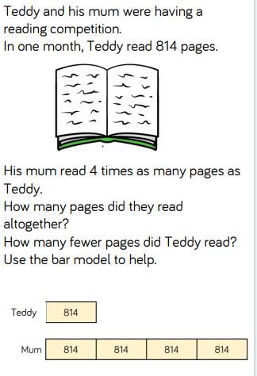
Challenge.

