Slide 1
Forces and Magnets
This half term, our science topic is:

Slide 2
LO: To know how we can show and measure contact forces.
LO: To predict using cause & effect.

Slide 3
Vocabulary
force push pull contact force
distance force gravity force arrow
movement (associated terminology) magnetic magnetism poles (north, south) attract repel non-magnetic
These are some of the words we will be using over the course of the unit.

Slide 4
What do you think a contact force is?
A force that acts between two objects that are physically touching.

Slide 5
Can you think of anything that you do that uses contact forces?

Slide 6
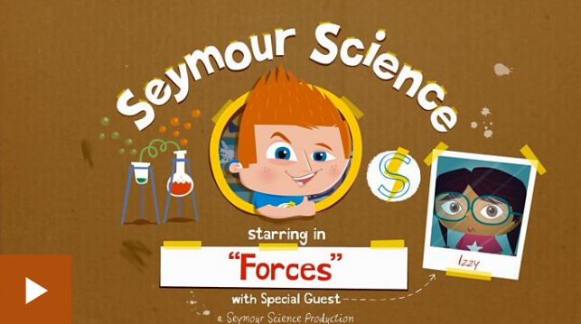
Let’s watch this short video to find out more.

Slide 7
Now we are going to have a go at using contact forces.
Face your partner and hold hands. Carefully lean backwards. Don’t let go.
Are you using a push or a pull?

Slide 8
What do you think would happen if one partner pulled harder than the other?
Safety: You need to do this activity sensibly and carefully so that no-one falls.
Decide who is going to pull harder and then carefully have another go. What happened? Why do you think this happened?
Swap roles.

Slide 9
On the next two slides are some activities for school learners and home learners. All learners should:
BEFORE: say what you think might happen.
AFTER: say what actually happened.
WHY: can you explain why?

Slide 10
This is a force meter. It measures force.
We are going to hang the force meter between two tables. Then we are going to hook to different items to the force meter. What do you think will happen? How much pull force do the different items exert?
Note the number of newtons (N) shown on the meter’s scale.
(Home learners – see next slide)

Slide 11
Home learners
Have a go at some contact force activities at home. You could get some ideas from the video we watched.
What happens to the object if you pull or push harder?
What happens to the object if you pull or push more gently?

Slide 12
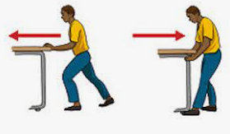
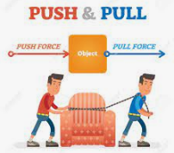
Then, draw a science model to show what has happened using force arrows. Remember a bigger force is represented by a bigger arrow and a smaller force is represented by a smaller arrow. Always write push or pull above your arrow and make sure the arrow is facing the correct direction (the direction of the force).
Can you write what has happened and why?

Slide 13
Tell your partner 3 things you have learnt about contact forces.

