Slide 1
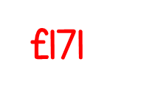
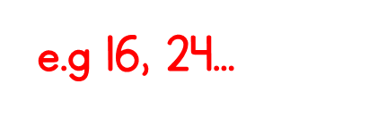
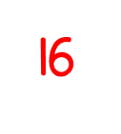
Year 5 | Week 2 | Day 3

Slide 4
1) 1 × 415 =
2) 100 × 415 =
3) 200 × 415 =
4) 415 × 201 =

Slide 5
415
1) 1 × 415 =
2) 100 × 415 =
3) 200 × 415 =
4) 415 × 201 =
41,500
83,000
83,415
415 × 200 + 415 × 1

Slide 7
2,313 $×$ 32 =
Have a think
TTh | Th | H | T | O
 | 2 | 3 | 1 | 3
 |  |  | 3 | 2
$$×$$
4
6
2
6
2,313
2
$($_____ $×$ __$\text{_})$
$$+$$
$($_____ $×$ __$\text{_})$

Slide 8
2,313 $×$ 32 =
74,016
TTh | Th | H | T | O
 | 2 | 3 | 1 | 3
 |  |  | 3 | 2
$$×$$
4
6
2
6
2,313
2
$($_____ $×$ __$\text{_})$
6
9
3
9
0
2,313
30
$$+$$
$($_____ $×$ __$\text{_})$
7
4
0
1
6
1
1
1

Slide 9
Let’s consider what that calculation would look like using the area method.
2,313 $×$ 32 =
$$×$$
2,000
300
10
3
30
60,000
9,000
300
90
2
4,000
600
20
6
60,000 + 9,000 + 4,000 + 600 + 300 + 90 + 20 + 6 =
74,016

Slide 10
6,324 $×$ 33 =
208,692
Have a think – try this one in your books. Do you notice anything as you do it?
 | TTh | Th | H | T | O
 |  | 6 | 3 | 2 | 4
 |  |  |  | 3 | 3
$$×$$
1
8
9
7
2
6,324
3
$($_____ $×$ __$\text{_})$
1
1
$$+$$
1
8
9
7
2
0
6,324
30
$($_____ $×$ __$\text{_})$
1
1
2
0
8
6
9
2
1
1
1

Slide 11
4,145 $×$ 52 =
215,540
Have a think – try this one in your books as well
 | TTh | Th | H | T | O
 |  | 4 | 1 | 4 | 5
 |  |  |  | 5 | 2
$$×$$
2
0
4,145
2
8
9
$($_____ $×$ __$\text{_})$
1
2
0
7
2
5
0
4,145
50
$$+$$
$($_____ $×$ __$\text{_})$
2
2
2
2
1
5
5
4
0
1
1

Slide 12
Can you spot the three errors?
Have a think
 | TTh | Th | H | T | O
 |  | 5 | 4 | 0 | 2
 |  |  |  | 2 | 4
 | 2 | 1 | 6 |  | 8
$$×$$
4
0
5,402
4
$($_____ $×$ __$\text{_})$
2
1
0
0
2
4
$$+$$
1
0
8
5,402
20
$($_____ $×$ __$\text{_})$
1
3
2
4
7
2
2
9
6
4
8

Slide 13
Have a go at the questions on the worksheet – copy them into your book

