Slide 1
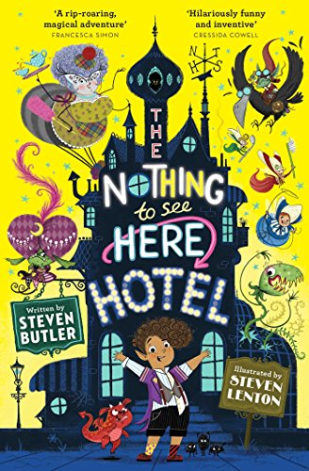
The Nothing To See Here Hotel
https://www.lovereading4kids.co.uk/login?redirect=extract/14969/The-Nothing-to-See-Here-Hotel-by-Steven-Butler.html
Steven Lenton and Steven Butler
To the end of Page 13

Slide 2
Quick Start
What type of creature is Granny?
What is the name of the narrator?
What was his Grandad called?

Slide 3
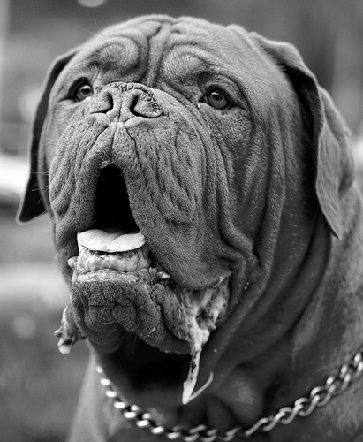
Vocabulary Check
sweet or short dumplings of fun
slobbering as she did so
right out at the far end of the seafront
searching for weird and exotic things
Regurgita Glump

Slide 4
Partnered Talk
Why do you think the author talks about the big bad wolf when introducing Granny?

Slide 5
Individual Thinking
How does the author want the reader to feel about Granny? How do you know? What words does he use?

Slide 6
Individual Thinking
‘You’re probably thinking that I’ve had my brains scrambled or I’m loop de loop crazy’
Why might Frankie expect the reader to think he’s crazy?

Slide 7
Partnered Talk
Look at Page 13.
Why does the author put some of the words in capital letters?

Slide 8
Solo Work
A big, mean troll that can eat people should be scary, but this story does not seem scary.
Why do you think it doesn’t seem scary?

