Slide 1
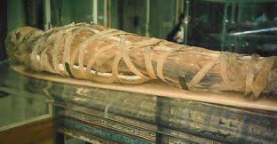
Mummification!
Year 4 become Ancient Egyptian embalmers… Yuck!

Slide 2
Equipment
Here is a list of things that will help you:
Tomatoes
Antibacterial hand gel (containing alcohol)
Natron (Table salt and bicarbonate of soda)
Kitchen towel
Containers
Knives
Spoons
Weighing scales

Slide 3
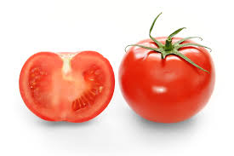
Step One
Look at your dead body (tomato)
What does it look like? (colours, shine, skin etc)
What does it smell like?
How does it feel?
Make notes in your topic book; you can draw a picture if you wish!

Slide 4
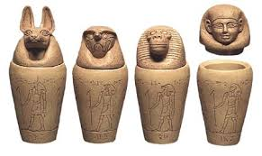
Step Two
Make a small incision in the body (tomato) using a knife and scoop out the seeds inside using a spoon.
We can throw these bits away (but the ancient Egyptians would store the lungs, liver, stomach and guts in canopic jars.)

Slide 5
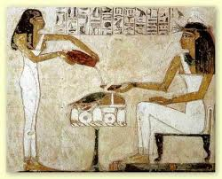
Step Three
Rub your body (tomato) inside and out with the alcohol (antibacterial hand gel) using kitchen towel. This will kill any nasty germs that may be lurking inside the body.

Slide 6
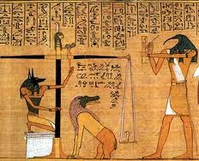
Step Four
Weigh your mummy. This is its pre-mummification weight.
Be sure to make a note of this weight; we will need this weight later on!

Slide 7
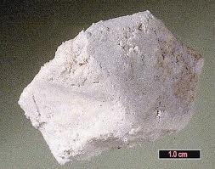
Step Five
Next, pack the body (tomato) with a special salt called Natron. (an equal mix of table salt and bicarbonate of soda)
Place your stuffed body inside a container also filled with Natron.

Slide 8
Now we wait!
Ancient Egyptians would have to wait 70 days to be able to complete their mummification process, but we are going to wait for one week.
What do you think will happen to the body (tomato)?

Slide 9
Science time!
All good scientists have to write down their methods and findings.
In your English books, write down your pre mummification weight, your method, and your predictions for what you think will happen to our mummies.

