Slide 1
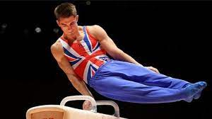
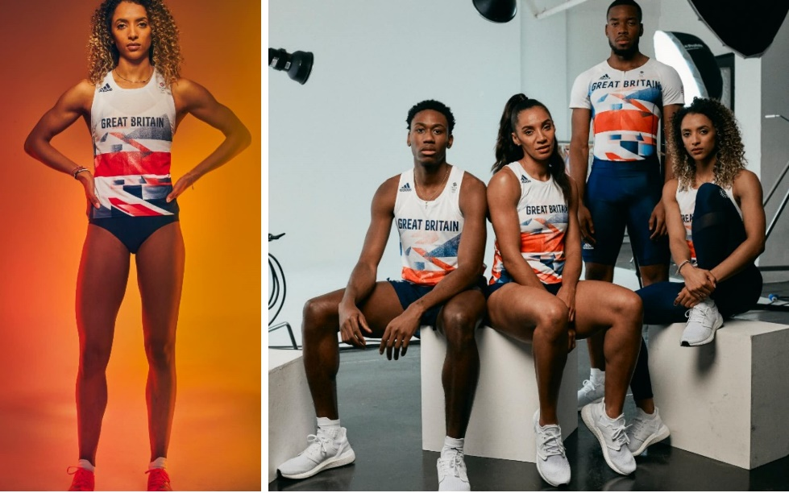

Slide 2
Can you remember the name of the author who wrote this book?

Slide 3
Kate Hale

Slide 4
During the workshop last Tuesday,
Kate spoke about how she was
inspired to find out facts and then link one fact to another.
It was fascinating to hear how she linked giraffes, to the Eiffel Tower to glitter.

Slide 5
As you probably know by now the Tokyo Olympics start on Friday 23rd July.
This enrichment week is all about the Olympics. As we are learning so many facts about the Olympics (past and present), I thought it would be a good idea to try and create some fact pages that include an Olympic fact.

Slide 6
Here are some pages from Kate’s book. Look how she connected one fact to another.
Your page could start with an Olympic fact, or have an Olympic fact in the middle or even as the last fact on the page!

Slide 7
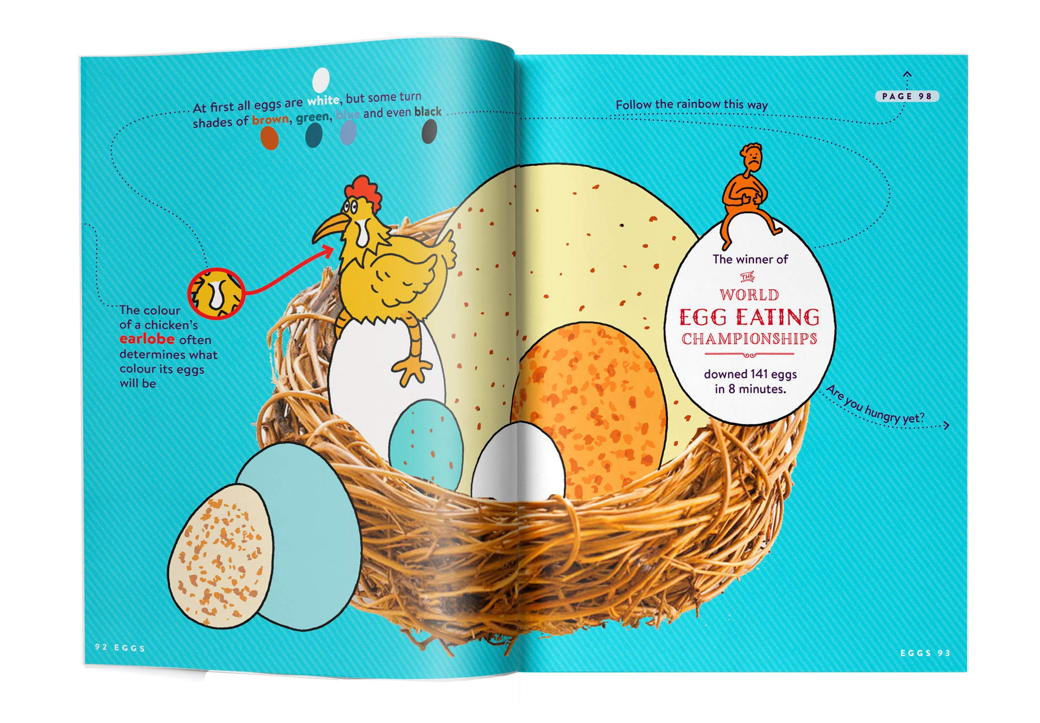

Slide 8
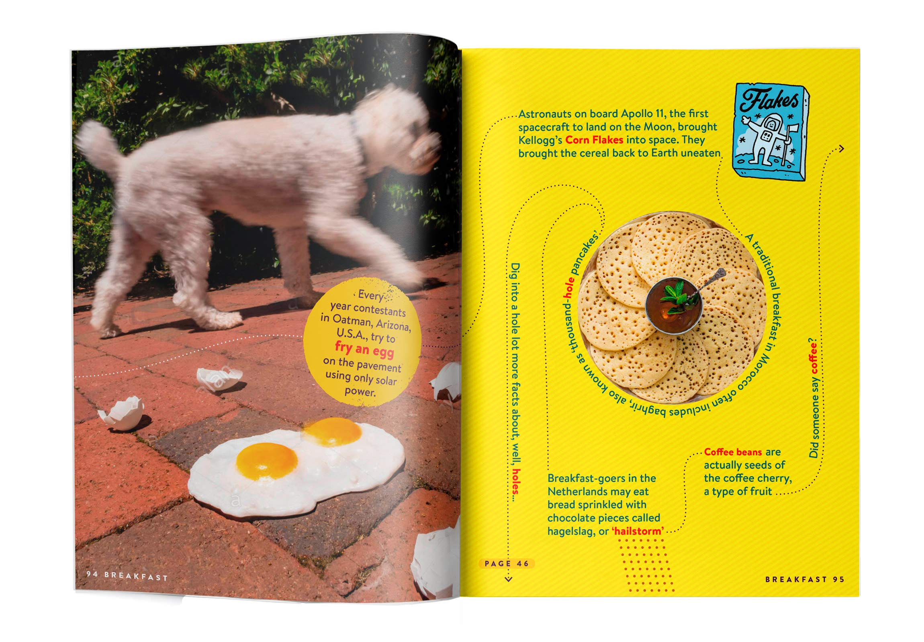

Slide 9
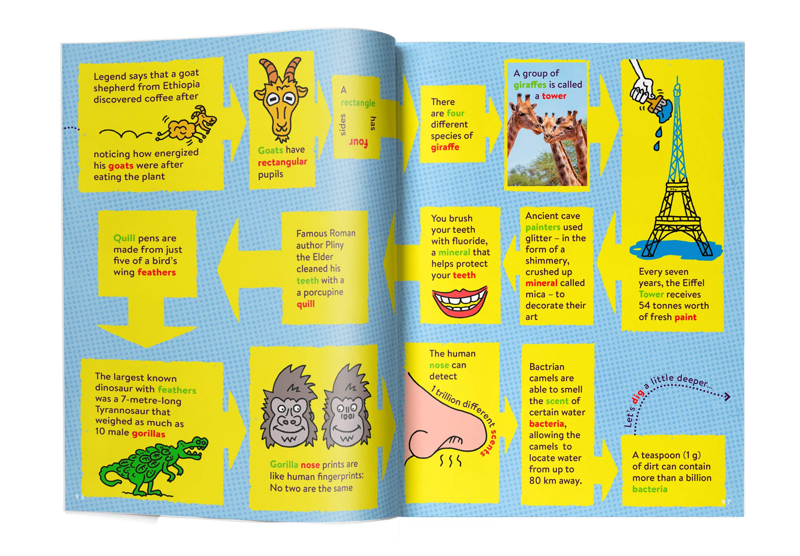

Slide 10
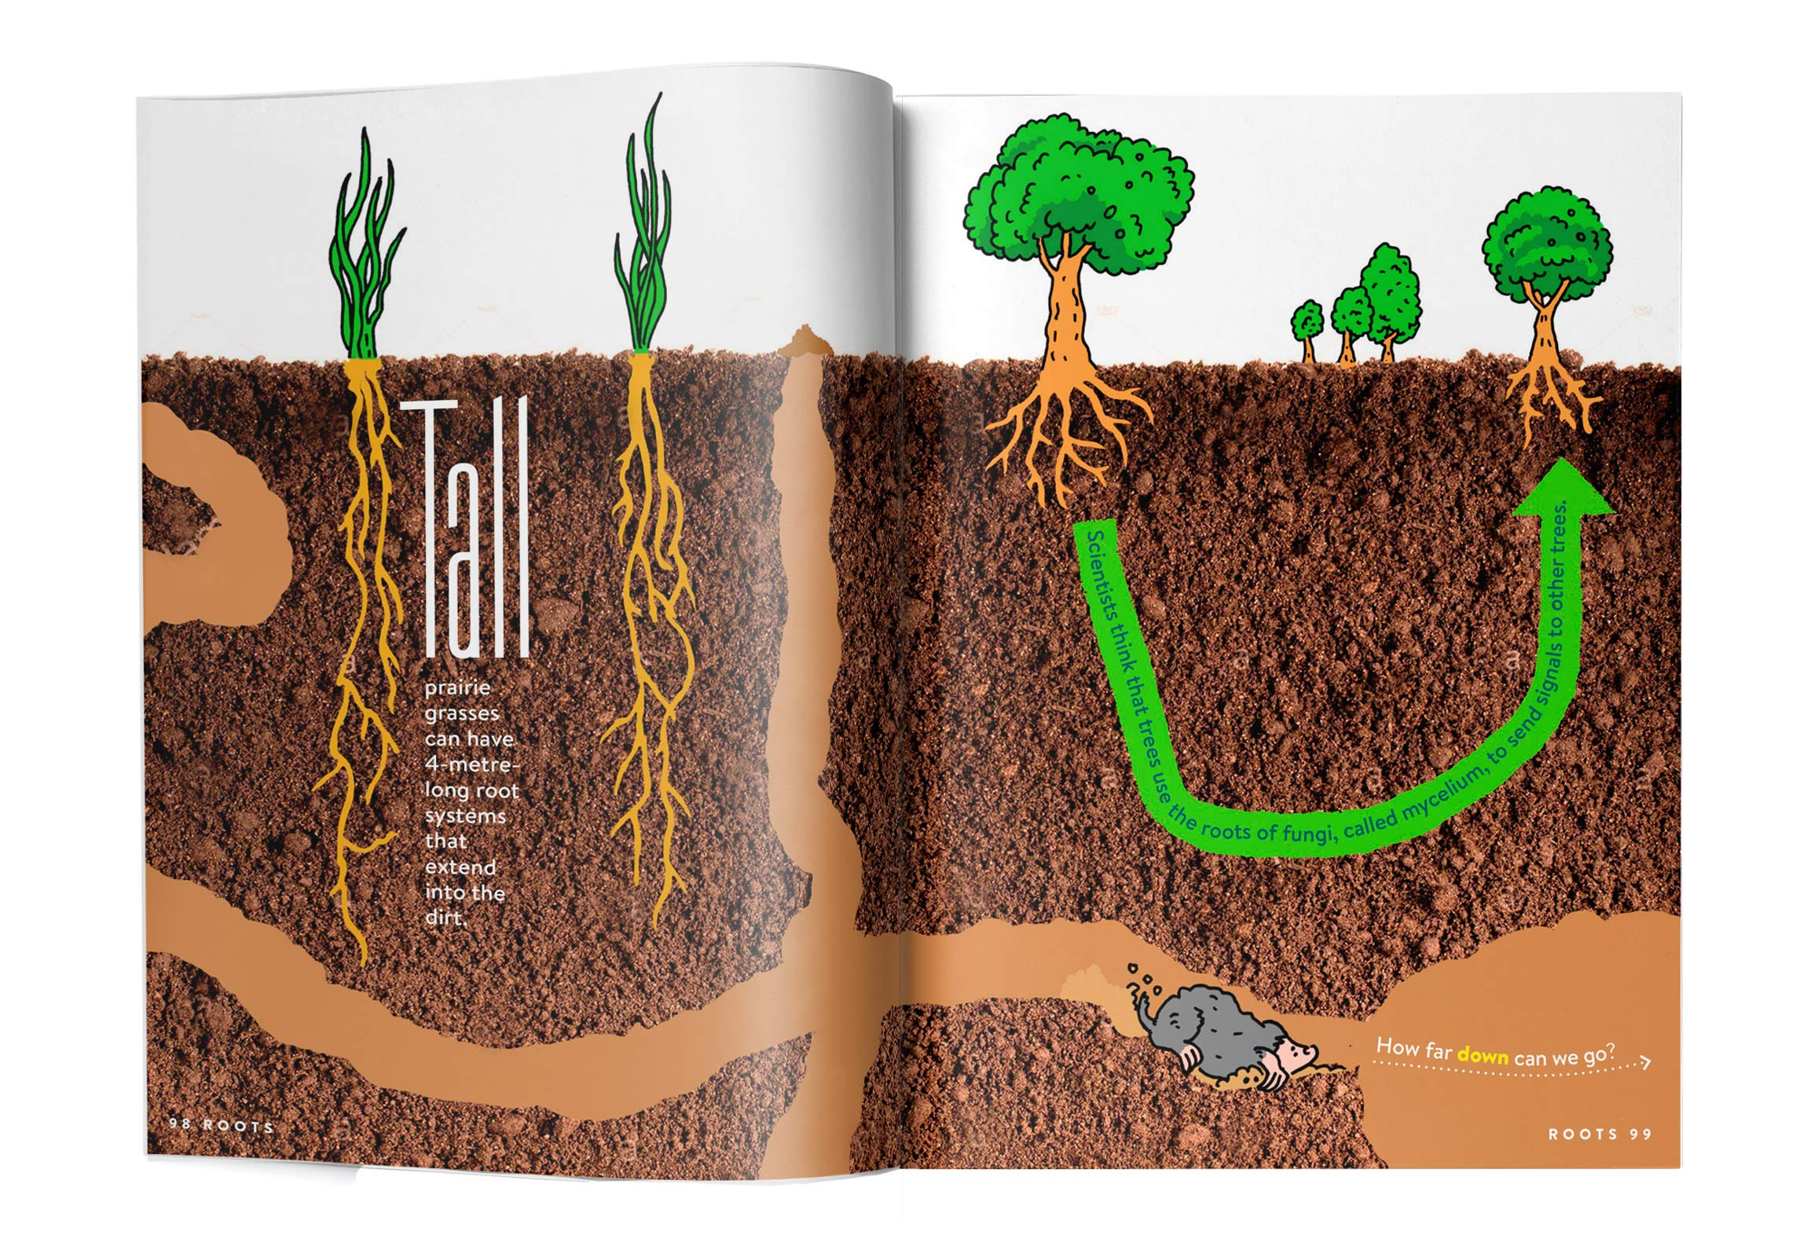

Slide 11
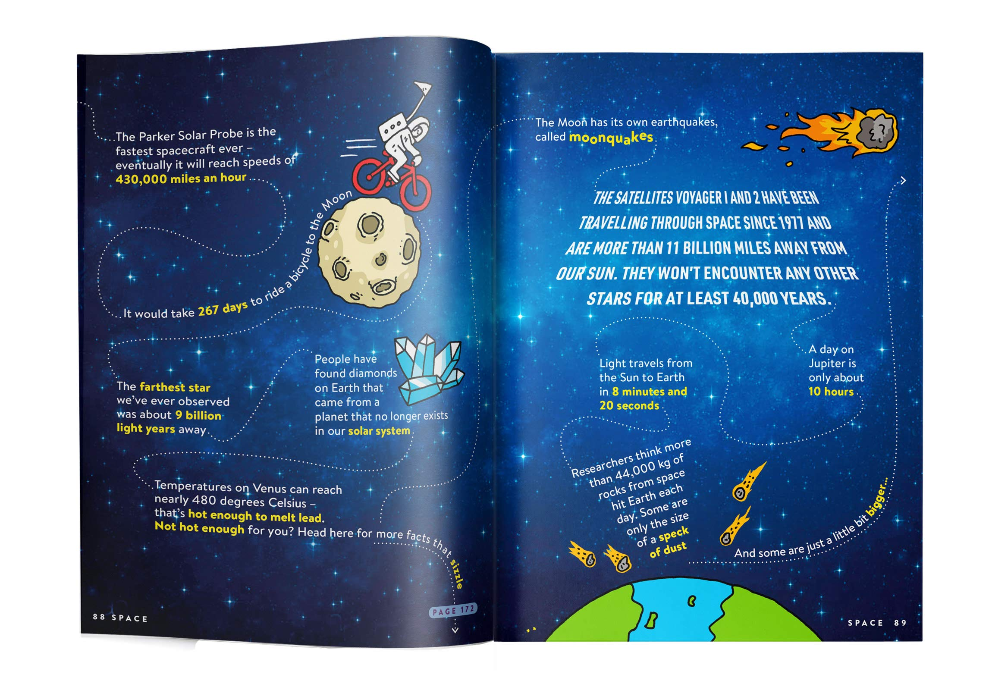

Slide 12
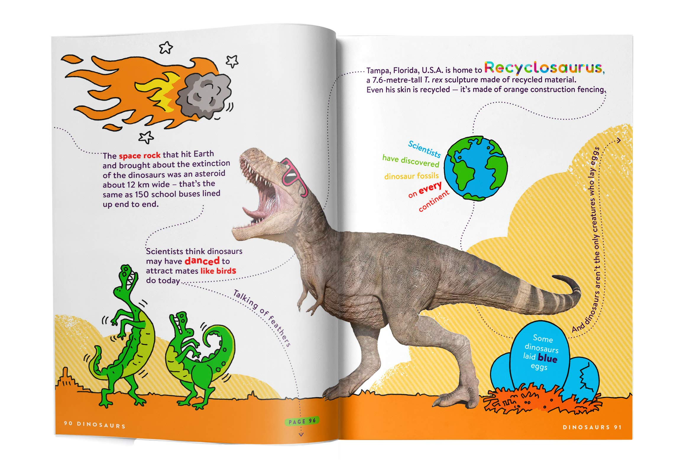

Slide 13
Hopefully, these pages have inspired you to think about your fact page.
You can work independently or with a partner.
You must verify your facts (check that they are true).
Try to link at least 4 facts, but you can do more.
Once you have linked facts, you then need to think of the presentation of these facts. What illustrations are you going to include? This is an ongoing task. We will have this session and then you can complete it whenever you have time this week. Let’s see if we can make a class ‘Factopia’ book.

