Slide 1
7.12.21
L.O.- I can multiply and divide by 7.

Slide 2
30 $+$ 12 $=$ 15 $+$ 6 $=$ 45 $+$ 18 $=$
5 $×$ 9 $=$ 2 $×$ 9 $=$
5 $×$ 6 $=$ 2 $×$ 6 $=$
35 $+$ $=$ 42
Double 21

Slide 3
30 $+$ 12 $=$ 15 $+$ 6 $=$ 45 $+$ 18 $=$
5 $×$ 9 $=$ 2 $×$ 9 $=$
5 $×$ 6 $=$ 2 $×$ 6 $=$
35 $+$ $=$ 42
Double 21
42
21
63
45
18
30
12
7
42

Slide 4
Today we are going to be learning our 7 times tables.
Let’s put the multiples of 7 on our metre stick, write them on our whiteboard and chant them together.
Then, we will watch this video and try to join in with the answers.
https://www.youtube.com/watch?v=WdF_vFAxwas

Slide 5
Complete the sentences.
4
There are ____ heptagons.
Each heptagon has ____ sides.
There are ____ sides altogether.
7
28

Slide 6
Complete the missing numbers.
4
There are ____heptagons.
Each heptagon has ____ sides.
There are ____ sides altogether.
7
28
7
28
$+ + + =$
7
7
7
$× =$
4
7
28
$× =$
7
4
28

Slide 7
7 $×$ 4 $=$ 28
4 $×$ 7 $=$ 28
28 $÷$ 4 $=$ 7
28 $÷$ 7 $=$ 4

Slide 8
28
7
7
7
7
7 $×$ 4 $=$ 28
7
28 $÷$ 4 $=$
4 $×$ 7 $=$ 28
4
28 $÷$ 7 $=$

Slide 9
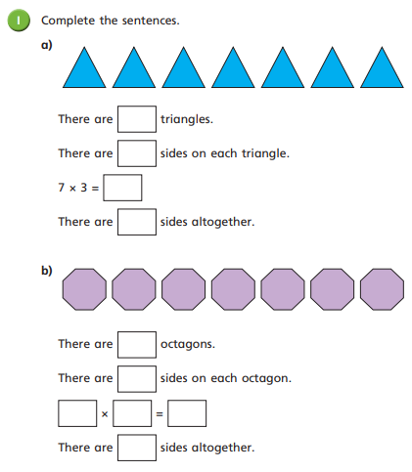
Complete question 1 on your worksheet.

Slide 10
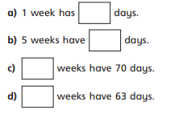
Copy and complete these sentences in your book.

Slide 11
I don’t know my 7 times-table yet, I’ve only learnt up to my 5 times-table
4
10
14
So I can add 5 lots and 2 lots together
Don’t worry, you can use those to help you. Watch…
7 $×$ 2 $=$
14
5 $×$ 2 $=$
10
2 $×$ 2 $=$
4
10 $+$ 4 $=$
14

Slide 12
So I can add 5 lots and 2 lots together
Don’t worry, you can use those to help you. Watch…
7 $×$ 3 $=$
7 $×$ 2 $=$
14
21
5 $×$ 2 $=$
5 $×$ 3 $=$
10
15
2 $×$ 2 $=$
2 $×$ 3 $=$
4
6
10 $+$ 4 $=$
15 $+$ 6 $=$
14
21

Slide 13
You could also subtract 7 from 70 like when we looked at the 9 times-table
You could also have done
5 $×$ 7 plus 1 $×$ 7
So I can add 5 lots and 2 lots together
Have a think
7 $×$ 9 $=$
7 $×$ 6 $=$
63
5 $×$ 9 $=$ 45
45 $+$ 18 $=$ 63
2 $×$ 9 $=$ 18
42
5 $×$ 6 $=$ 30
30 $+$ 12 $=$ 42
2 $×$ 6 $=$ 12

Slide 14
42 $÷$ 7 $=$
6
Have a think
I know that 35 $÷$ 7 is 5
7
5
35
6
42

Slide 15
42 $÷$ 7 $=$
6
Have a think
I know that 35 $÷$ 7 is 5
I know that 21 $÷$ 3 is 7
7
3
21
6
42
3
21

Slide 16
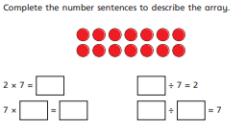
Complete question 2 on your worksheet. If you finish, complete an example of your own.

Slide 17
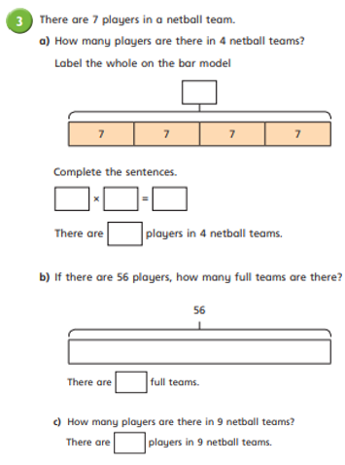
Finish the questions on your worksheet.

Slide 18
Now, we will all be given a card with a 7x table multiplication fact on. We will try to get around the class as quickly as we can by answering each others questions.
Then, we will play multiplication bingo but today with our 7’s.
Again, if you have a correct call you can move up the star chart.
Then, we have a 7x tables space race if you want to take the challenge.

