Slide 1
Thought for the Day – Background information for Adults.
Collective worship in schools aims to provide the opportunity for pupils to worship God, to consider spiritual and moral issues and to explore their own beliefs; to encourage participation and response, whether through active involvement in the presentation of worship or through listening to and joining in the worship offered; and to develop community spirit, promote a common ethos and shared values, and reinforce positive attitudes. Collective worship allows time for personal reflection and prayer.
Acts of collective worship may include exploring an idea or theme, hearing quotes from an individual or a story about someone’s life and their impact in the world, for example. It gives opportunities for pupils to reflect on a diverse range of world views, religious and otherwise. Collective acts of worship can contain some elements which relate specifically to the Christian religion, and, where appropriate, address the special status accorded to Jesus, but when such material is shared with non-Christian pupils it is shared in a spirit and in a manner which is educational in intent. In other words, pupils are informed that Christians believe that Jesus is the Son of God. Christians who attend the act of collective worship might be afforded an opportunity to worship him. However, whilst non-Christian pupils will not be required to worship Jesus, they shall be invited, to encourage the feeling of community, to reflect in silence on what they have heard.

Slide 2
Taken from a Save the Children Document

Slide 3
Chinese New Year
Monday
This year, Chinese New Year will be celebrated tomorrow, the first of February.
https://www.bbc.co.uk/cbeebies/watch/chinese-new-year
Watch -Preparing for Chinese and Lunar New Year

Slide 4
Chinese New Year
Tuesday
This year, Chinese New Year will be celebrated today, the first of February.
https://www.bbc.co.uk/cbeebies/watch/chinese-new-year
Watch -Celebrating Chinese and Lunar New Year

Slide 5
Chinese New Year
Wednesday
https://www.bbc.co.uk/cbeebies/watch/chinese-new-year
Watch -Chinese and Lunar New Year Story

Slide 6
Chinese New Year
Thursday
https://www.chroniclelive.co.uk/whats-on/whats-on-news/gallery/30-fabulous-photos-chinese-new-17638356
Look at photographs of the Chinese New Year celebrations 2020 – The Year of the Rat – held in Newcastle.

Slide 7
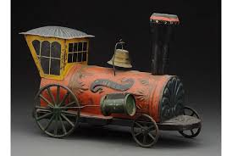
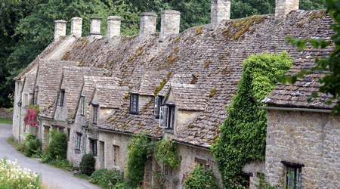
Friday
Whole School Focus:
Old and New,
Chinese New Year
What does the word ‘old’ mean?
Can you think of something that is ‘old’?
(trees, hills, rivers, house, castle, an old book/toy/picture at home, War Medals, Grandparents….)
What does the word ‘new’ mean?
Can you think of something ‘new’?
(Snowdrops/flowers/annual plants, house, a new items at home- sofa, kitchen, toy, Puppy, baby…)

Slide 8
Friday
What do you like about working from home or at school?
What have you learned this week?
Have you helped someone else to learn?
Ask the children to listen to our school prayer.
You might like to change the word ‘school’ to ‘home’,
if you have been at home this week.
Remind the children that
Amen means- “I agree”
The children might like to say “Amen” at the end.
Our School Prayer.
God bless our school.
Bless those who teach,
Bless those who learn,
Bless us with knowledge.
Amen.

