Slide 1
Stuart Little
EB White
Up to ‘said the doctor cheerfully, as he left’
https://www.lovereading4kids.co.uk/book/10147/Stuart-Little-by-E-B-White.html

Slide 2
Quick Start
What was strange about Stuart?
What is Stuart’s surname?
What three things does Stuart keep in his pockets?

Slide 3
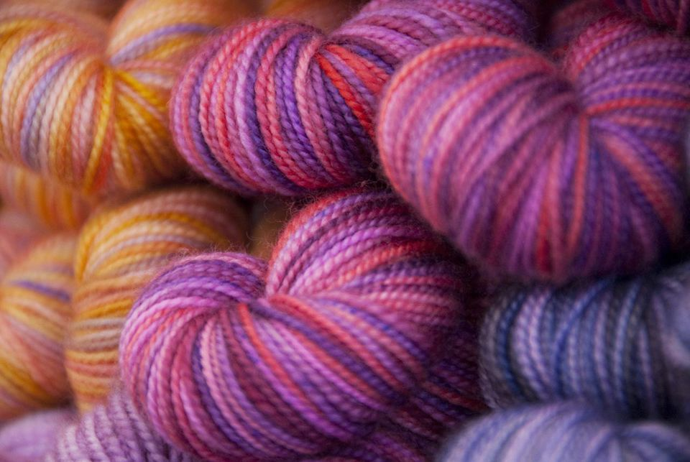
Vocabulary Check
carrying a small cane
he could climb lamps by shinnying up the cord
made him a worsted suit
his handkerchief
looked into his ears solemnly

Slide 4
Individual Thinking
When Mrs Frederick C. Little’s second son arrived, everybody noticed that he was not much bigger than a mouse.
Why do you think everyone noticed this?

Slide 5
Partnered Talk
The Littles don’t seem at all bothered that Stuart is a mouse.
What does this tell us about them?

Slide 6
Partnered Talk
‘the pleasant, shy manner of a mouse’
Why do you think the author describes mice as pleasant and shy?

Slide 7
Individual Thinking
“Feed him up!” said the doctor.
What does this mean?
How would Stuart benefit from being ‘fed up’?

Slide 8
Solo Work
Choose one word to describe the Little family and explain your choice of word.

