Slide 1
Light
This half term, our science topic is:

Slide 2
LO: To know what light is and where it comes from.
LO: To begin to use a science model to describe.

Slide 3
Vocabulary
light dark/darker/darkest bright/brighter/brightest dim
light source (various) eye reflect reflective shiny dull shadow
block (transparent, opaque)
These are some of the words we will be using over the course of the unit.

Slide 4
Where do you think light comes from?

Slide 5
Light sources
A source of light makes light. The Sun and other stars, fires, torches and lamps all make their own light and so are examples of sources of light.

Slide 6
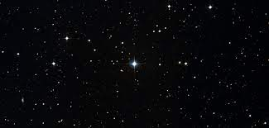
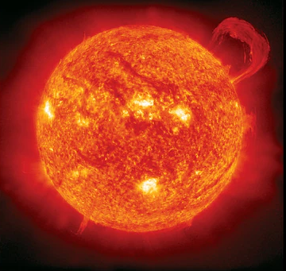
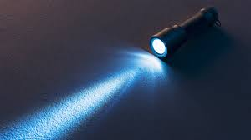
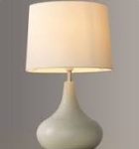
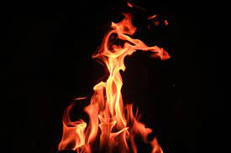
Light sources
A source of light makes light. The Sun and other stars, fires, torches and lamps all make their own light and so are examples of sources of light.

Slide 7
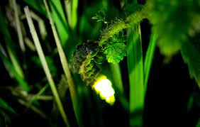
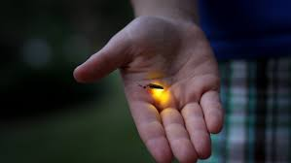
Some animals, such as fireflies and glow-worms, are light sources. They make their own light to attract mates.

Slide 8
Can you think of any other light sources?

Slide 9
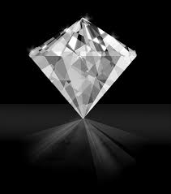
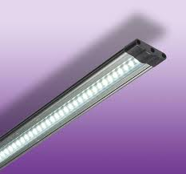
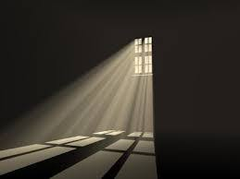
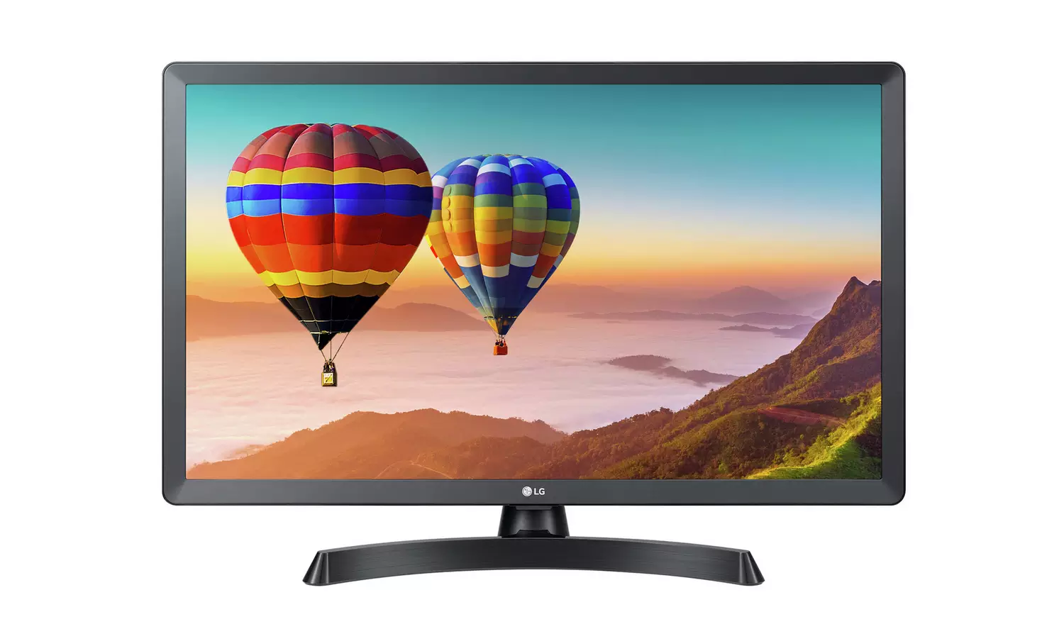
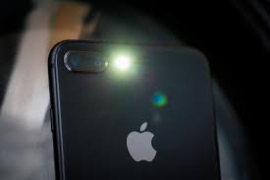
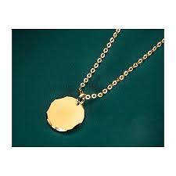
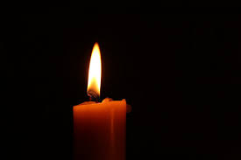
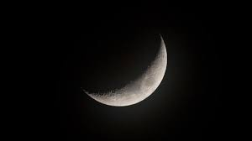
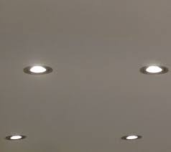
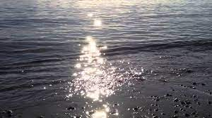
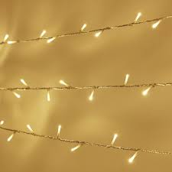
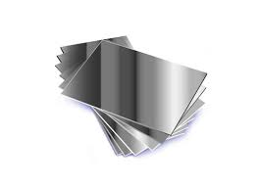
Can you sort the pictures with your partner? Write your answers on your whiteboard.
light source not a light source

Slide 10
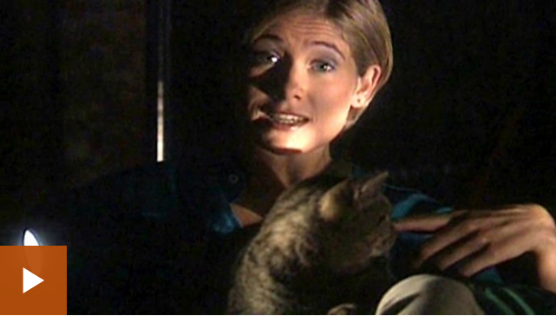
A light source is required to see objects.

Slide 11
Do you want to move any of your answers? Can you explain why?
light source not a light source

Slide 12
Check your answers. Are there any that surprise you?
light source not a light source

Slide 13
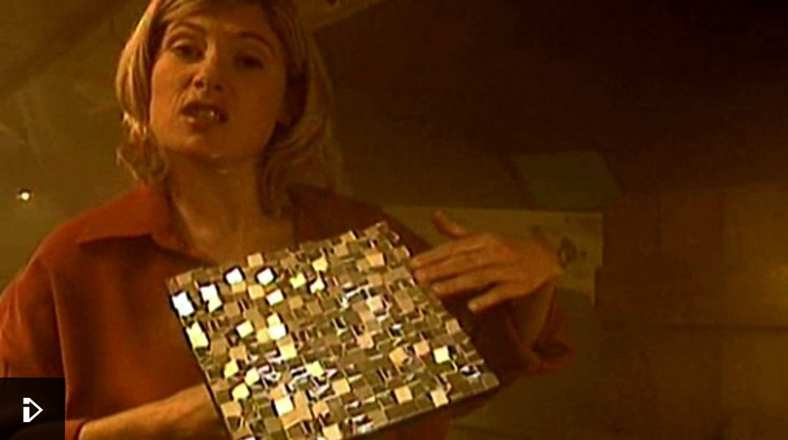
Light travels in a straight line.

Slide 14
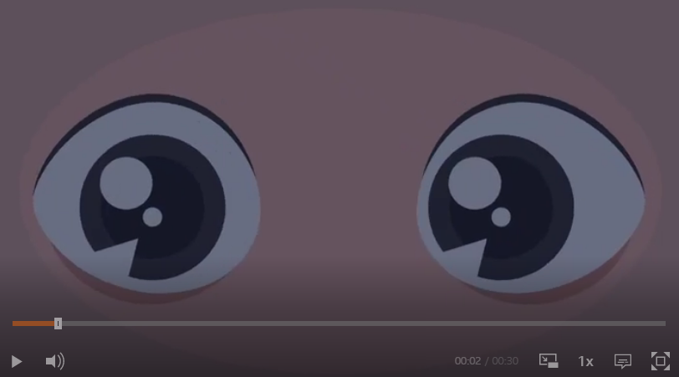
How do our eyes detect light?

Slide 15
Light travels in straight lines. When light hits an object, it is reflected (bounces off) and enters our eyes. This is how we see the object.

Slide 16
Science model to describe how we see

Slide 17
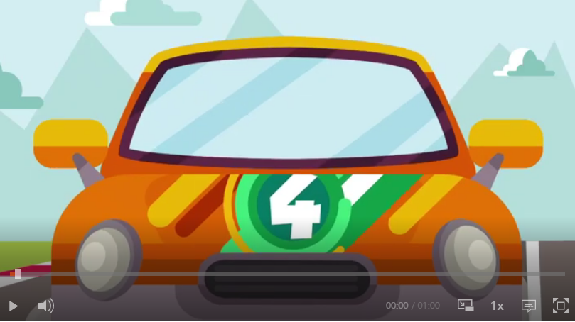
Fascinating fact alert!

Slide 18
Tell your partner 3 things you have learnt about light.

