Slide 1
Thursday 27th January 2022
LO: To write instructions for how to build a junk model robot

Slide 2
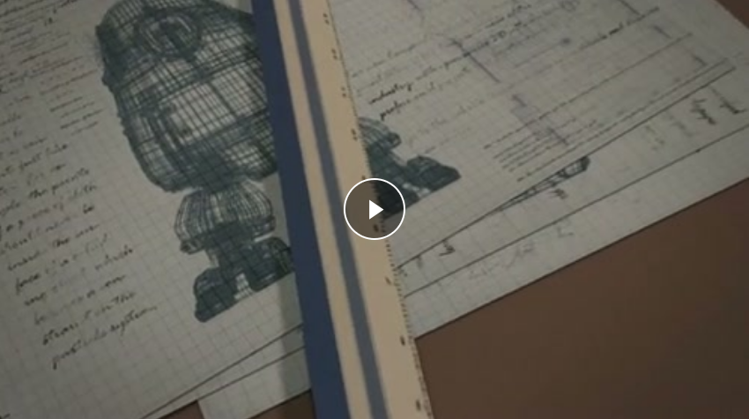
Let’s watch the clip again.
Girl and Robot

Slide 3
What can you remember about writing instructions?

Slide 4
Today’s task
Write instructions for how to build a junk model robot.
On the next slide are some images of junk model robots to give you some ideas.

Slide 5
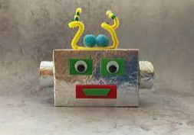
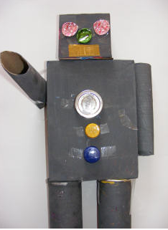
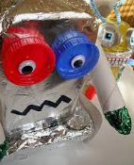
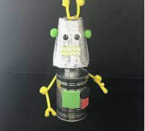

Slide 6
Vocabulary
First Next Then After that Finally
carefully slowly gently immediately
fold bend stick cover place put

