Slide 1
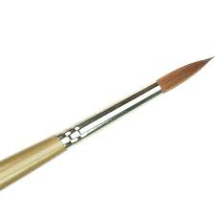
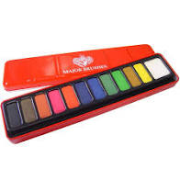
Art

Slide 2
Botanical Art
Last week, we started learning about botanical art. We went outside to draw plants and flowers just using our lead pencils. We looked at the plants very carefully and included a lot of detail.
We are going to continue this week by doing some more plant or flower illustrations, but this time we will use colour.
First of all, let’s have a quick recap…

Slide 3
Vocabulary:
Botany - the scientific study of plants
Botanical - something that is related to botany
Botanical artist - someone who records and documents the details of plants by drawing and painting them.

Slide 4
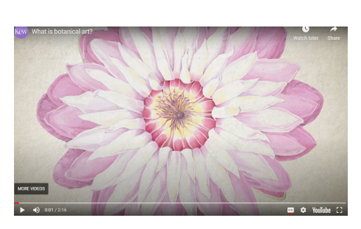

Slide 5
This is Yvonne Marie Arnsdorf.
She is a botanical artist from the UK. She won the Royal Horticultural Society Gold Medal for her art.

Slide 6
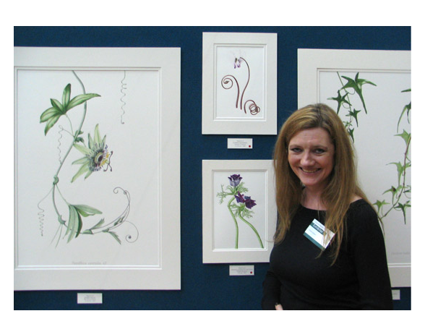
She has looked at plants very carefully before painting them.
She has worked very neatly and precisely.
She will have spent a lot of time on each painting.

Slide 7
Can you find a plant outside? Remember if you are isolating, this will have to be from your own garden or window box, or it could be a house plant.
Look at it very carefully. What details can you see? You might want to take a photo so that you can zoom in to see more detail.
Can you draw the plant very lightly with a pencil. Then carefully add some colour with paint or coloured pencils. Take your time, don't rush. Keep looking back at the plant or photo so that you are drawing or painting what you see.
Have a look at the next couple of slides to see some more examples of botanical art.

Slide 8
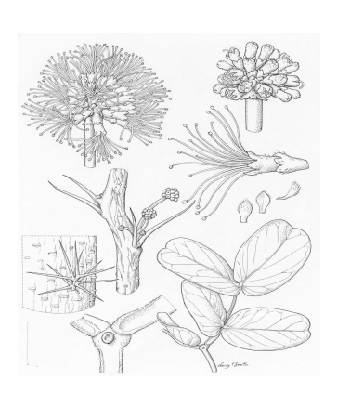
First of all, use a pencil very lightly.
Include as much detail as you can.

Slide 9
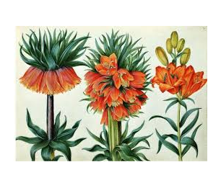
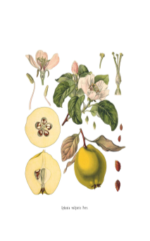
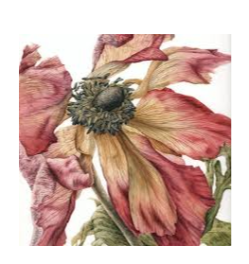
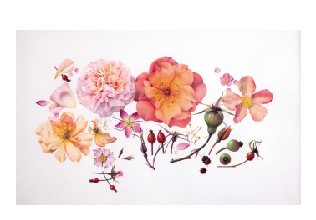
Then carefully add paint or coloured pencil.
Could someone identify the plant from your illustration?

