Slide 1
21.01.21 LO- I can understand how dynamics are used within music.

Slide 2
Match the definition to the element
Elements
Descriptions
Harmony
Texture
Melody
Rhythm
Dynamics
Structure
Mood
Tempo
The general emotion of the piece – happy/sad/scary/relaxing etc.
The volume – whether it’s loud or soft
The overall form of the piece – intro/verse/chorus/verse/chorus/outro etc.
A mixture of beats and silence (you can demonstrate this easier on percussion…)
The main tune of the piece
How many instruments are playing
The chords/accompaniment part underneath
Speed of the piece

Slide 4
Our Genre of the week this week is Flamenco . Listen to the selection of Flamenco music https://www.youtube.com/watch?v=wPJPmHSxKFc Our song of the week for this week is "El Vito" by Embrujo Mestizo https://www.youtube.com/watch?v=TuHHUDnFSO0 Flamenco Dance is a style of spirited, rhythmical dance performed to flamenco music, often with castanets. Here is an example, https://www.youtube.com/watch?v=UQ8pzZH6b94

Slide 5
Within our music session this week we are focusing on Rhythm – the lengths of the beats used within a piece of music.
We remember what rhythm means by remembering how to spell it – Rhythm Helps You To Have Music.

Slide 6
Rhythm – how long or short the notes are.
Listen again to the song of the week listening specifically for the rhythm used.
https://www.youtube.com/watch?v=TuHHUDnFSO0
Think about from 20 seconds in, the guitar and castanets play the same rhythm. Can you clap the rhythm?
The guitar can play long and short notes – think about our science work on sound. Why is a guitar able to play long notes?
Write a couple of sentences about why you think we have changes of rhythm (note lengths) within music?

Slide 7
Why do you think we have changes of rhythm within music?
It would be quite boring if all the notes were the same length wouldn’t it?! Rhythm also helps us to be able to move and dance to the music.
Compare this idea to words. Words have different lengths and different numbers of syllables. Use the words of the week. Clap out the number of syllables in the words. While you are doing this think about the rhythm of the words. Are some syllables longer than others?
Listen to some music that you enjoy. How is rhythm used within the music you listen to?
Remember the rhythm is the pattern of long and short notes.
Can you clap the rhythm for the chorus of the song you have chosen?
Can you make up a dance routine using the rhythm to guide your movements?

Slide 8
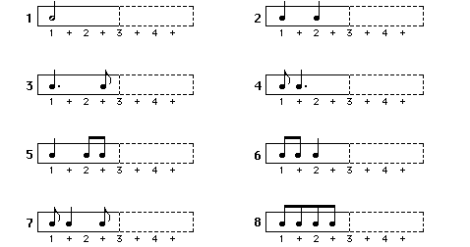
When it’s a good time for the household, practise your trumpet playing the different 2 beat rhythms.
Clap them out first then try to play them.
Use the numbers underneath to support your counting.

