Slide 1
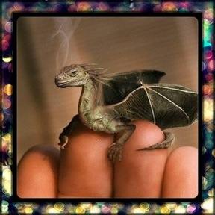
Wednesday 11th November.
LO – I can write descriptively about a dragon.

Slide 2
Think about this creature.
TTYP about it.
Where is it from?
Why is it so small?
Are there more like him?
Where does he live?
How will you look after it?
Will you keep it a secret or tell someone?
What is it called?
Is it magic? What magic can it do?
I like to imagine that it is a really small dragon which you can keep in your pocket but when you need to it can grow huge so that you can ride it.

Slide 3
5 focus writing.
As a class, we need to choose five things to think about and write about…
Once we have decided on the five areas we want to describe, let’s create a piece of writing together.
Teacher to model the writing.

