Slide 1
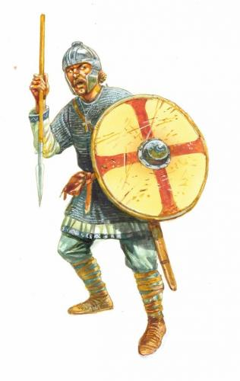
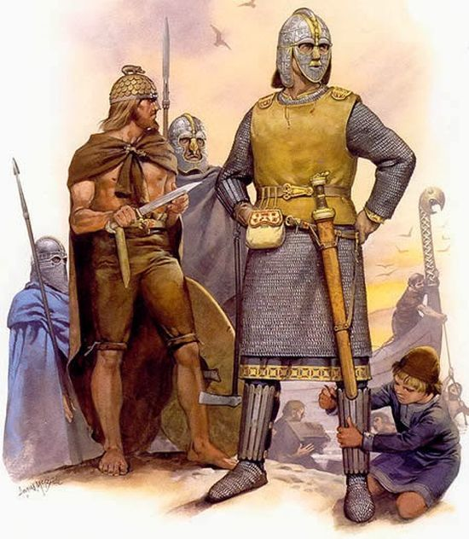
Anglo - Saxons Artefacts
Lesson 3

Slide 2
Lets recap… watch the video. Who were the Anglo-Saxons?
Explore the village scene by clicking on the characters to hear what their life was like.
Read about growing up in an Anglo-Saxon village.
Read about the jobs Anglo-Saxons did.
Before you look at the artefacts, read the next slide!

Slide 3
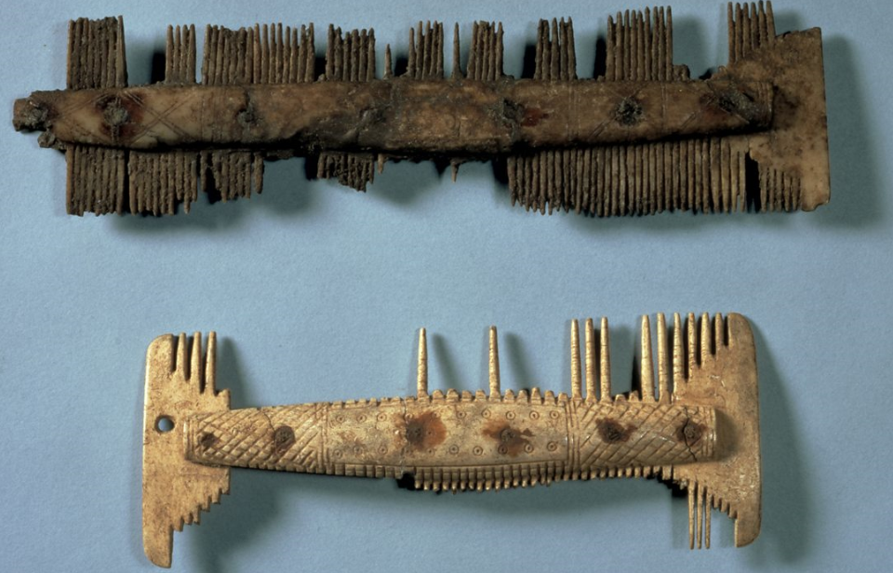
On the website, look at the artefacts and before you read the text underneath the artefacts, see if you can answer these questions:
What do you think the object is?
Who do you think would have used it?
What do you think it is made of?
What can it teach us about Anglo-Saxon life?
Any other observations?

Slide 4
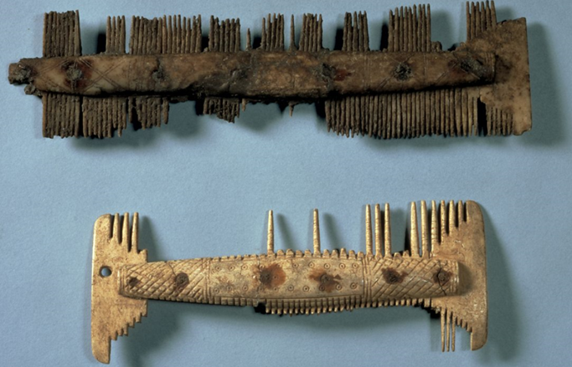
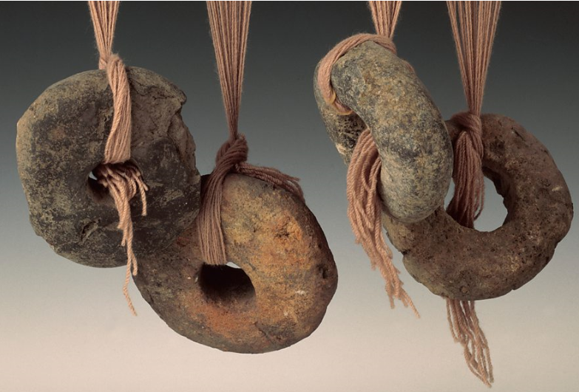
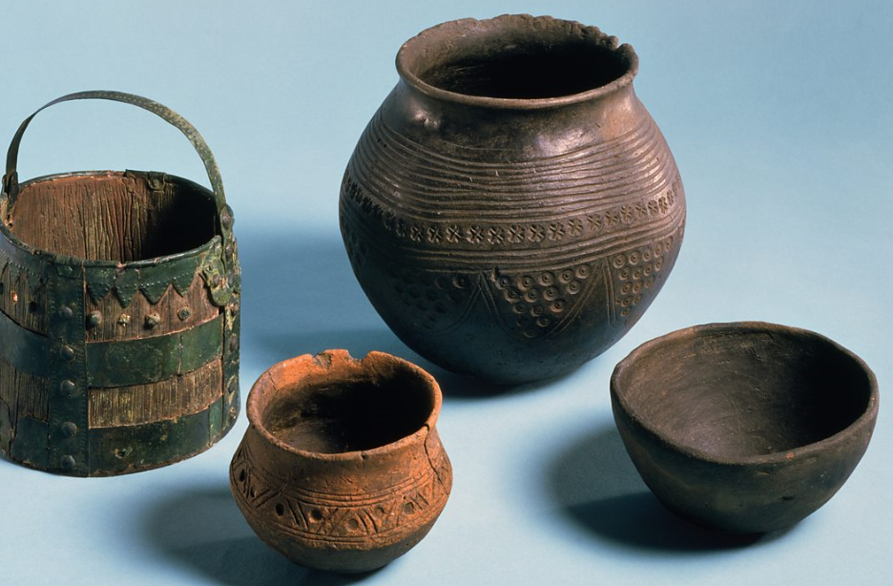
Read the text under the artefacts. Were you correct?
Choose three of the artefacts to draw and write underneath each one what it is and what it tells us about the Anglo-Saxons.

