Slide 1
Journey to the Jungle

Slide 2
Tuesday 15th February 2022
LO: To practise our sentence structure

Slide 3

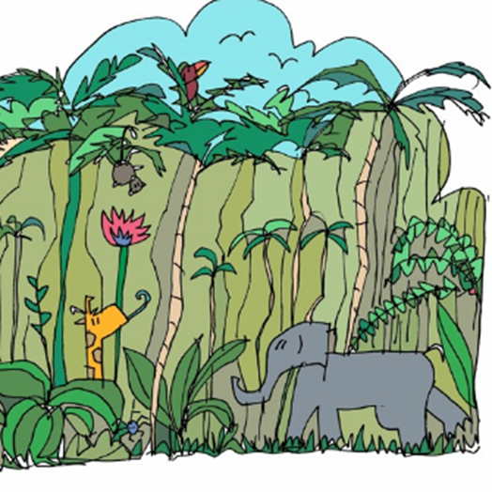
Let’s listen to the text again.
Join in saying the text out loud with actions.
Click on the picture to listen (From 0.22 seconds)

Slide 4
Before you write your letter, let’s practise some sentences that will help you to write like an explorer.

Slide 5
More Detail Please
You can add detail to your sentences by using the simple joining words and or but.

Slide 6
For example:
I trudged through the dense forest and collected samples of the plant life.
I tried to catch a fish but they were too fast for me.
Create sentences about your jungle and add detail using and or but.

Slide 7
Add in ‘When’
The log uses sentence signposts to tell the reader when something happened in the journey. The ones used in the log are known technically as ‘fronted adverbials’ – adverbs (or phrases beginning with adverbs) that are placed at the front of sentences to show us WHEN.

Slide 8
Can you find any of these in the text?
That’s right! These include: First, Next, After that, Then, Afterwards, After a while, Finally, When …

Slide 9
For example:
Next, I trekked to a clearing and found a beautiful plunge pool.
Finally, I headed back to camp because the sun began to set.
Redraft your sentences, using fronted adverbials to show WHEN things happened.

Slide 10
Explain A Bit More
Now try practising some sentences that will help you explain what you were doing, using because to enable you to explain.

Slide 11
For example:
Finally, I headed back to camp because it was getting late.

Slide 12
Look at the sentences you have already written, but try adding because to explain why you did something. Start your sentence with a fronted adverbial again. Remember, you can spin your sentence round and start with because, as well. Let’s look at some examples…

Slide 13
First, I set out early because the jungle was far away.
Because the jungle was far away, the first thing I did was set out early.
After that, I packed my camera because I wanted to photograph the flowers.

Slide 14

Now have a go at writing some of your own.

