Slide 1
3.2.22
LO – I can count in tenths.
TTYP about the answers to the questions on the following slide.

Slide 2
Year 4 | Week 5 | Day 1

Slide 3
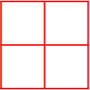
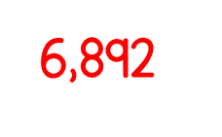
Day 1

Slide 4
What fractions of the cubes are each colour?
Which of the fractions above are unit fractions?
Which of the fractions above are non-unit fractions?
Yellow $=$
Red $=$
Green $=$

Slide 5
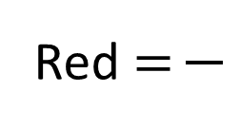
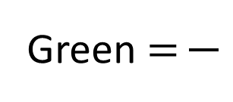
What fractions of the cubes are each colour?
Which of the fractions above are unit fractions?
Which of the fractions above are non-unit fractions?
5
4
1
Yellow $=$
Red $=$
Green $=$
10
10
10
Green $\frac{\text{1}}{\text{10}}$
Yellow $\frac{\text{5}}{\text{10}}$
Red $\frac{\text{4}}{\text{10}}$

Slide 6
What fraction are yellow?
$\frac{\text{1}}{\text{10}}$
0
$\frac{\text{2}}{\text{10}}$
$\frac{\text{3}}{\text{10}}$
$\frac{\text{4}}{\text{10}}$

Slide 7
What fraction are yellow?
$\frac{\text{1}\text{0}}{\text{10}}$
or 1
$\frac{\text{9}}{\text{10}}$
$\frac{\text{8}}{\text{10}}$
$\frac{\text{7}}{\text{10}}$

Slide 8
Have a go at questions 1 and 2.

Slide 9
0
$\frac{\text{1}}{\text{10}}$
$\frac{\text{2}}{\text{10}}$
$\frac{\text{3}}{\text{10}}$
$\frac{\text{4}}{\text{10}}$
$\frac{\text{5}}{\text{10}}$
$\frac{\text{6}}{\text{10}}$
$\frac{\text{7}}{\text{10}}$
$\frac{\text{8}}{\text{10}}$
$\frac{\text{9}}{\text{10}}$
$\frac{\text{10}}{\text{10}}$
or 1
0
1
$\frac{\text{1}}{\text{10}}$
$\frac{\text{2}}{\text{10}}$
$\frac{\text{3}}{\text{10}}$
$\frac{\text{4}}{\text{10}}$
$\frac{\text{5}}{\text{10}}$
$\frac{\text{6}}{\text{10}}$
$\frac{\text{7}}{\text{10}}$
$\frac{\text{8}}{\text{10}}$
$\frac{\text{9}}{\text{10}}$
$\frac{\text{10}}{\text{10}}$

Slide 10
Have a go at question 3.

Slide 11
2
$\frac{\text{1}\text{1}}{\text{10}}$
$\frac{\text{12}}{\text{10}}$
$\frac{\text{13}}{\text{10}}$
$\frac{\text{14}}{\text{10}}$
$\frac{\text{15}}{\text{10}}$
$\frac{\text{16}}{\text{10}}$
$\frac{\text{17}}{\text{10}}$
$\frac{\text{18}}{\text{10}}$
$\frac{\text{19}}{\text{10}}$
$\frac{\text{20}}{\text{10}}$

Slide 12
Answer questions 4 and 5. When completed try the challenge question.

Slide 13
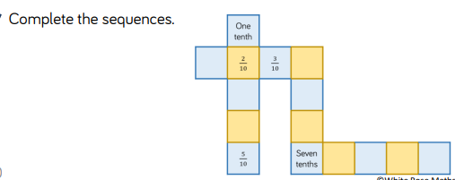
Try this challenge question.

