Slide 1
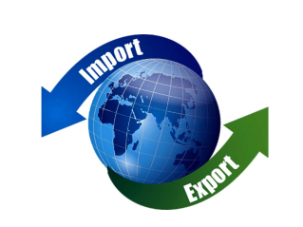
04.01.22
LO: To understand what international trade is.
International/ Global Trade

Slide 3
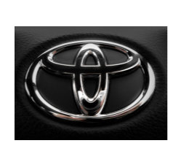
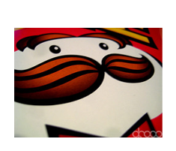
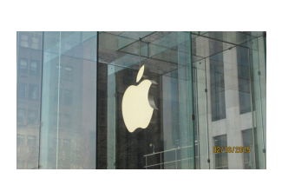
Do you recognise these company logos?
Lego is a toy company.
It was founded in Denmark. The Lego Group operates 138 retail stores
Toyota is a Japanese company that manufactures cars. The headquarters are in Japan
but Toyota cars are produced,
sold, and bought all over the world.
Pringles headquarters are in the USA.
Pringles are enjoyed by people in countries all over the world.
Apple Inc. is an electronics company based in California, USA. Apple has shops in many countries and anyone in the world can by an Apple computer or Ipad etc over the internet and have it delivered.
Move the image to reveal the answers.

Slide 4
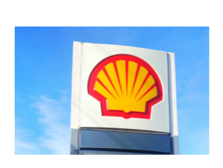
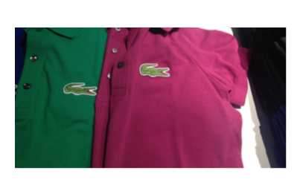
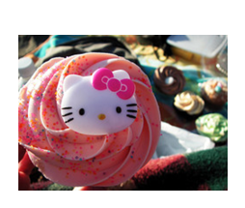
How about these?
Shell is an oil and gas company. It is an English and Dutch company with its headquarters in the Netherlands.
Starbucks Coffee Company is based in Seattle, USA.
The coffee beans come from countries such as Costa Rica and are sold in coffee shops all over the world.
The Hello Kitty logo can be found on lots of items from notebooks to bags. The company Sanrio who makes these goods is a Japanese company.
Lacoste is a French clothing company. Lacoste has stores worldwide and also sells goods online to countries all over the world.

Slide 5
Where are these goods sold?
Goods such as clothing, computers, drinks, food and toys are made by these
companies.
They sell these goods to people living in countries in all seven continents of the world.
They are sold on a global scale.
A class of children in Australia, India, Sweden, North America, or China are as likely to recognise these logos as you are.

Slide 6
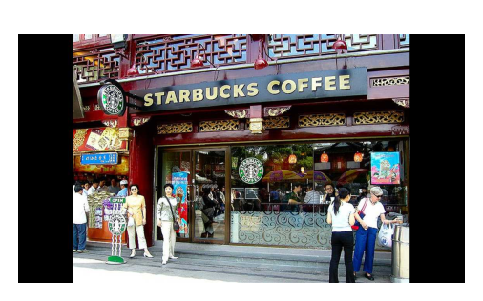
Starbucks in Shanghai, China
Starbucks Coffee Company started in Seattle, USA.
You can now buy Starbucks coffee in countries all over the world.

Slide 7
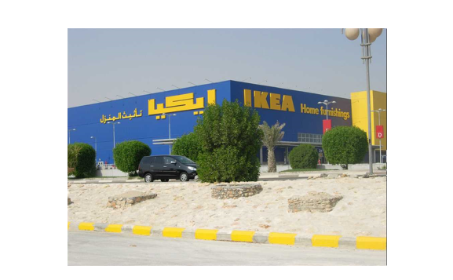
IKEA in Saudi Arabia, Middle East
IKEA started in Sweden, Europe.
You can now buy IKEA furniture all over the world.

Slide 8
What is trade?
Trade is the buying and selling of goods and services we want and need.
Trade involves the exchange of goods or services in return for other goods or services or money.

Slide 9
The scale of trade
When we think about trade as geographers we consider the scale of trade and think about how trade links places and people.

Slide 10
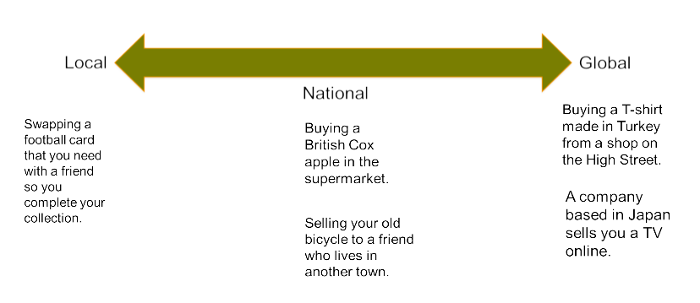
The scale of trade

Slide 11
Trade in the past
Trade has occurred between people since the beginning of civilisation when people exchanged goods and skills within their community on a local scale.
Even in the Stone Ages people exchanged goods such as tools, clothing and food.
Trade only occurred on a local scale at this time. People had no contact with people from distant places.

Slide 12
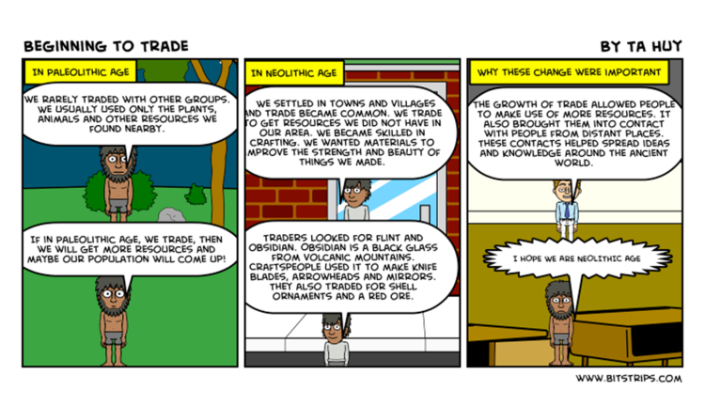

Slide 13
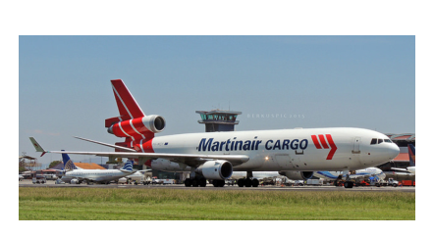
How trade got ‘global’
The scale of trade has increased through time and exchanges can now happen on a global scale.
The development of communication, technology and transport have enabled trade to be carried out on this scale.

Slide 14
A process called ‘globalisation’ has occurred.
Globalisation: process of the world’s countries becoming more connected as a result of international trade and cultural exchange.
Trade now happens on a larger scale (global) and at a faster pace than ever before. This means we can sell and have more access to larger range of products.

Slide 15
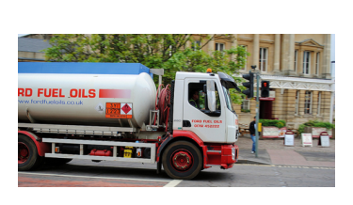
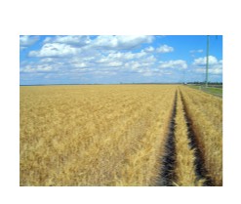
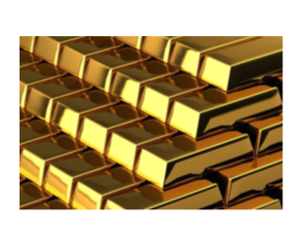
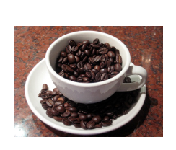
What are the current top ten most traded items in the world?
Crude oil
Coffee
Natural gas
Gold
Brent oil
Silver
Sugar
Corn
Wheat
Cotton

Slide 16
Crude oil: supplies the modern world with our energy needs.
Coffee: the world consumes 2.25 billion cups of coffee a day!
Natural gas: used for everything, from cooking, to heating, to lighting our homes.
Gold: used for currency and by investors.
Sugar: traded in every country in the world, by 2030, the annual consumption of sugar will exceed 257 million tons!

Slide 17
Lots of things in our homes and even in our classroom are from all over the world and imported to this country.
Imported: (of goods or services) brought into a country from abroad for sale.
Look at some of these examples and see where they were made...

Slide 18
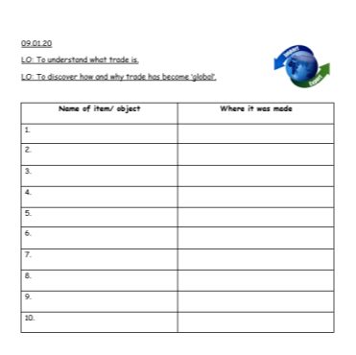
Task
See how many different things in the classroom you can find which were made in different counties. Complete the worksheet in your book.

