Slide 1
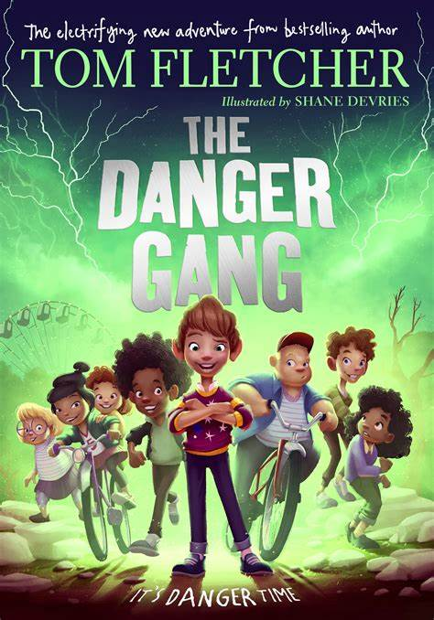
The Danger Gang
Book Review By Ivy

Slide 2
The Danger Gang is a great book for people who like longer books. You are able to finish it pretty quickly, but you can make it last a long time. It’s a Great book to read in spare time and really enjoyable.
The book is all about a weird storm. And it’s making children go a bit unusual, one by one, and its up to the danger gang to stop it…
Read the book to find out what happens.

Slide 3
The main characters in the book are called:
Franky Brown
Eric Flipperson
Katy Speck
Jamelia Pointer
Mollie Mcclear
Suzy Prune
Charlie Campbell
Ronnie Nutbog

Slide 4
I really enjoyed this book because of the storyline. It only took me three days to read because I couldn’t put it down. I will read this book again because it is just so good!

Slide 5
The Author of the book is…
Tom Fletcher
He is also a musician and songwriter. He is in the band McFly.

Slide 6
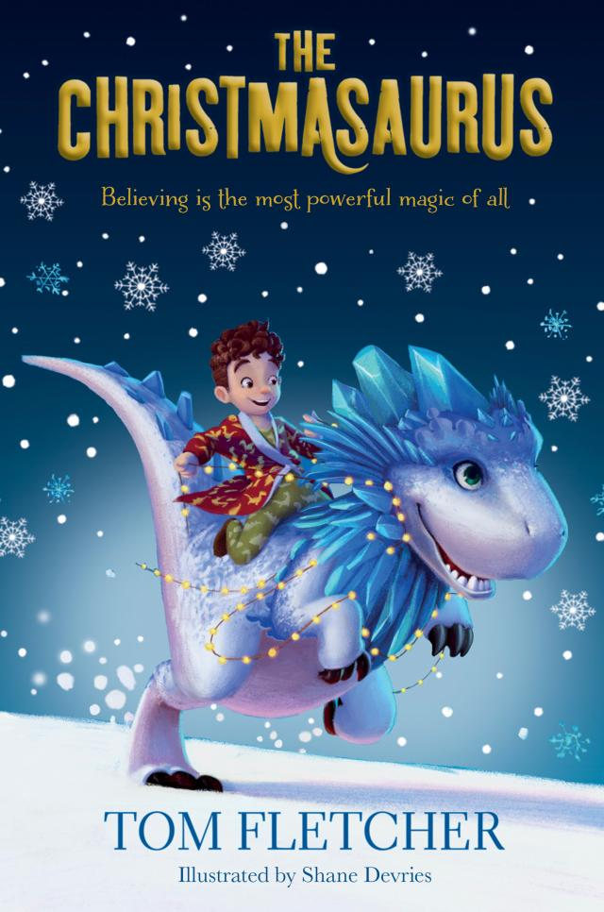
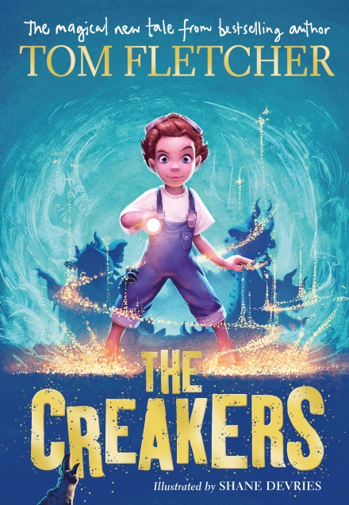
I have read some of his other books including, The Creakers, The Christmasaurus and The Christmasaurus and the Winter Witch!

