Slide 1
Wednesday 26th January 2022
LO: To create a leaflet explaining how a robot works

Slide 2
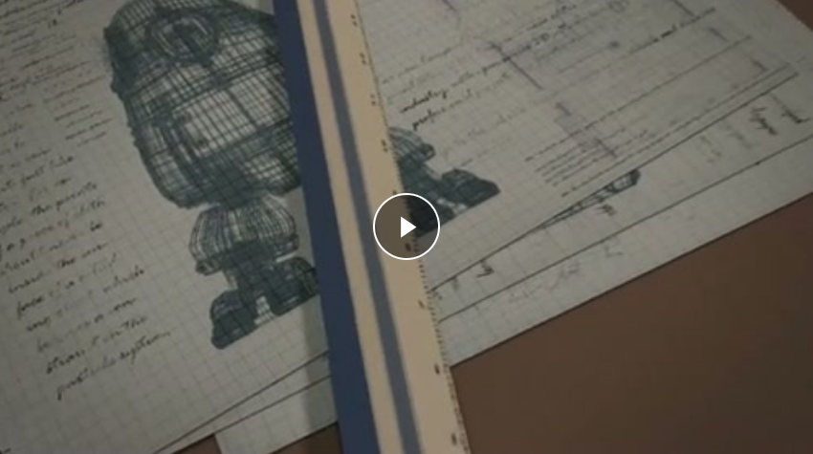
Let’s watch the clip again. Concentrate on the parts of the robot and what they might do.
Girl and Robot

Slide 3
Under the robot’s neck, is the on/off switch.
The first phrase (up to the comma) is a preposition phrase (doing the job of an adverb). It states where the on/of switch is. After writing one at the start of a sentence we need to put a comma.
Can you think of another one that could describe how the robot works?

Slide 4
Here are some more ideas:
Behind the handle,
Beyond the cable,
Above the screw,
Under the metal flap,
Next to the switch,
Can you finish each sentence by SAYING it to your partner?

Slide 5
Today’s task
Draw your own robot and then create a leaflet to explain HOW it works. On the next page is an example to give you some ideas.
Tip: Imagine to are telling someone else HOW to use the robot as they have not had one before.

Slide 6
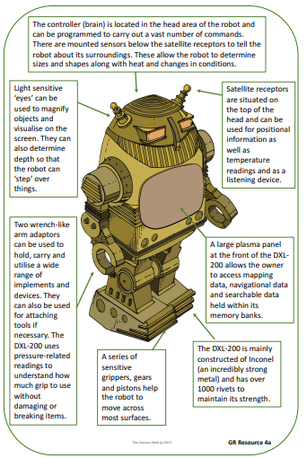

Slide 7
Vocabulary
bolt nut cable handle lever knob hinge light plug button piston temperature gauge
twist switch turn glow crank
beep hum buzz click
Can you think of any more words you might need?

