Slide 1
Tuesday 11th January 2022
LO: To co-create a toolkit for suspense

Slide 2
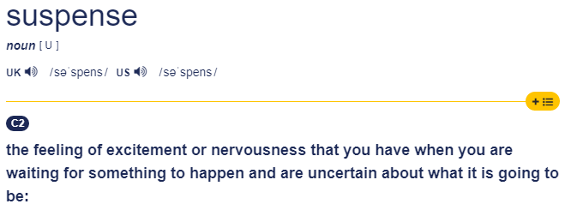
What is suspense?

Slide 3
First, let’s say our story out loud with actions.
As you do this, notice which parts of the story make you feel excited or nervous about what might happen.

Slide 4
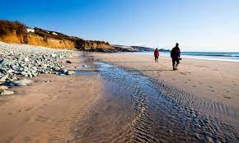
Adventure at Sandy Cove

Slide 5
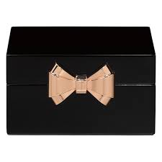
“Hurry up,” shouted Joe as he climbed over the rocks. Carefully, Rahul followed. The two boys stopped at a rock pool and began to search for shells. “Hey, what’s this?” shouted Joe to Rahul. In the rock pool was a small, black box wrapped in plastic. The boys tugged it loose. What was inside? Joe pressed the silver catch and the lid popped open. It was full of jewels!

Slide 6
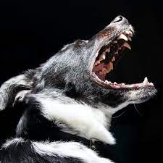
At that moment, a scruffy old man shouted at the boys. His wolf-like dog barked menacingly. Joe snapped the lid down, picked up the box and the two boys began to scramble over the rocks. They slipped and struggled towards the cliffs.

Slide 7
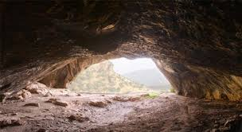
“Quick! Let’s hide in here,” said Joe, rushing into a cave. It was dark and damp inside and they could hear water dripping. They felt their way further in and crouched behind a rock. Rahul’s heart pounded. All at once, the scruffy man appeared at the cave mouth. He shone a torch around. The light cast shadows on the cave wall. The children ducked down and kept as still as stone, but the dog could sense them. It padded closer and closer, growling menacingly. Rahul gripped Joe’s arm. They could see its white teeth, smell its damp hair and feel its hot meaty breath.

Slide 8
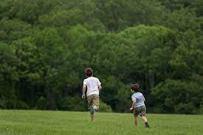
Suddenly there was a distant shout. ‘Here Dog!’ hissed the man, roughly grabbing its collar. “Those boys have got away. Quick. After them!” Joe and Rahul held their breath until they could hear the sound of the man and his dog stumbling back across the rocks. They waited for a long while before creeping out. Even though the beach was empty, the boys ran home as fast as they could.

Slide 9
At first Mum didn’t believe them. It was only when Joe opened the box that she decided to call the police. When the police arrived they told Mum that the big house up the road had been burgled only the night before. They had spent all day searching for a trace of the jewels. Their only clue had been the footprints of a large dog. Joe shut his eyes. He could imagine the headlines: ‘PRICELESS JEWELS FOUND BY SCHOOLBOY DETECTIVES. And there was a reward too!

Slide 10
Yesterday we learnt about Show Don’t Tell. What other techniques do writers use to create suspense?
Which parts of the story make you feel excited or nervous about what is going to happen?

Slide 11
Let’s collect some ideas…
Now let’s see if we can find some of these techniques in the text. You could highlight them with different colours as you go.
Can you find…

Slide 12
Show don’t tell – Showing how a character feels by their actions
Rahul’s heart pounded.

Slide 13
Threatening noises
the dog growled

Slide 14
Saying what the character sees, hears or feels to describe the scary creature
It padded closer and closer, growling menacingly. They could see its white teeth, smell its damp hair and feel its hot meaty breath.

Slide 15
Speech to take the characters to the next place
“Quick! Let’s hide in here,”

Slide 16
Questions that make the reader think
What was inside?

Slide 17
Empty words e.g.
something, someone

Slide 18
Can you choose 3 of these features and write a your own sentence for each one?

