Slide 1
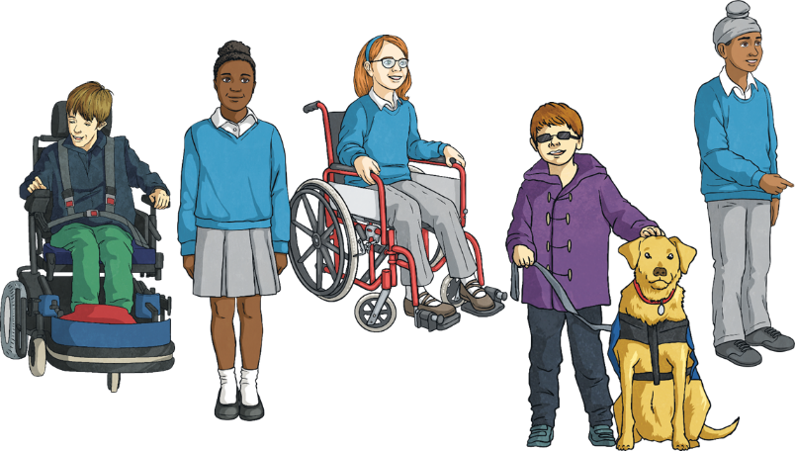
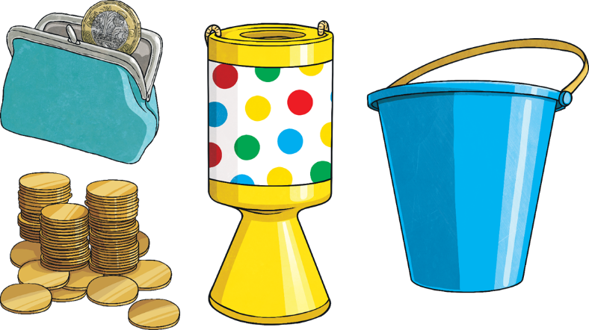
What Event Do These Pictures Represent?

Slide 3
Aim
To learn about the purpose of BBC Children in Need.
To know how everyone can support BBC Children in Need.

Slide 4
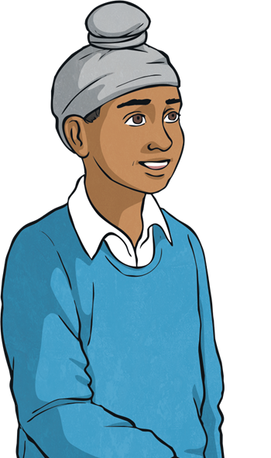
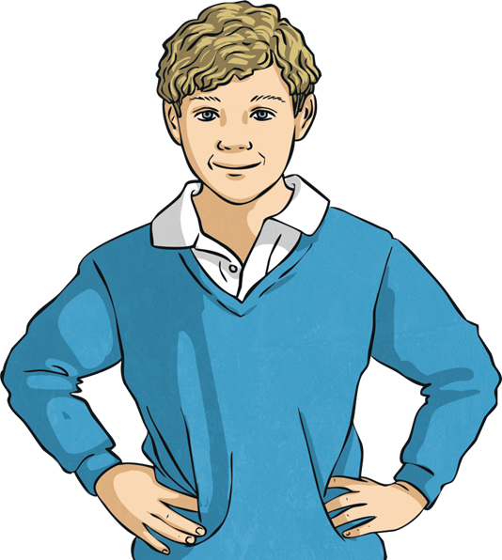
What Is BBC Children in Need?
I’ve heard of BBC Children in Need but what do they do?
BBC Children in Need is a charity which funds hundreds of important projects that help disadvantaged children and young people across the UK.
Talk about it
Talk to the person beside you about your understanding of BBC Children in Need and what it is all about. See if you can come up with three statements about BBC Children in Need.

Slide 5
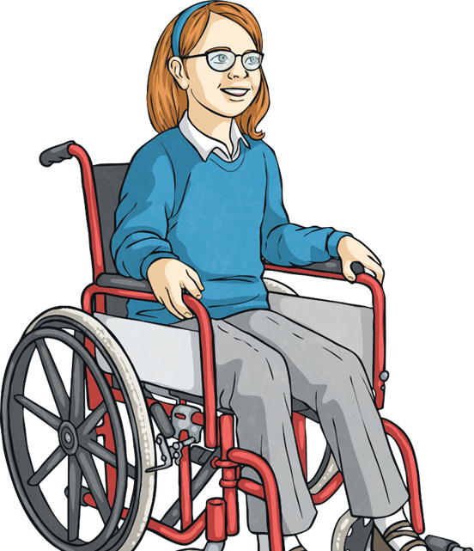
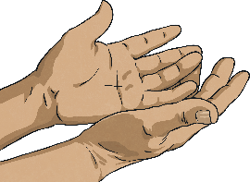
What Sort of Projects Does BBC Children in Need Fund?
BBC Children in Need fund a range of projects.
Some involve providing activities for children with disabilities so that they get to try new things;
some support children who care for a disabled parent
and some provide funding to help families who have suffered the death of a child or parent.
So many children have their lives improved by BBC Children in Need.
Have a go!
See if you can think of three types of project which BBC Children in Need might fund.

Slide 6
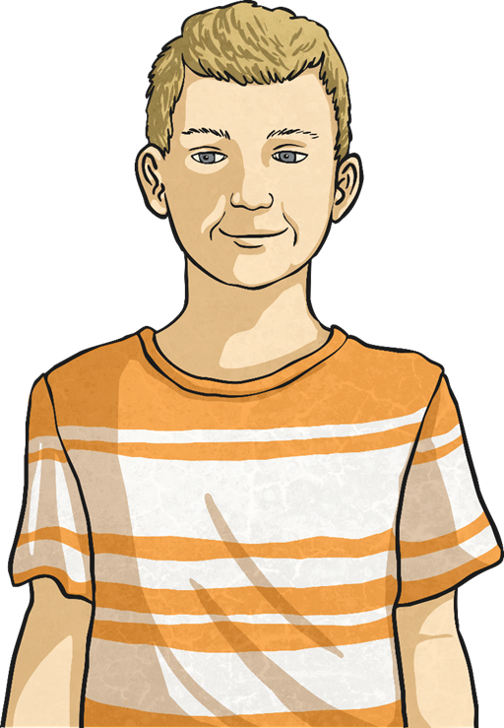
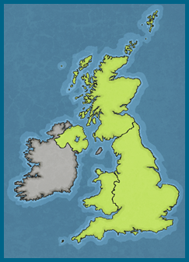
Here Are Some of the Children Supported by BBC Children in Need
This is Jack. Jack lives in Scotland. He has autism. Jack cannot speak and mainly communicates through sounds. He started hurting himself because he couldn’t express his feelings.

Slide 7
Here Are Some of the Children Supported by BBC Children in Need
This is Jack. Jack lives in Scotland. He has autism. Jack cannot speak and mainly communicates through sounds. He started hurting himself because he couldn’t express his feelings.

Slide 8
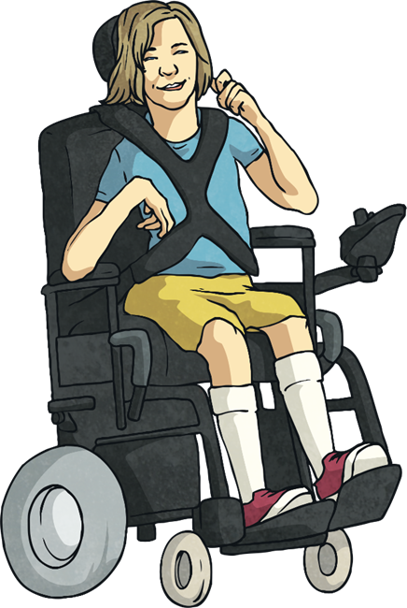
Here Are Some of the Children Supported by BBC Children in Need
This is Millie. Millie lives in Yorkshire. When she was born, she didn’t get enough oxygen. This lead to her being wheelchair dependent and having many complex needs. Her mum is her full-time carer, which means she doesn’t have much time to spend with Millie’s brother, Sam.

Slide 9
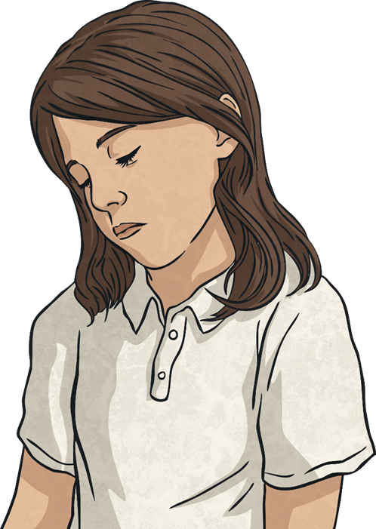
Here Are Some of the Children Supported by BBC Children in Need
This is Jess. Jess lives in Wales. She grew up in a disruptive family situation where there were a lot of arguments and violence. Her behaviour changed and she had to leave the family home.

Slide 10
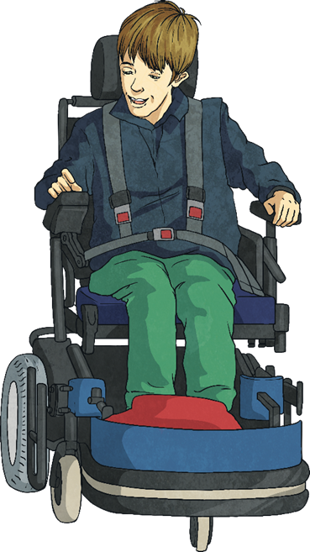
Here Are Some of the Children Supported by BBC Children in Need
This is Ben. Ben has cerebral palsy which means he has difficulty controlling his movements. Ben found it really hard to play any sports but he loves football.

Slide 11
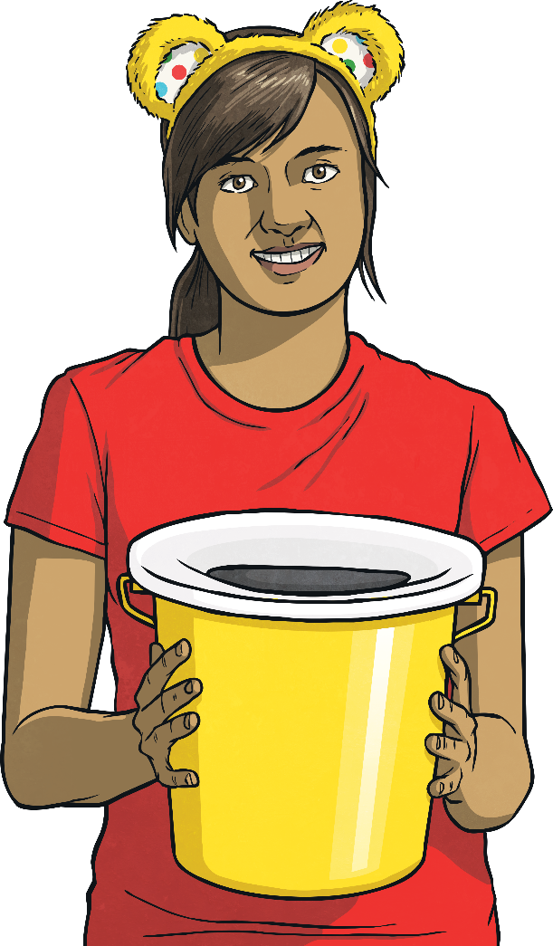
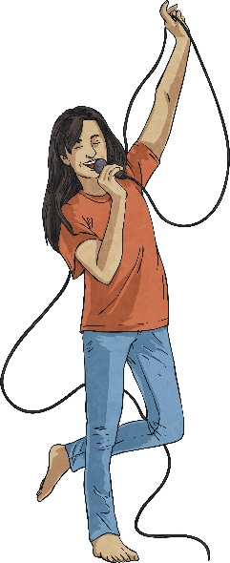
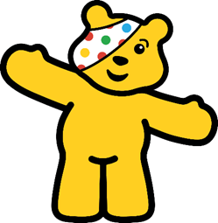
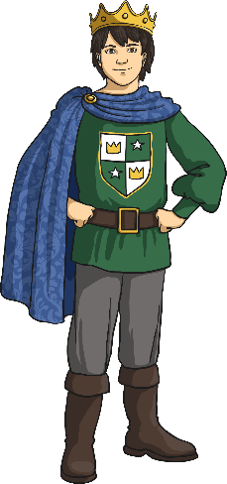
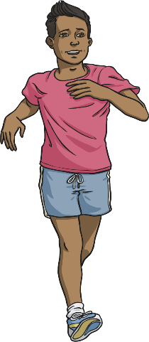
How Can We Get Involved?
Talk about it
There are so many ways you can raise money for BBC Children in Need!
We can get involved by:
organising a coffee morning or cake sale;
Download the Free Fundraising Pack and get involved!
doing a sponsored event using this sponsorship form;
holding a talent show or concert;
Fundraising is the main way everyone can get involved. How many different fundraising ideas can you think of? Talk to the person beside you.
filling an outline of Pudsey with coins;
having a dress-up day at school.

Slide 12
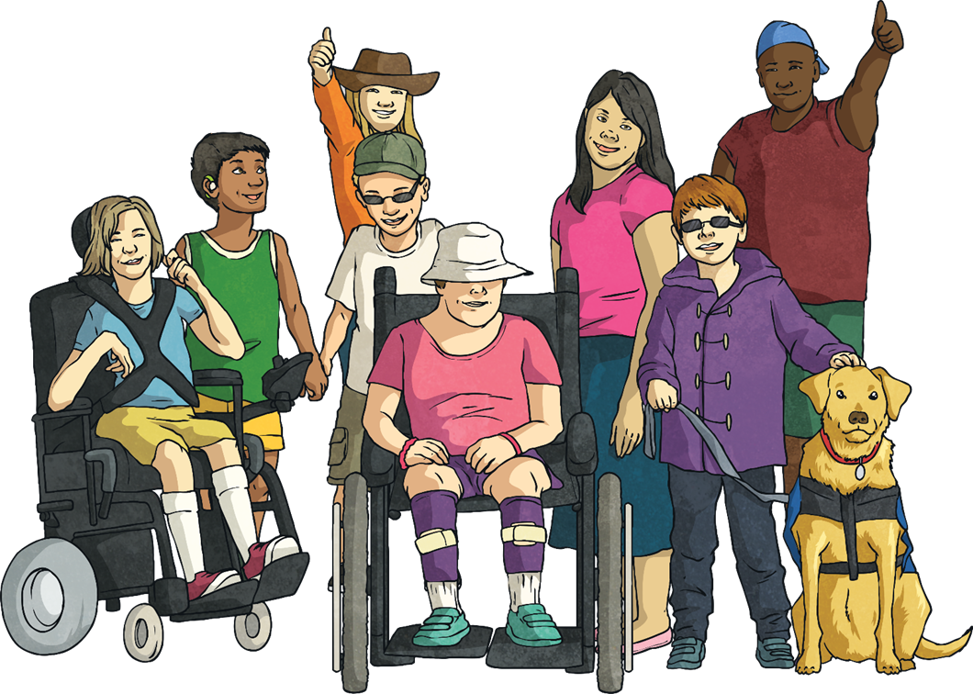
Time to Think

Slide 13
Aim
To learn about the purpose of BBC Children in Need.
To know how everyone can support BBC Children in Need.

