Slide 1
Monday 8th November. L.O. – I can co-write a tool kit for a suspense story.

Slide 2
Zelda Claw and the Rain Cat
We will write up the words of the week in our magpie books. Words of the week are:
petrified, bleak, ominous, breathless and eerie.

Slide 3
Zelda Claw and the Rain Cat
Stick the copy of the Zelda Claw test in the middle of two pages ready to construct your toolkit.
Use highlighter pens to help make a key.

Slide 4
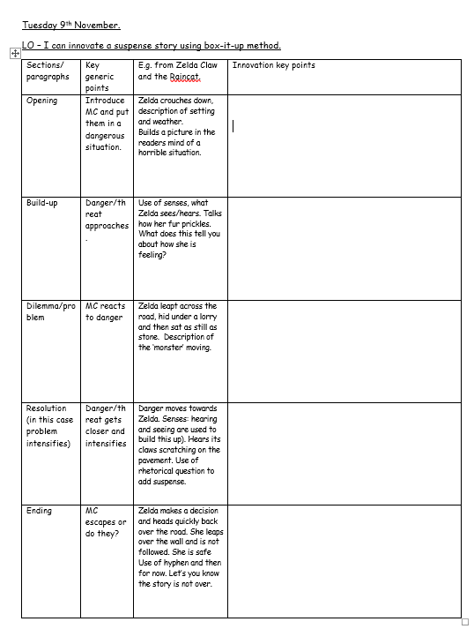
Wednesday 10th November.
LO – I can plan a story using box-it-up method.

Slide 6
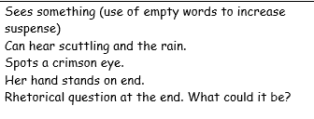

Slide 8
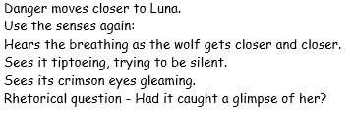

Slide 9
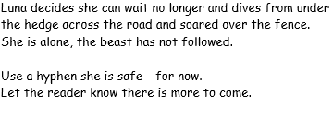

Slide 10
Wednesday 10th November.
LO – I can write sentences with suspense openers.
Vocabulary choices can really impact a suspense story. Look back at the toolkit and see how many features include vocabulary choices.
Sentence openers are really important in suspense writing.

Slide 11
Wednesday 10th November.
LO – I can write sentences with suspense openers.
Let’s look at a sentence opener together.
Shaking with fear,
TTYP and see if you can think of an ending to this sentence.

Slide 12
Shaking with fear, the children were completely frozen, petrified as if a spell had been cast over them.
Shaking with fear, the boy fell to the floor and whimpered.
Shaking with fear, I could feel my heart pounding, as if about to leave my chest!
Shaking with fear, Ann realised the end was drawing near.
.

Slide 13
Hardly daring to breathe,
Silently,
Without warning,
Petrified,
Shaking with fear,
Through the dim light,
At that moment,
Turning,
Use one of the sentence openers and see if you can write two or three sentences using the example above.

Slide 14
Thursday 11th November.
LO – I can share my opinions about a text and use inference to answer questions.
All night, thunder growled overhead. Zelda crouched in the darkness, staring. Wind lashed the glistening tarmac and the street lights flickered; Zelda shivered. Where could she escape from the downpour?
At that moment, Zelda sensed something crawling. It was creeping along the pavement, hugging close to the shadows and moving eerily. Silently, a vague shape slipped into a doorway and Zelda was sure that she had glimpsed the flicker of a green eye. She could just hear a low growl even though the rain danced a thousand deaths on the pavement. Her fur prickled as she tensed herself. What was it?

Slide 15
Now that we have read it as a class, read this through with your partner for fluency.
Underline any words you do not understand. (We will talk about these words as a class and add them to our magpie books).

Slide 16
Answer the following questions as fully as you can.
How is Zelda feeling?
How do we know?
Could she be feeling any other emotions?
What does the word 'staring' infer?
How does the author use language to build a picture of the scene?
Challenge. Can you predict what will happen next in the story? You could continue to write the next paragraph if you wish

Slide 17
Friday 12th November.
I can write the beginning of a suspense story using my box it up.

Slide 18
Paragraph one: Opening.
Thunder growled overhead. Zelda crouched in the darkness, staring. Wind lashed the glistening tarmac and the street lights flickered, casting shadows across the darkened road. Rusted dustbins rattled in the wind, fences creaked and the rain drummed on car roofs. Zelda shivered. Where could she escape from the downpour?
Here is my innovation:
The storm continued to grumble, the lightning exploding like fireworks in the darkness – and then blackness enveloped once again. Luna tucked herself down in the blackness, watching. Wind whistled around the road and the lightning cause shadows to appear and then disappear as if they hadn’t existed at all. Wheelie bins drove along the streets, garden gates opened and closed again as the deafening rain bounced off surfaces. Luna shuddered. Where could she go to escape from this horrific storm?
You have 20 minutes to innovate your first paragraph.

Slide 19
Paragraph two: Build up.
Here is my innovation in yellow, the original is in white.
At that moment, Zelda heard something crawling along the pavement, hidden by shadows. Silently, a vague shape slipped into a doorway. A green eye flickered. Zelda’s fur prickled as she watched. What was it?
At that moment, Luna heard something tiny scuttling along the road, hidden by the jet-black darkness. Suddenly, a jagged shape crept into a doorway. A crimson eye glimmered. Luna’s fur stood on end as she watched. What could it be?
You have 15 minutes to innovate your second paragraph.

Slide 20
What did paragraph 2 end with?
Can we all end our own writing with the same feature.
Please make sure you read your writing from the start to make sure it makes sense.
Check both of the paragraphs that you have written today.
Can you edit to improve? Are your sentence openers varied? Have you a mixture of short and long sentences? Look back at your toolkit and make sure you have included features.

